Slide 1
THIS
IS
JEOPARDY
Notes:
1

Slide 2
With
Your
Host...
Mrs. Pride
Notes:
2

Slide 3
3.4 - Water
Diagrams
Vocab
3.2 - Food
3.3 - Oxygen
MISC.
100
100
100
100
100
100
200
200
200
200
200
200
300
300
300
300
300
300
400
400
400
400
400
400
500
500
500
500
500
500
Notes:
3

Slide 4
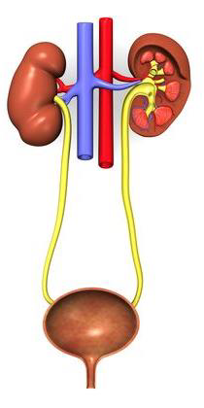
Identify this organ
A 100
Notes:
4

Slide 5
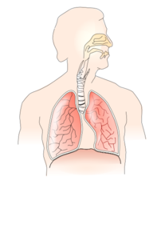
Identify this organ
A 200
Notes:
5

Slide 6
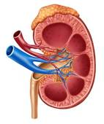
Identify this structure
A 300
Notes:
6

Slide 7
What structure is “W”
A 400
Notes:
7

Slide 8
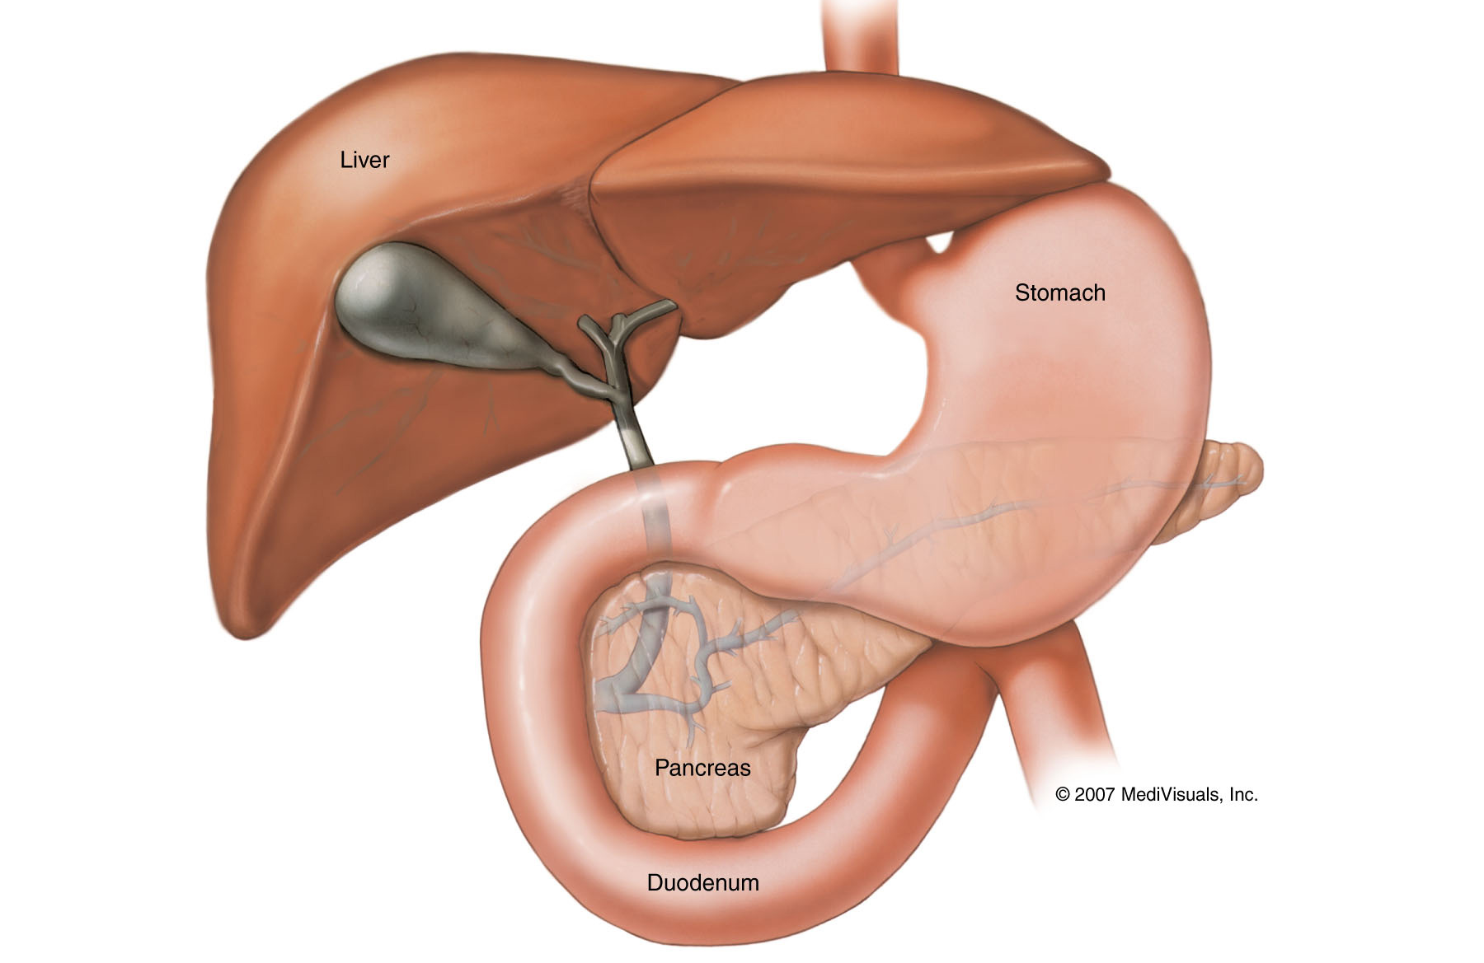
Identify this structure
Identify each organ
A
C
B
D
E
A 500
Notes:
8

Slide 9
What are the building blocks for all nutrients called?
B 100
Notes:
9

Slide 10
How does BMI differ from BMR?
B 200
Notes:
10

Slide 11
Which hormone regulates sodium and potassium levels?
B 300
Notes:
11

Slide 12
Which term refers to the volume of air breathed in and out without conscious effort?
B 400
Notes:
12

Slide 13
Match the term to the correct definition:
Anabolism
Catabolism
Metabolism
Chemical reactions that break down molecules for energy
Total amount of an organism’s chemical reactions
Chemical reactions that create larger molecules
B 500
Notes:
13

Slide 14
Location for 90% of nutrient absorption
C 100
Notes:
14

Slide 15
Organ that serves both digestive and endocrine functions
C 200
Notes:
15

Slide 16
Where is the energy stored in a molecule of ATP?
C 300
Notes:
16

Slide 17
DAILY DOUBLE
DAILY DOUBLE
Place A Wager
C 400
Notes:
17

Slide 18
Name both inactive enzymes.
C 400
Notes:
18

Slide 19
Name 3 enzymes involved in carb digestion.
C 500
Notes:
19

Slide 20
Which cavity houses the respiratory organs?
D 100
Notes:
20

Slide 21
Where is the location for gas exchange?
D 200
Notes:
21

Slide 22
What is the name for ATP generation with oxygen?
D 300
Notes:
22

Slide 23
Identify 3 diseases associated with the respiratory system.
D 400
Notes:
23

Slide 24
The total volume of air that can be exhaled after a deep breath (maximum inhalation)
D 500
Notes:
24

Slide 25
What is the functional unit of the kidney?
E 100
Notes:
25

Slide 26
Identify 2 functions of the urinary system.
E 200
Notes:
26

Slide 27
Caffeine is an ADH blocker. Describe what will happen when you consume a large quantity of caffeine
E 300
Notes:
27

Slide 28
What are the 3 parts to a urinalysis?
E 400
Notes:
28

Slide 29
Water reabsorption does NOT occur in this area of the nephron
E 500
Notes:
29

Slide 30
Which hockey team currently possesses the Stanley Cup?
F 100
Notes:
30

Slide 31
Which country held the 2010 Winter Olympics?
F 200
Notes:
31

Slide 32
How many pounds of candy does the average American eat in a year?
F 300
Notes:
32

Slide 33
What was the most popular BOY baby name in 2013?
F 400
Notes:
33

Slide 34
Which movie starred the lifeguard Wendy Peffercorn?
F 500
Notes:
34

Slide 35
The Final Jeopardy Category is:
3.2 Food
Please record your wager.
Click on screen to begin
Notes:
35

Slide 36
Identify the enzymes involved in protein digestion. The enzymes must be listed in the order they are used.
Click on screen to continue
Notes:
36

Slide 37
Thank You for Playing Jeopardy!
Game Designed By C. Harr-MAIT
Notes:
37

