Slide 1
Unit 3
What you should have gotten and what you should focus on.

Slide 2
Unit 3 Section1 Activities 1&2
Blood Detectives-
  Anna’s Blood Slide
  Normal Blood Slide
  Components of Blood
    What are they?
    What do they do?
  Hematocrit
    What ratios do you normally find the components of blood in?
    What can this test indicate?

Slide 3
The Basics of Sickle Cell
An inherited (genetic) disease.
Affects more than 70,000 Americans.
More prevalent in those of African descent, Mediterranean descent, and Middle Eastern Descent.

Slide 4
Blood
Composed of 4 parts.
Plasma
Red Blood Cells
White Blood Cells
Platelets

Slide 5
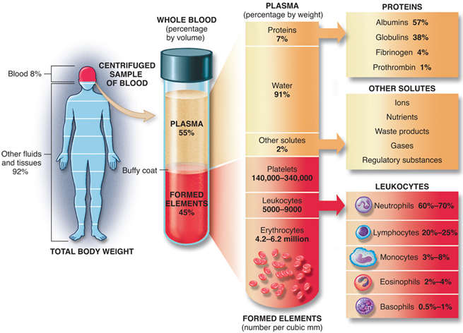
Plasma
The liquid portion of the blood.
Suspends the other components of blood.
Provides the medium for osmosis and exchange of materials.

Slide 6
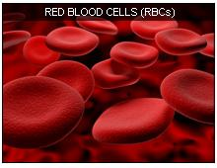
Red Blood Cells (Erythrocytes)
Contain hemoglobin.
  More about this in 3.2.3
Carry oxygen.
Do not have a nucleus to make more room.
Biconcaved disk shape to provide more surface area for oxygen.
Most numberous within the plasma.

Slide 7
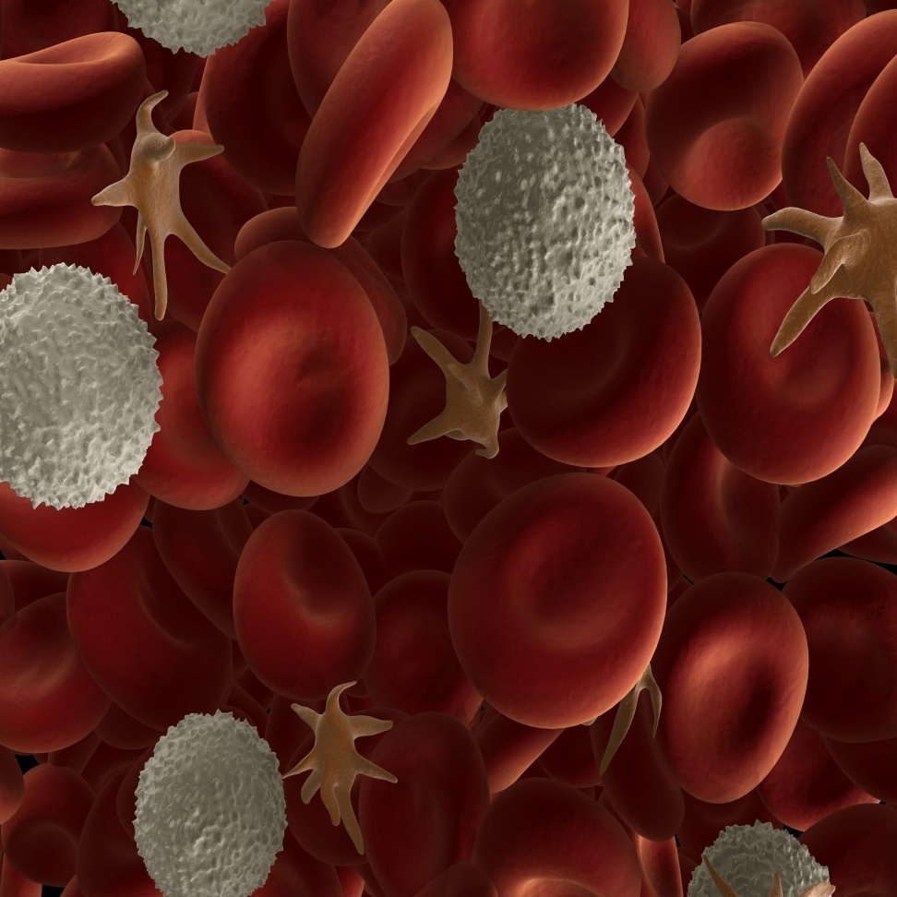
White Blood Cells (Leukocytes)
Many different types.
Contain information for the bodies immune response.
Far fewer than RBCs

Slide 8
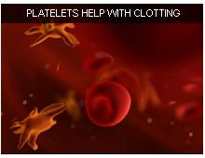
Platelets
Small cells that cling to blood vessels and help with blood clotting.

Slide 9
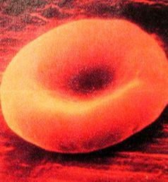
Healthy Red Blood Cell
Round
No Nucleus
Shape gives large surface area for oxygen to bind to hemoglobin.

Slide 10
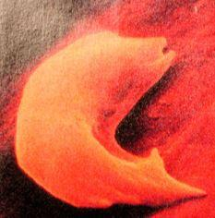
Sickled Red Blood Cell
"sickle shaped"
Larger than healthy cells.
Less surface area to carry oxygen.
Can become stuck in smaller blood vessels.

Slide 11
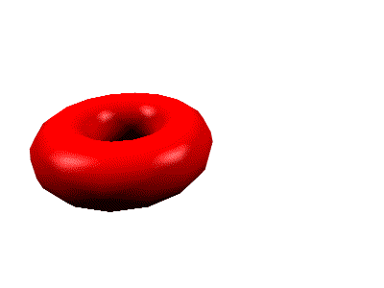
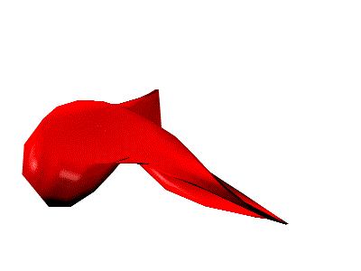
Sickle Cell Anemia
Sickle Cell anemia is an inherited red blood cell disorder. Normal red blood cells are round like doughnuts, and they move through small blood tubes in the body to deliver oxygen.
Sickle red blood cells become hard, sticky and shaped like sickles used to cut wheat. When these hard and pointed red cells go through the small blood tube, they clog the flow and break apart. This can cause pain, damage and a low blood count, or anemia.

Slide 12
The origin of the disease is a small change in the protein hemoglobin
The change in cell structure arises from a change in
the structure of hemoglobin.
A single change in an amino acid causes hemoglobin
to aggregate. (More in 3.2.)

Slide 13
Unit 3 Section 2 Activities 1-3
Protein Synthesis – You should have this down!
Molecular Workbench- How do hydrophobic, hydrophilic, negatively charged, and positively charged regions act within an environment?

Slide 14
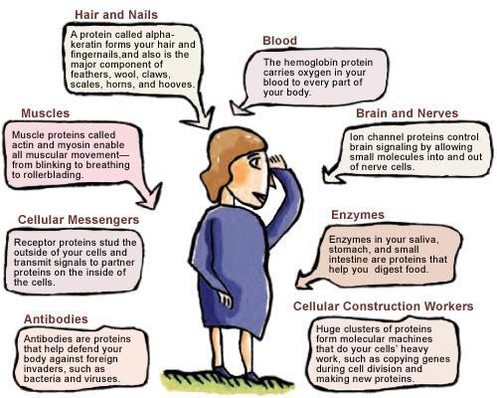
Protein Synthesis (Gene Expression) Notes
Proteins (Review)
Proteins make up all living materials

Slide 15
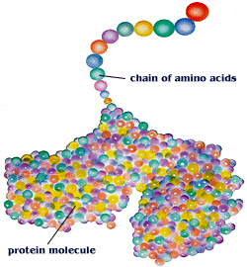
Proteins are composed of amino acids – there are 20 different amino acids
Different proteins are made by combining these 20 amino acids in different combinations

Slide 16
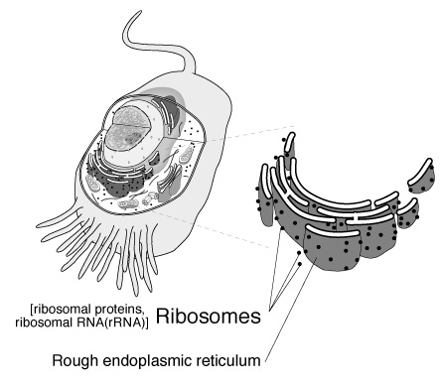
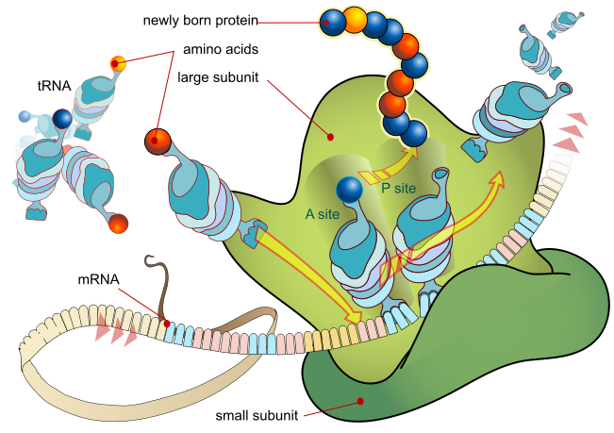
Proteins are manufactured (made) by the ribosomes

Slide 17
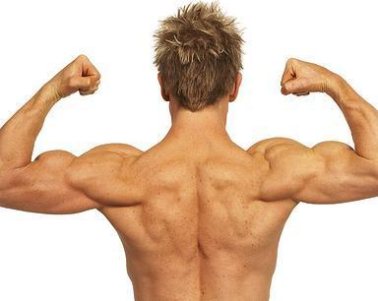
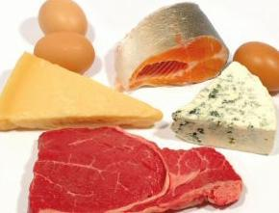
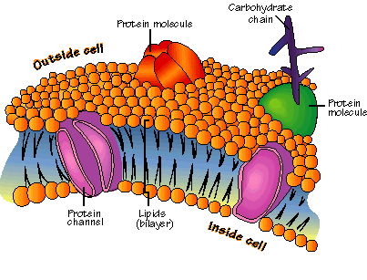
Function of proteins:
Help fight disease
Build new body tissue
Enzymes used for digestion and other chemical reactions are proteins
(Enzymes speed up the rate of a reaction)
4. Component of all cell membranes

Slide 18
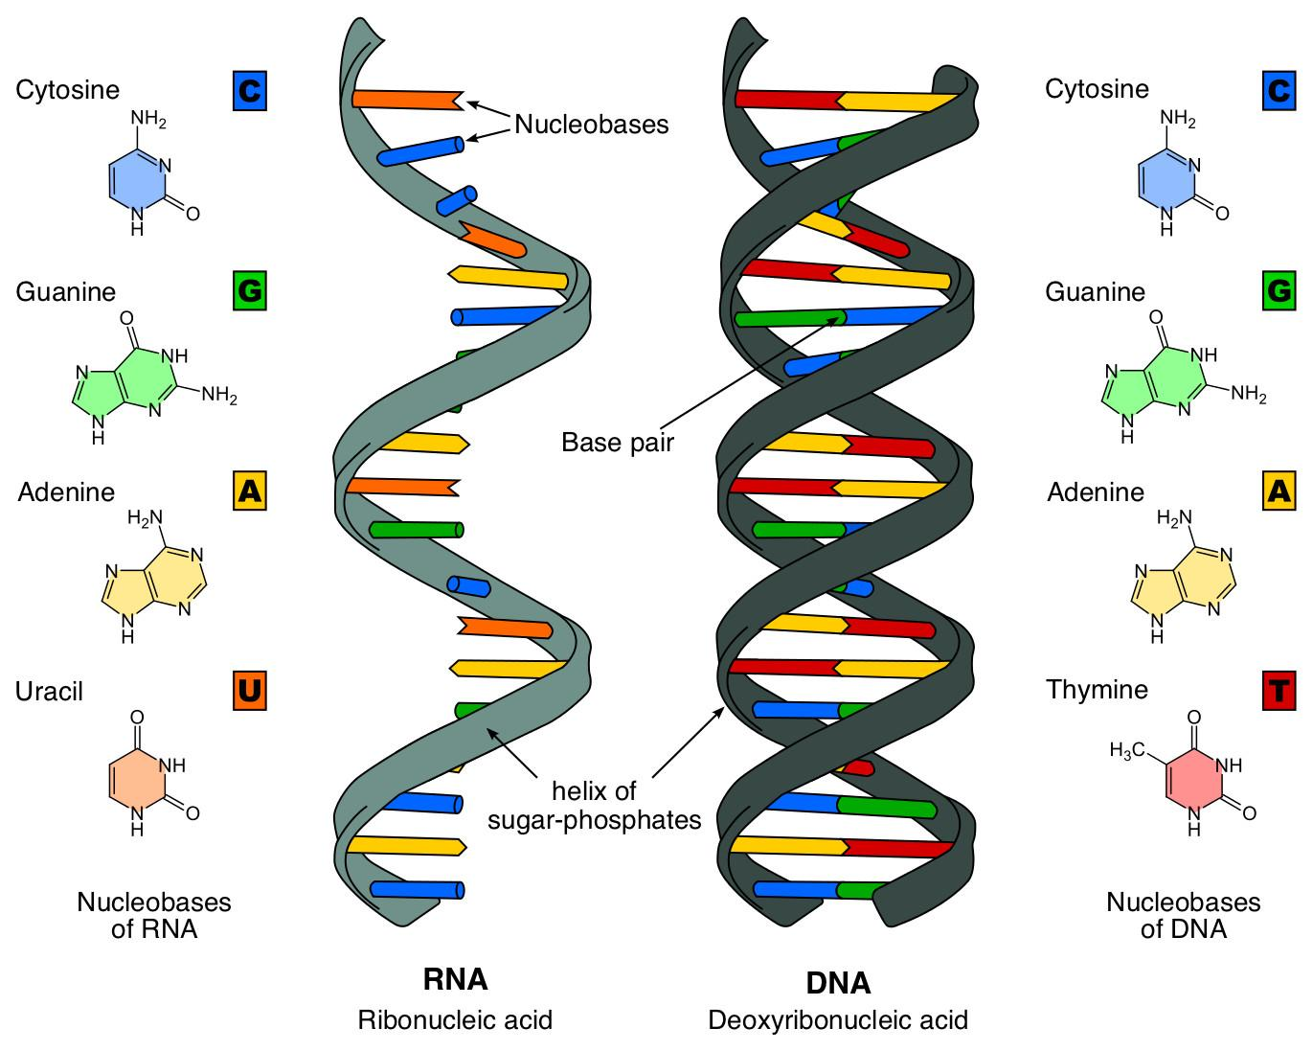
RNA Vs. DNA

Slide 19
Making a Protein—Transcription
First Step: Copying of genetic information from DNA to RNA called Transcription
Why?
DNA has the genetic code for the protein that needs to be made.
proteins are made by the ribosomes—ribosomes are outside the nucleus in the cytoplasm.
DNA is too large to leave the nucleus (double stranded), but RNA can leave the nucleus (single stranded).

Slide 20
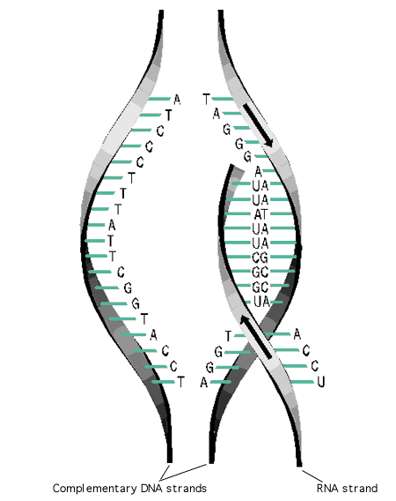

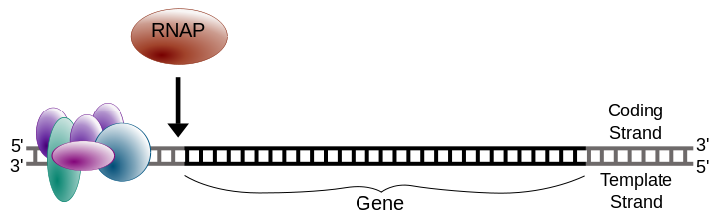
Part of DNA temporarily unzips and is used as a template to assemble complementary nucleotides into messenger RNA (mRNA).

Slide 21
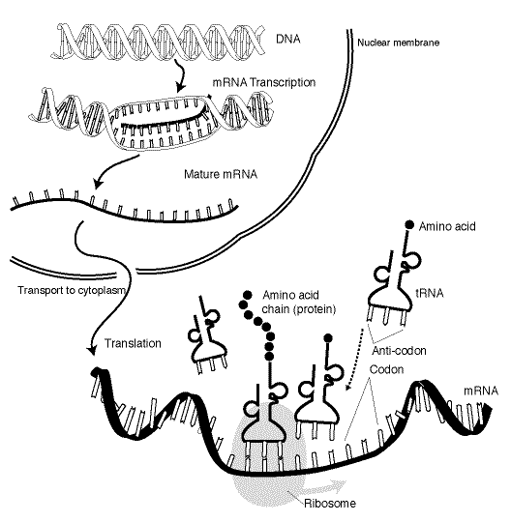
mRNA continues to copy nucleotides until it reaches the Termination sequence of the gene it is copying.
mRNA then goes through the pores of the nucleus with the DNA code and attaches to the ribosome.

Slide 22
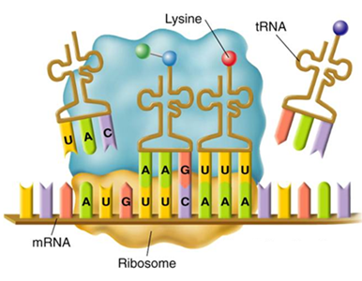
Making a Protein—Translation
Second Step: Decoding of mRNA into a protein is called Translation.
Transfer RNA (tRNA) carries amino acids from the cytoplasm to the ribosome.

Slide 23
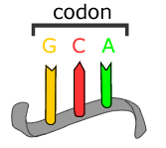
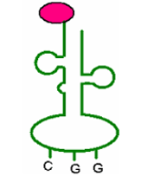
A series of three adjacent bases in an mRNA molecule codes for a specific amino acid—called a codon.
A triplet of nucleotides in tRNA that is complementary to the codon in mRNA—called an anticodon.
Each tRNA codes for a different amino acid.
Amino acid
Anticodon

Slide 24
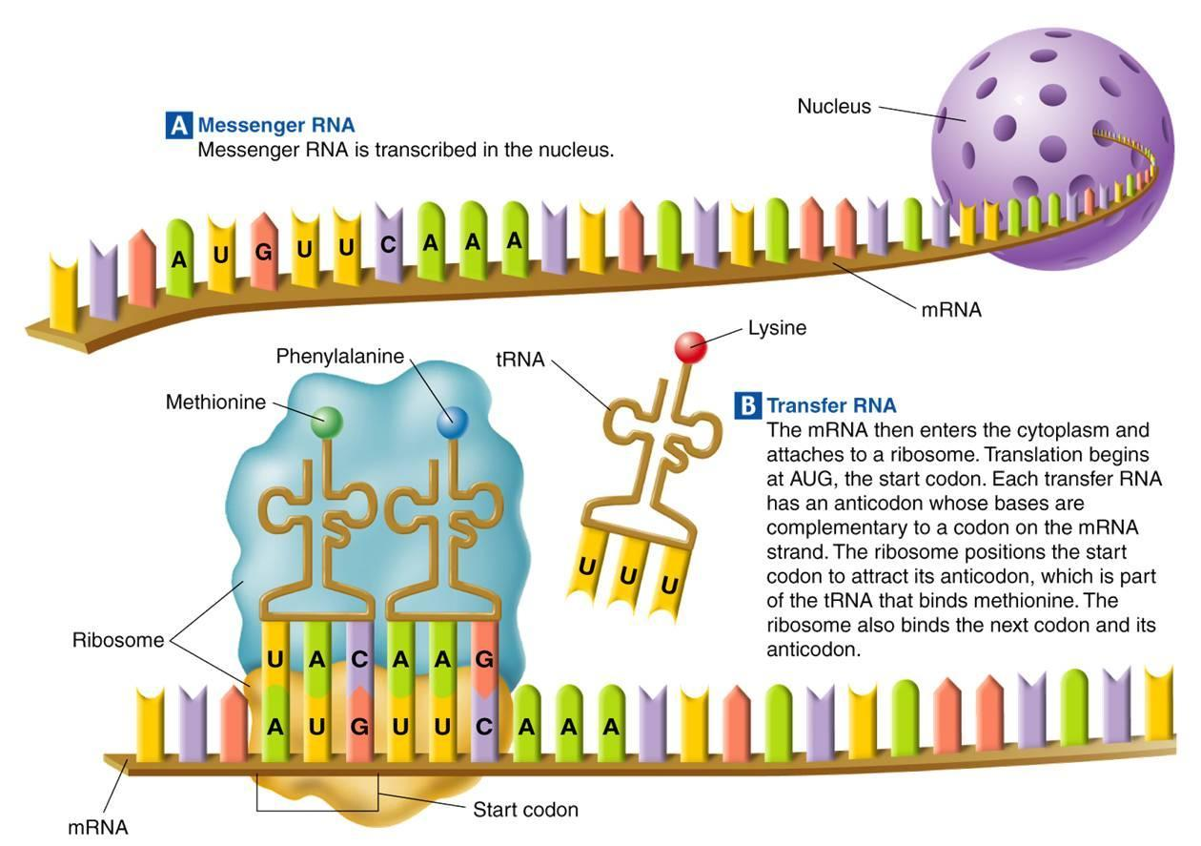
mRNA carrying the DNA instructions and tRNA carrying amino acids meet in the ribosomes.

Slide 25
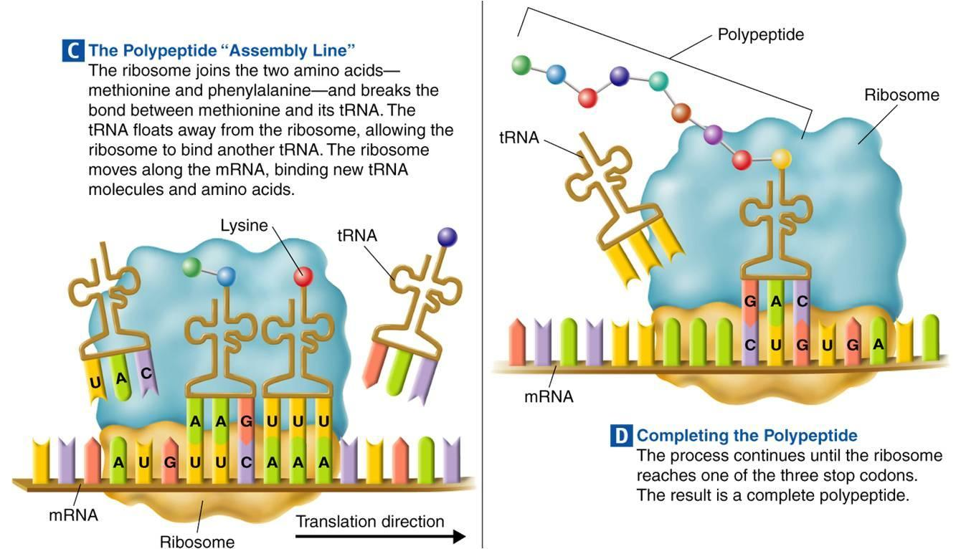
Amino acids are joined together to make a protein.
Polypeptide = Protein

Slide 26
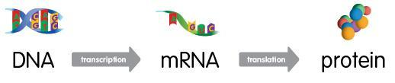
Protein Synthesis

Slide 27
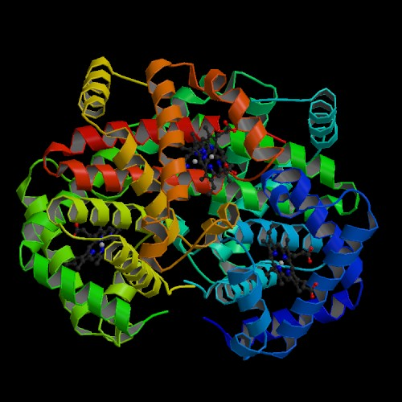
The function of hemoglobin is to carry oxygen
Hemoglobin A
Normal hemoglobin has
four subunits that each
contain an oxygen binding site.
2 Alpha chain hemoglobin
2 Beta chains hemoglobin
Biswal, B. K., Vijayan, M.: Structures of Human Oxy- and Deoxyhaemoglobin at Different Levels of Humidity: Variability in the T State Acta Crystallogr., Sect.D 58 pp. 1155 (2002)

Slide 28
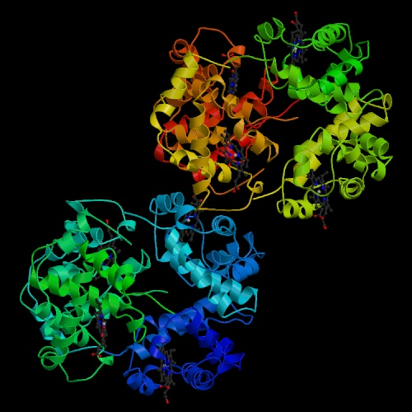
The origin of sickle cell anemia is a mutation in hemoglobin
Hemoglobin S
A single mutation in
hemoglobin results in a
binding of one protein
to another.
2 normal alpha chain hemoglobin
2 beta chain hemoglobin “s” (sickle mutation)
Padlan, E. A., Love, W. E.: Refined crystal structure of deoxyhemoglobin S. I. Restrained least-squares refinement at 3.0-Å resolution. J Biol Chem 260 pp. 8272 (1985)

Slide 29
Just ONE nucleotide!
Normal Beta Hemoglobin Chain (first 6 codons)
GTG-CAC-CTG-ACT-CCT-GAG
Val-His-Leu-Thr-Pro-Glu
Sickle Beta Hemoglobin Chain s (first 6 codons)
GTG-CAC-CTG-ACT-CCT-GTG
Val-His-Leu-Thr-Pro-Val

Slide 30
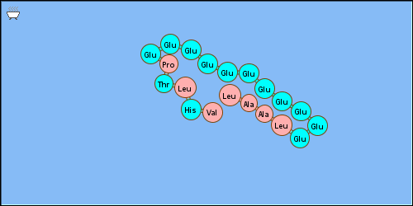
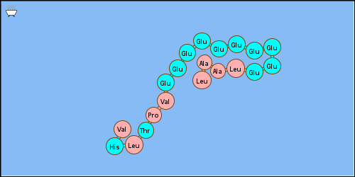
What is the big deal?
Blue is Hydrophilic- Pink is Hydrophobic
Normal Beta Hemeglobin
Sickle Beta Hemoglobin

Slide 31
Just ONE nucleotide!
What type of a mutation is this?
  Substitution
Why is it a big deal?
  Changes the properties of the amino acid, thus changes the shape of the protein.

Slide 32
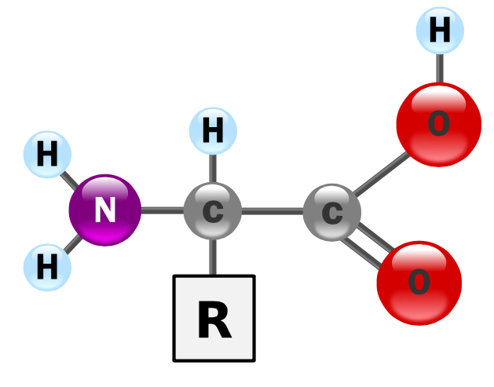
First, A Little Review
Proteins are polymers of amino acids.
The parts of an Amino Acid
  Central Carbon
  Side Chain (R-Group)
  Carboxyl Group
  Hydrogen
  Amino Group

Slide 33
More Review…
There are 20 amino acids. The "R" group makes each one unique.
Dehydration synthesis links amino acids together.

Slide 34
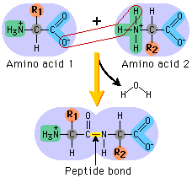
Amino Acid Bonding
Bond between amino acids = peptide bond.
The bond joins the carboxyl group of one AA to the Amino Group of the other.
This leaves R-groups (side chains) free to interact.

Slide 35
How the R-Groups Interact
R-Groups will interact in 4 ways.
3 of the ways work in or out of water:
  Van der Waals Forces
  Electrostatic Charge
  S-S Bonds
1 is specific to water:
  Hydrogen bonding

Slide 36
Van Der Waals Forces
Occur because all molecules have an electron cloud.
When electrons come in contact, they repel one another.
When they're on opposite sides of two molecules, they weakly attract one another.

Slide 37
Electrostatic Charge
Side chains, like all molecules, have a charge.
  Some are positive
  Some are negative
  Some are neutral
Opposites attract, like repel. This causes folding in the chain.

Slide 38
S-S Bonds
Several amino acids contain sulfer.
Sulfur containing R-Groups will interact with other sulfur-containing R-Groups.
Those r-groups form covalent bonds with one another.

Slide 39
Hydrogen Bonds
In water, the electron cloud gets pulled away from the R-group by the Oxygen in H₂O
This allows some molecules to form hydrogen bonds with neighboring molecules.

Slide 40
Hydrophobic and Hydrophilic
Hydrophilic
  Neutral, polar R-Groups can shift their electrons to one end or the other.
  This allows them to attract water molecules.
  This part of the AA Chain stays straight.

Slide 41
Hydrophobic and Hydrophilic
Hydrophobic
  Electrically neutral, non-polar molecules.
  "Avoid" polar R-Chains and Water molecules as much as possible.
  Water molecules then bond with other water molecules and "herd" non-polar molecules together.

Slide 42
In Oil
Hydrophilic R-Groups react in the opposite way they react in water.
Those molecules are more attracted to each other, than the substance they're in.
Hydrophobic molecules are NOT herded as they are in water, and basically dissolve.

Slide 43
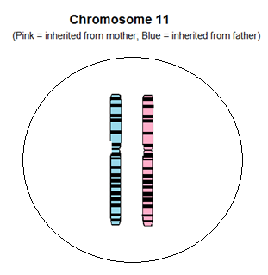
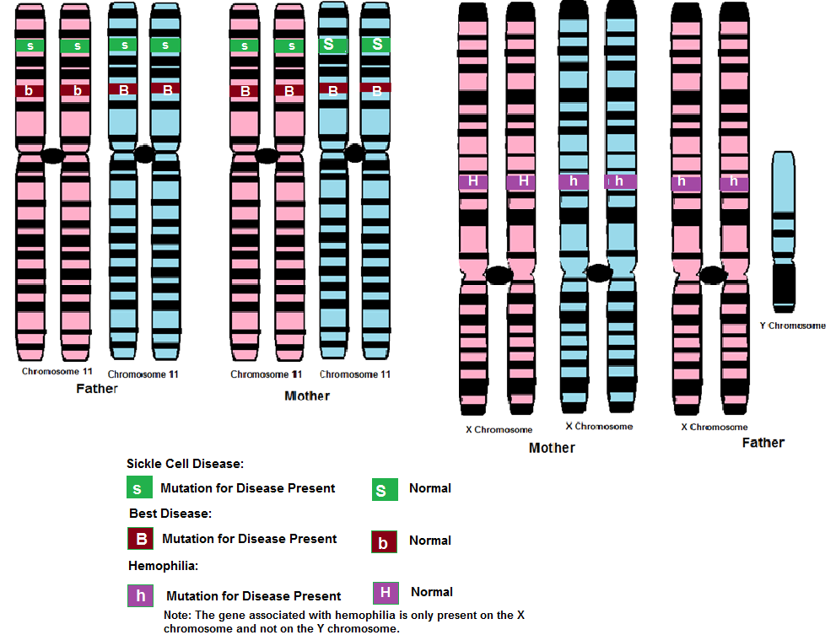
Unit 3 Section 3 Activity 1
Mitosis and Meiosis

Slide 44
Some Vocabulary:
SOMATIC
Any cell except a sperm or egg
AUTOSOME
Any chromosome other than a sex chromosome (X or Y)
GAMETE
An egg or sperm

Slide 45
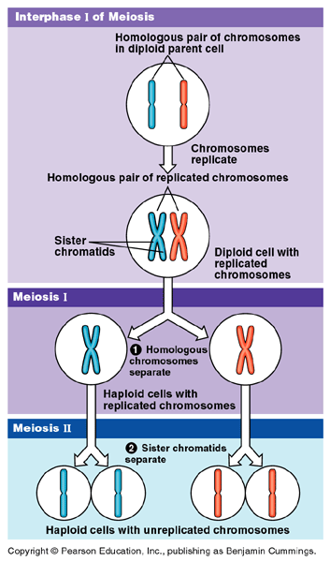

Slide 46
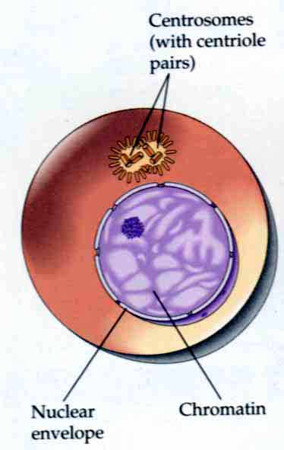
MEIOSIS I
Interphase I

Slide 47
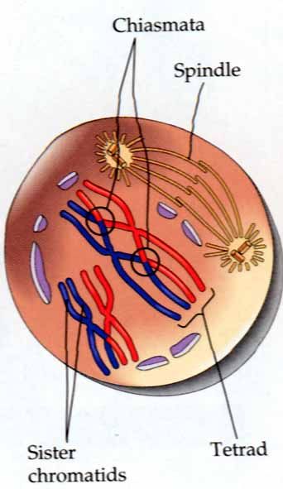
MEIOSIS I
Prophase I

Slide 48
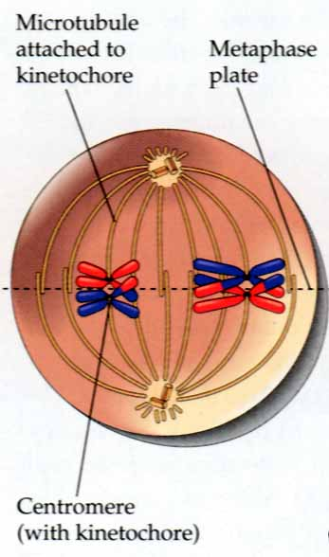
MEIOSIS I
Metaphase I

Slide 49
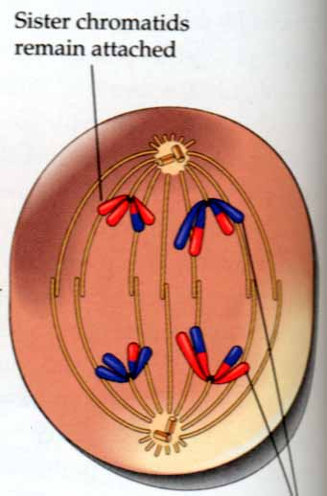
MEIOSIS I
Anaphase I

Slide 50
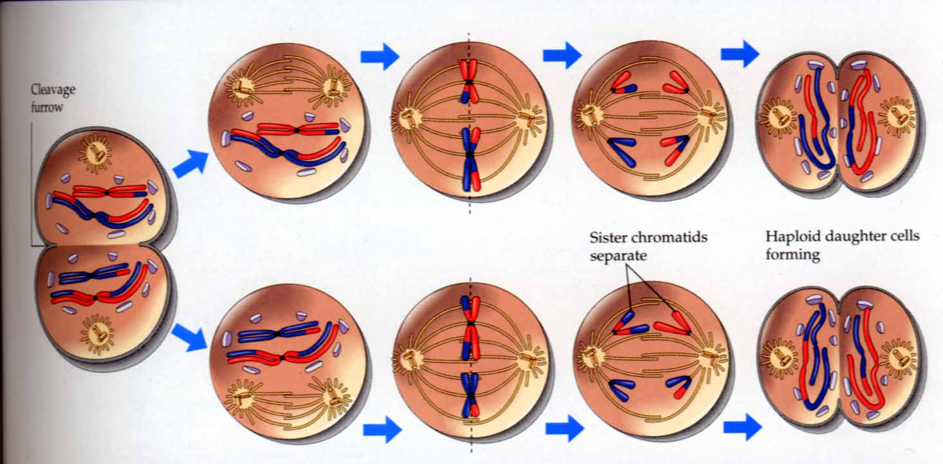
MEIOSIS I
Telophase I

Slide 51
MEIOSIS II
Prophase II
Metaphase II
Anaphase II
Telophase/cytokinesis II

Slide 52
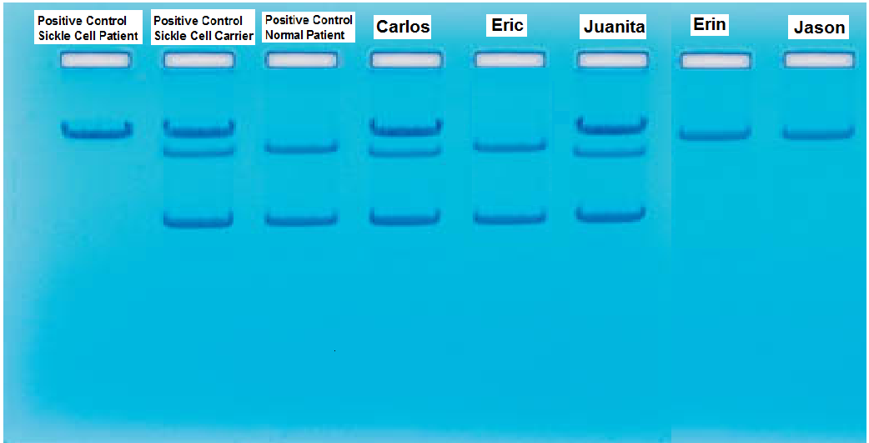
Unit 3 Section 3 Activities 1-3
Family inheritance- Pedigrees
Reading a gel electrophoresis
Punnett Squares
Word Distribution of Sickle Cell

Slide 53
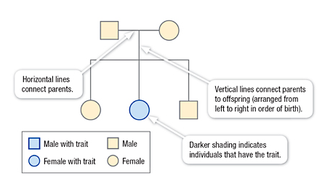
Pedigree
Looks at family history and how a trait is inherited over several generations and can help predict inheritance patterns
Symbols represent females, males, those who carry or are affected by the trait being examined, and family relationships

Slide 54
Pedigree Symbols
Male
Heterozygous
Male
Affected
Male
Heterozygous
Female
Affected
Female
Female
New marriage
into family
Marriage/Mating
1st Generation
of Children

Slide 55
Connecting Pedigree Symbols
Examples of connected symbols:
Married Couple
Siblings
Notes:
These symbols also represent relationships between people. some may have to each other.

Slide 56
Symbols in a Pedigree Chart
Affected
X-linked
Autosomal carrier
Deceased
Notes:
These are examples of different types of symbols. These symbols would be the same for males or for females, except for X-linked carrier which is only used for females. So an affected male would be a square that is filled in completely. A deceased female would be a circle with a diagonal slash.

Slide 57
Organizing the pedigree chart
  Generations are identified by Roman numerals
I
II
III
IV
© 2007 Paul Billiet ODWS

Slide 58
Organising the pedigree chart
Individuals in each generation are identified by Arabic numerals numbered from the left
Therefore the affected individuals are II3, IV2 and IV3
I
II
III
IV
© 2007 Paul Billiet ODWS

Slide 59
Rules of Inheritance
Autosomal Recessive
Appears in both sexes with equal frequency
Trait tend to skip generations
Affected offspring are usually born to unaffected parents
When both parents are hetzyg. ~1/4 of the progeny will be affected
Appears more frequently among the children of consanguine marriages
X-Linked Dominant
Both males and females are affected; often more females than males are affected
Does not skip generations. Affectd sons must have an affected mother; affected daughters must have either an affected mother or an affected father
Affected fathers will pass the trait on to all their daughters
Affected mothers if heterozygous will pass the trait on to 1/2 of their sons and 1/2 of their daughters
Autosomal Dominant
Appears in both sexes with equal frequency
Both sexes transmit the trait to their offspring
Does not skip generations
Affected offspring must have an affected parent unless they posses a new mutation
When one parent is affected (het.) and the other parent is unaffected, ~ 1/2 of the offspring will be affected
Unaffected parents do not transmit the trait
X-Linked Recessive
More males than females are affected
Affected sons are usually born to unaffected mothers, thus the trait skips generations
Approximately 1/2 of carrier mothers’ sons are affected
It is never passed from father to son
All daughters of affected fathers are carriers
Notes:
It turns out that Mendel’s laws apply to all of the genes encoded by chromosomes in the nucleus
But it turns out that a few additional traits are due to DNA sequences found in other organelles, namely the mitochondria and the chloroplasts
Mitochondria and chloroplasts are thought to have arisen from a bacterial precursor that was internalized by a cell and whose presence was maintained by a sybiotic relationship - bact cell made energy but got what it needed from the rest of the cell
Both of these plastids have their own chromosomes (circular) that encode cellular genes, many of which are utilized by the organelle.
It turns out that the pattern of inheritance from these genes does not follow a Mendelian pattern
In fact in most cells all mitochondria are inherited from their mother (think about the big egg and the little sperm)

Slide 60
Autosomal Dominant
Vertical pattern: multiple generations affected
Males and females equally likely to be affected
See male to male transmission
Each child of an affected individual has a 50% chance to be affected
Unaffected individuals do NOT pass on the gene
Every affected child has an affected parent
Adapted from The Pedigree: A Basic Guide, by Jorgenson, Yoder & Shapiro

Slide 61
Autosomal Dominant
Late-onset trait
dx 60
dx 50
dx 45
4
3
4
dx 45
3
2
An individual who inherits the disease gene but does not develop
the condition until adulthood
Examples: Huntington disease, most hereditary cancer syndromes
Adapted from The Pedigree: A Basic Guide, by Jorgenson, Yoder & Shapiro

Slide 62
Autosomal Dominant
New Mutation
3
2
3
An alteration occurs in the egg or sperm that made the affected individual (may be first family member to be affected)
Recurrence risk for unaffected parents is considered to be low
Risk of new mutation is associated with advanced paternal age in some disorders (e.g. Achondroplasia)
Adapted from The Pedigree: A Basic Guide, by Jorgenson, Yoder & Shapiro

Slide 63
Autosomal Recessive
Horizontal pattern: single generation affected.
Males and females equally likely to be affected
Parents of affected child are unaffected gene carriers and have
a 1 in 4 or 25% recurrence risk
Unaffected siblings have a 2/3 or 67% chance to be carriers.
Children of affected individuals are obligate carriers.
Adapted from The Pedigree: A Basic Guide, by Jorgenson, Yoder & Shapiro

Slide 64
X-linked
2
3
4
2
3
2
Males are more often affected than females
Affected males pass the gene to all of their daughters and none of
their sons (NO male-to-male transmission)
Daughters of carrier females have a 50% chance to be unaffected
carriers. Sons of carrier females have 50% chance to be affected.
Affected males in the family are related to each other through carrier
females (“Knight’s move”)

Slide 65
Punnett Square
A Punnett square is a chart that shows all of the possible combinations of alleles that can result from a genetic cross.
 | X | X
X
Y

Slide 66
Predicting Inheritance
For example:
T = represents the gene for TALL in pea plants
t = represents the gene for short in pea plants
So:
TT & Tt both result in a TALL plant, because T is dominant over t. t is recessive.
tt will result in a short plant.
Remember there are two genes for every trait! One from each parent.

Slide 67
Punnett Squares
The genes from one parent go here.
The genes from the other parent go here.

Slide 68
Punnett Squares
 | T | T
t | Tt | Tt
t | Tt | Tt

Slide 69
Punnett Squares
 | T | T
t | Tt | Tt
t | Tt | Tt

Slide 70
Punnett Squares
 | T | T
t | Tt | Tt
t | Tt | Tt

Slide 71
Punnett Squares
 | T | T
t | Tt | Tt
t | Tt | Tt

Slide 72
Punnett Squares
 | T | T
t | Tt | Tt
t | Tt | Tt

Slide 73
Punnett Squares
 | T | T
t | Tt | Tt
t | Tt | Tt
F₁ generation

Slide 74
Interpreting the Results
The genotype for all the offspring is Tt.
The genotype ratio is:
Tt - 4/4
The phenotype for all the offspring is tall.
The phenotype ratio is:
tall - 4/4

Slide 75
Punnett Squares
 | T | t
T | ?? | ??
t | ?? | ??
Your Turn!!

Slide 76
Punnett Squares
 | T | t
T | TT | Tt
t | Tt | tt
F₂ generation

Slide 77
Punnett Squares
Next, give the genotype and phenotype ratios of the offspring (F₂ generation).

Slide 78
Punnett Squares
Genotype ratio: TT - 1
 | T | t
T | TT | Tt
t | Tt | tt

Slide 79
Punnett Squares
Genotype ratio: TT - 1, Tt - 2
 | T | t
T | TT | Tt
t | Tt | tt

Slide 80
Punnett Squares
Genotype ratio: TT - 1, Tt - 2, tt - 1
 | T | t
T | TT | Tt
t | Tt | tt

Slide 81
Punnett Squares
Genotype ratio: TT - 1, Tt - 2, tt - 1
 | T | t
T | TT | Tt
t | Tt | tt
Phenotype ratio: Tall - 3

Slide 82
Punnett Squares
Genotype ratio: TT - 1, Tt - 2, tt - 1
 | T | t
T | TT | Tt
t | Tt | tt
Phenotype ratio: Tall - 3, short - 1

Slide 83
Punnett Squares
 | T | t
T | TT | Tt
t | Tt | tt
This is a monohybrid cross. We worked with only one trait. The height of the plant.

Slide 84
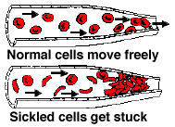
What is Sickle Cell Anemia (SCA)?
First described in Chicago in 1910 by James Herrick as an inherited condition that results in a decrease in the ability of red blood cells to carry oxygen throughout the body
  Sickle red blood cells become hard and irregularly shaped (resembling a sickle)
  Become clogged in the small blood vessels and therefore do not deliver oxygen to the tissues.
  Lack of tissue oxygenation can cause excruciating pain, damage to body organs and even death.

Slide 85
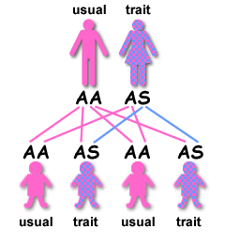
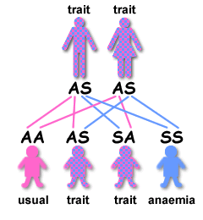
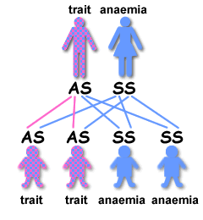
Genetics
2 copies of the gene for Hb (each parent)
HbS –Recessive
  S=Sickle
  A=Normal

Slide 86
Some Genetic History
The error in the hemoglobin gene results from a genetic mutation that occurred many thousands of years ago in people in parts of Africa, the Mediterranean basin, the Middle East, and India.
A deadly form of malaria was very common at that time
  Malaria epidemics caused the death of many
  In areas where malaria was a problem, children who inherited one sickle hemoglobin gene and who, therefore, carried the sickle cell trait - had a survival advantage.
  Unlike the children who had normal hemoglobin genes, they survived the malaria epidemics they grew up, had their own children, and passed on the gene- for sickle hemoglobin.

Slide 87
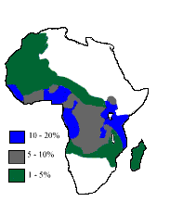
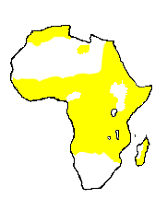
Sickle Cell Gene
Severe Malaria

Slide 88
History
As populations migrated, the sickle cell-mutation spread to other Mediterranean areas, further into the Middle East and eventually into the Western Hemisphere.
In the United States and other countries where malaria is not a problem, the sickle hemoglobin gene no longer provides a survival advantage.
Instead, it may be a serious threat to the carrier's children, who may inherit two abnormal sickle hemoglobin genes and have sickle cell anemia.

Slide 89
Medical Complications
This is NOT a complete list.
kidney damage and
loss of body water in urine
painful erections in men (priapism)
blood blockage in the spleen or liver (sequestration)
eye damage
low red blood cell counts (anemia)
delayed growth
pain episodes
strokes
increased infections
leg ulcers
bone damage
yellow eyes or jaundice
early gallstones
lung blockage

Slide 90
Developing Treatments
Hydroxyurea
  The first effective drug treatment for adults with severe sickle cell anemia reported in early 1995
  Daily doses of the anticancer drug, hydroxyurea, reduced the frequency of painful crises, acute chest syndrome, needed fewer blood transfusions
  Increases production of fetal hemoglobin in the blood
    Fetal hemoglobin seems to prevent sickling of red cells
    cells containing fetal hemoglobin tend to survive longer in the bloodstream

Slide 91
Developing Treatments
Bone marrow transplantation
  Shown to provide a cure for severely affected children with sickle cell disease
  Only about 18 percent of children with sickle cell anemia are likely to have a matched sibling.

Slide 92
The Ultimate Cure?
Gene Therapy
Correcting the “defective gene” and inserting it into the bone marrow
Turning off the defective gene and simultaneously reactivating another gene that turns on production of fetal hemoglobin.
No real cure for Sickle Cell Anemia at this time.
“In the past 30 years, the life expectancy of people with sickle cell anemia has increased. Many patients with sickle cell anemia now live into their mid-forties and beyond.”

