Slide 1
Unit Two: Diabetes
Serious effects a disease within one system can have on homeostasis in the body as a whole

Slide 2
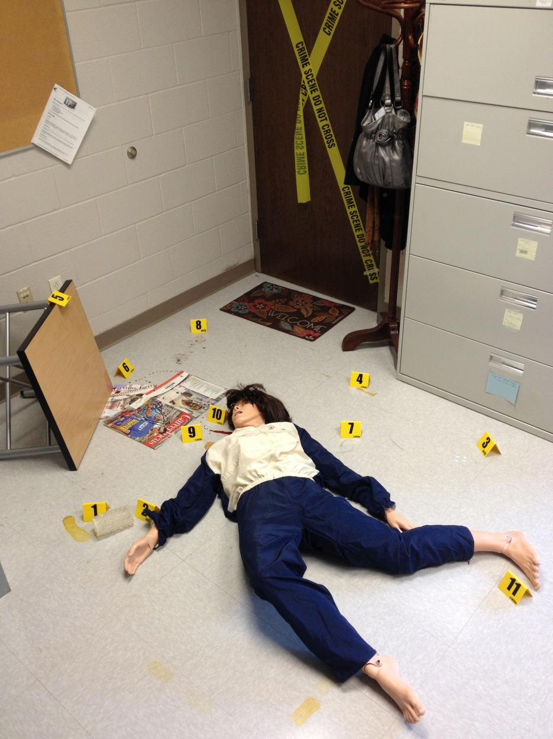
Back to Anna…
The ME noted she was wearing a Medical Alert bracelet labeling her as a diabetic
Pay attention to all aspects of her medical history and think about how diabetes impacts overall health and wellness.
Could this disease have contributed to her death?

Slide 3
Diabetes by the Numbers…
Worldwide
2002 - 171,000,000 known to be diabetic
2005 – 1 million people died from diabetes
2030- 371,000,000 expected to be diabetic
In the U.S.
2002 – 17,702,000 known to be diabetic
2030 – 30,317,000 expected
1/3 of adults do not know they have it
2002 - $132 billion health care cost, today BILLIONS! (CDC)
2000-2005 – age of onset getting younger

Slide 5
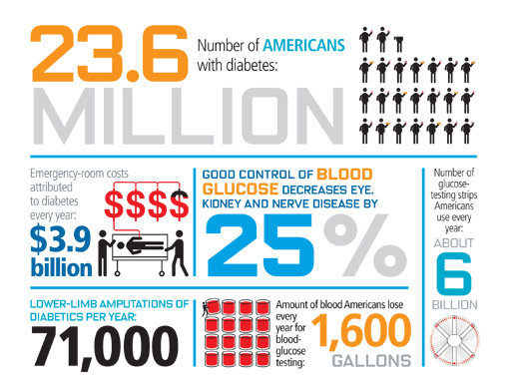

Slide 6
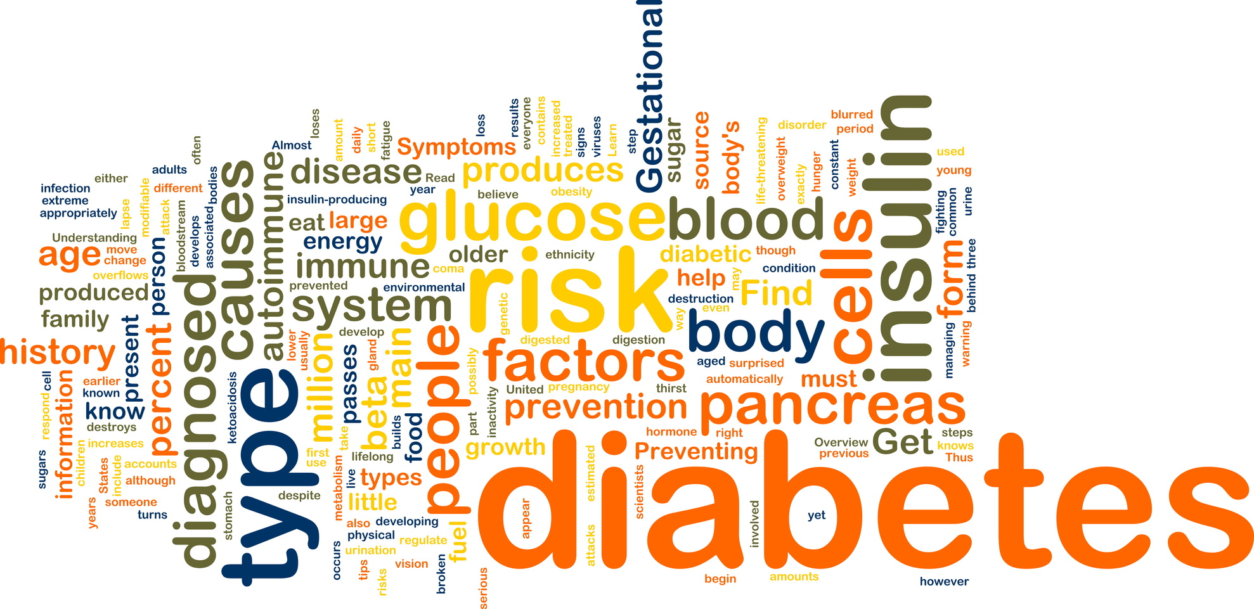
2.1 What is diabetes?

Slide 7
2.1 Essential Questions
What is diabetes?
How is glucose tolerance testing used to diagnose diabetes?
How does the development of Type 1 and Type 2 diabetes relate to how the body produces and uses insulin?
What is the relationship between insulin and glucose?
How does insulin assist with the movement of glucose into body cells?
What is homeostasis?
What does feedback refer to in the human body?
How does the body regulate the level of blood glucose?

Slide 8
2.1 Key Terms
Glucagon
Glucose Tolerance Test
Homeostasis
Hormone
Insulin
Negative Feedback
Positive Feedback
Type 1 Diabetes
Type 2 Diabetes

Slide 9
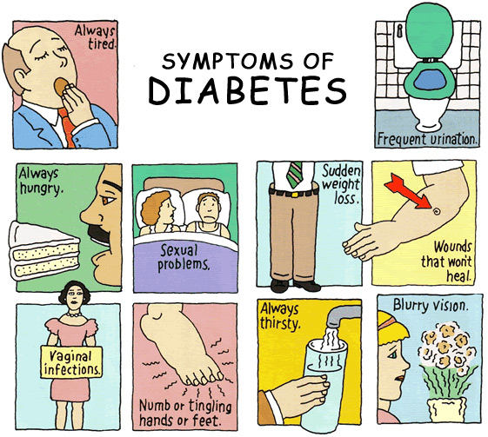

Slide 10
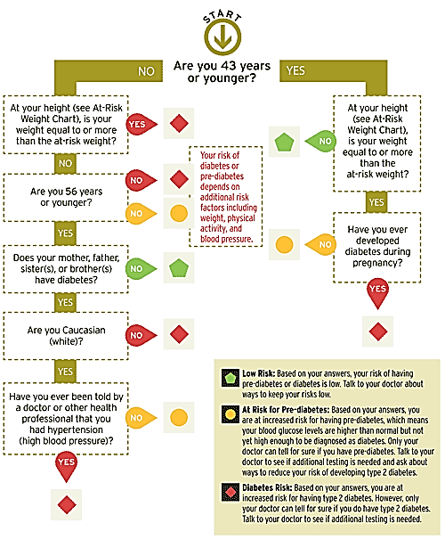
Height | Weight
4’10” | 148 lbs
4'11" | 153 lbs
5'0" | 158 lbs
5'1" | 164 lbs
5'2" | 169 lbs
5'3" | 175 lbs
5'4" | 180 lbs
5'5" | 186 lbs
5'6" | 192 lbs
5'7" | 198 lbs
5'8" | 203 lbs
5'9" | 209 lbs
5'10" | 216 lbs
5'11" | 222 lbs
6'0" | 228 lbs
6'1" | 235 lbs
6'2" | 241 lbs
6'3" | 248 lbs
6'4" | 254 lbs

Slide 11
Activity 2.1.1 Diagnosing Diabetes
Patient Histories
Case histories, physical exams, blood tests, urine test…etc.
The Fasting Plasma Glucose Test (FPG)
Preferred method: easy to do, convenient, and less expensive than
Glucose Tolerance Testing (GTT) (vs. FPGTT)
Gestational diabetes
Monitors the amount of sugar in blood plasma, over a set time period
Insulin Level Testing
Used to determine whether a patient has Type 1 or Type 2 diabetes
Glycated hemoglobin (A1C) test. This blood test
Blood sugar levels over a two to three month period and may assist in a diagnosis of diabetes and subsequent control

Slide 12
Activity 2.1.1
Includes the following
Conclusion Questions
Table and figure of GTT results
Table and figure of IT results
Paragraph diagnosing each patient with/without diabetes and if diabetic (based on GTT) if it’s Type I or II (based on IT)
Notes
Copy/paste tables and figures in word
Figures are not titled in excel, just word
Be sure to name axes, fix increments on x-axis and adjust scale to get rid of empty space.

Slide 13
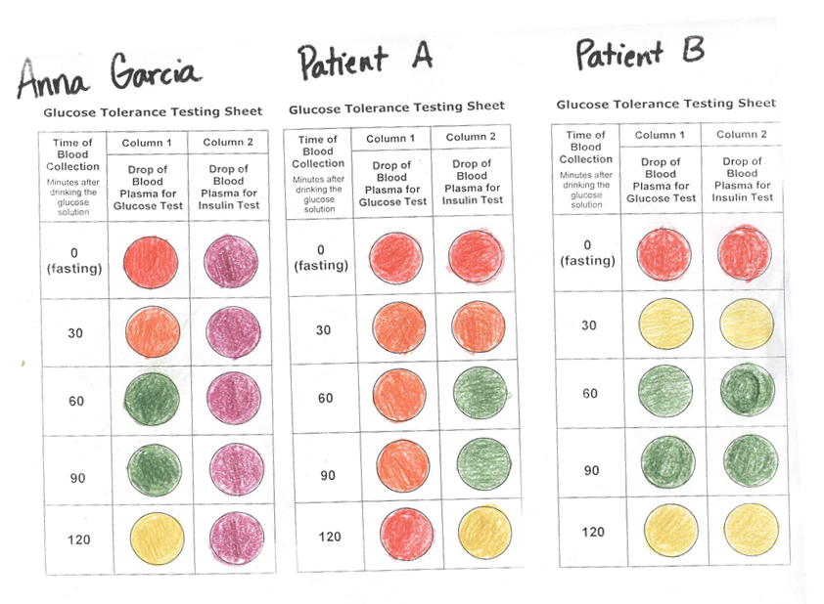

Slide 14
Figure 1. Glucose Tolerance Test Results

Slide 15
Figure 2. Insulin Test Results

Slide 16
Blood Test Results for Diabetes
Anna Garcia is a Type 1 diabetic
A prolonged rise in blood glucose levels indicates that Anna is a diabetic.
A lack of insulin in the blood at each time period indicates that she is a Type 1 diabetic.
She is not producing insulin and thus her glucose levels are remaining elevated over the time period.
Patient A is not diabetic, but should be considered pre-diabetic
A brief rise in glucose levels stays within the range of normal (perhaps elevated for a bit too long)
However, risk factors described show that the patient is at risk for Type 2 diabetes.
Patient B is a Type 2 diabetic
A prolonged rise in blood glucose levels indicates that Patient B is a diabetic.
Insulin testing reveals a normal level of insulin in the blood in response to increased levels of glucose.
Therefore, the patient produces insulin, but it is not being effectively used by the body, indicating Type 2 diabetes.

Slide 17
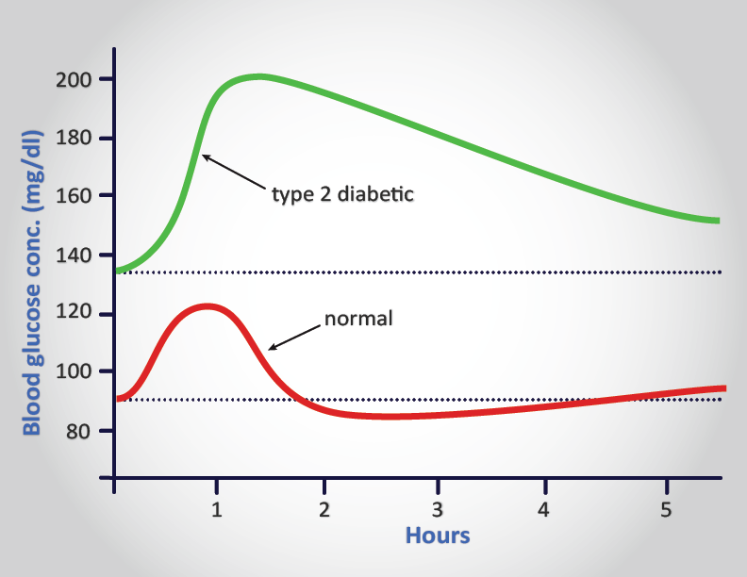
Interpreting Your Results!

Slide 18
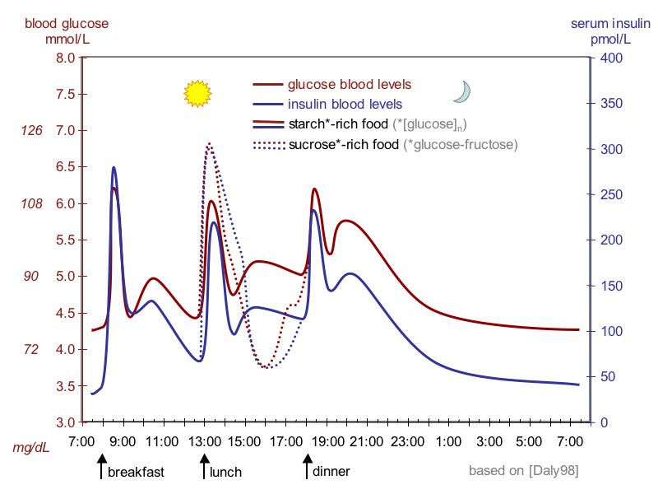
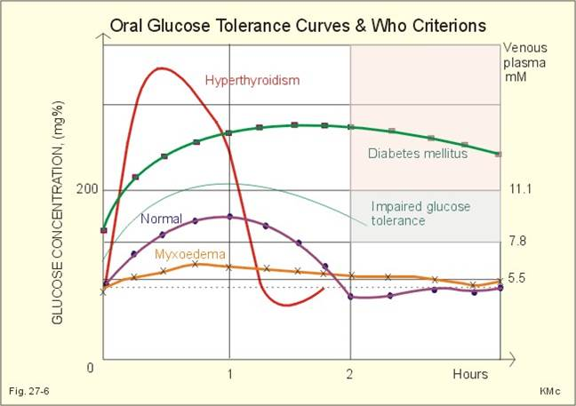

Slide 19
2.1.2: The Insulin Glucose Connection

Slide 20
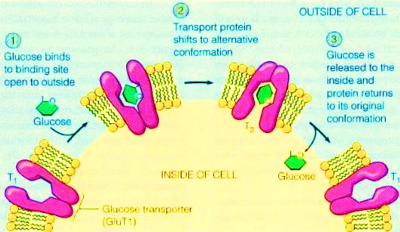
Insulin is required for your cells to take up glucose Glucose Transport Proteins (GLUTs)

Slide 21
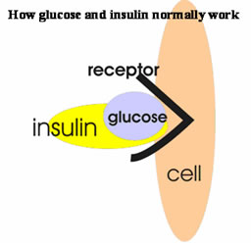
Without Insulin…
Cells do not take in the glucose they need for energy
Body doesn’t produce insulin = Type I
Cells becomes resistant to insulin= Type 2 diabetes
Same effect as if there was not insulin present
The cells do not take in glucose from the blood

Slide 22
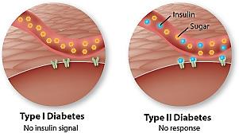
Types of Diabetes
Type 1: Insulin-Deficient Diabetes (Juvenile Diabetes)
Type 2: Insulin-Resistant Diabetes (Adult Onset)

Slide 23
Blood Glucose Level Insulin keeps it in homeostasis
Uses insulin, glycogen & glucagon hormones
Pancreas- Regulates BGL
Alpha and beta cells sense BGL
High BGL
High insulin (hormone) secretion from pancreas
Triggers cells to use more glucose
Triggers liver to store glucose as glycogen
BGL decrease
Low BGL
Pancreas STOPS producing insulin
Produces glucagon (hormone)
Frees glucose from glycogen in liver
BGL increase

Slide 24
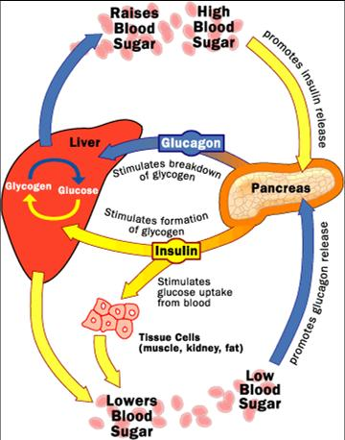
Glucose- Free in blood, what cells use for energy
Glycogen- Stored glucose in the liver
Glucagon- hormone stimulates freeing of glucose

Slide 25
Design requirements for the model
The model must be constructed of materials easily accessible at home or school.
The model must be 3-D with moveable parts.
The model should be labeled clearly.
The model must accurately show the role of insulin as it relates to glucose in the body.
Make sure that the model accurately depicts the role of the following terms in blood sugar regulation:
Glucose transport proteins
Cell membrane
Glucose
Blood
Cell
Insulin
Insulin receptors
Glycogen
Glucagon

Slide 26
Read & Discuss
The communication that exists in cells is an amazing process that is dependent on molecules that travel from one cell to the other. This chemical communication is highly specific and often involves protein molecules. The specific protein will be released by one cell and travel to a second cell. The protein binds to the second cell because that cell has a receptor for it. When the protein binds to the receptor, a cascade of events in the second cell is initiated. The specific protein molecules are referred to as signal molecules because they carry the signal from one cell to another. Signal molecules are also called ligands because they bind to other molecules, causing a reaction of some sort. The signal protein or ligand binds to a specific receptor on the surface of the cell. The location where the ligand attaches to the receptor is called the receptor site.

Slide 27
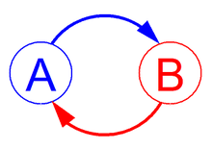
2.1.3 Feedback Loops
Feedback- a signal within a system that is used to control that system
Feedback loop- When feedback occurs and a response results
Found in many living and non-living systems
Enhance (+) changes or
Inhibit (-)changes
Keep a system operating effectively

Slide 28
2.1.3 Feedback Loops
Negative Feedback Loops
Positive Feedback Loops
Move above and below
Target set point
Towards stabilization
E.g. temperature
Move away from
Target set point
Amplify
E.g. fruit ripening (ethylene)

Slide 29
Negative Feedback: Body Temperature 37⁰C
Too Hot
Sweat- Evaporatative cooling
Vasodialate- (red face) Blood carried to surface, convection
Temperature Drops too far
Turn off cooling mechanisms
Too Cold
Goose bumps- Hair stands on end, skin pulls tight to conserve heat
Vasoconstrict- Pull blood inward, less convection
Shivering- Muscle constriction
Temperature goes too high
Turn off heating mechanisms

Slide 30
Negative Feedback: Blood Glucose Level
Uses insulin & glucagon hormones
Pancreas- Regulates BGL
Alpha and beta cells sense BGL
High BGL
High insulin secretion from pancreas
Triggers cells to use more glucose
Triggers liver to store glucose as glycogen
BGL decrease
Low BGL
Pancreas STOPS producing insulin
Produces glucagon
Frees glucose from glycogen in liver
BGL increase
Watch Negative Feedback and Insulin Production

Slide 31
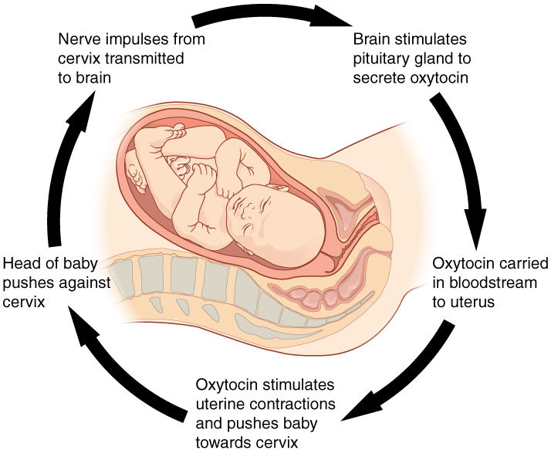
Positive Feedback Loop: Childbirth

Slide 32
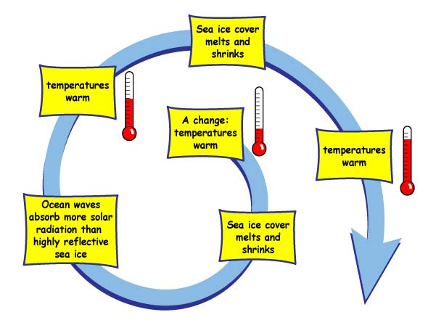
Positive Feedback Loop: Sea Ice Melt

Slide 33
What if there is an error in the loop?
Type I Diabetics
Beta cells don’t work
No insulin is secreted
Glucose levels increase without a check and balance
Type II Diabetics
Too much glucose throughout life
Cells stop recognizing insulin
Glucose levels increase without a check and balance

Slide 34
Activity 2.1.3 Feedback Loops
Watch Biology Essentials #18 with Mr. Anderson (15m)
http://www.youtube.com/watch?v=CLv3SkF_Eag
Complete Activity 2.1.3 ( 2 concept maps worth 25pts/ea)
Print Thursday, due Friday, work alone
Include at least 3 images in each
Connecting lines should always have text
Make sure both are well organized, logical, readable and complete
Word Clouds Due Friday (you can print these on Friday)
Create your own on Wordle (http://www.wordle.net/create)
Chose your own topic
Anna- use your evidence report
Diabetes- use your diagnosis report
Other- Any health topic- find a health related document online to us
Figure this out on your own, use each other
But complete individual word clouds

Slide 36
Career Journal
Certified Diabetes Educator:
Any format you chose with all the same info as the general guidelines.

Slide 37
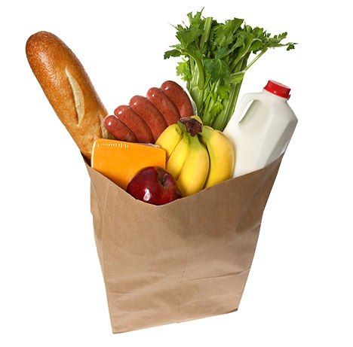
Bring in Food Samples Monday!!!
Ritz crackers
Some brand of low fat crackers
Whole Milk
Skim milk
Potato chips
Apple juice
Yogurt
Gelatin
Cereal
Peanuts (ground) – NOTE: Pay attention to allergies
Lemon Lime soda (7UP)

Slide 38
2.1 Essential Questions & Key Terms
What is diabetes?
How is glucose tolerance testing used to diagnose diabetes?
How does the development of Type 1 and Type 2 diabetes relate to how the body produces and uses insulin?
What is the relationship between insulin and glucose?
How does insulin assist with the movement of glucose into body cells?
What is homeostasis?
What does feedback refer to in the human body?
How does the body regulate the level of blood glucose?
Glucagon
Glucose Tolerance Test
Homeostasis
Hormone
Insulin
Negative Feedback
Positive Feedback
Type 1 Diabetes
Type 2 Diabetes

Slide 39
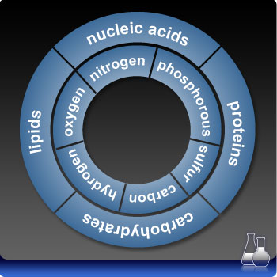
2.2 The Science of Food
Macromolecules
Nutrients we need
The main nutrients in our food
Large organic molecules that contain carbon
Necessary for life
Proteins
Carbohydrates
Lipids
An adequate amount of each of these is needed to keep the body in balance

Slide 40
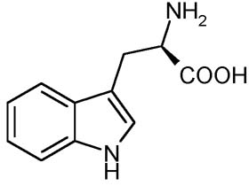
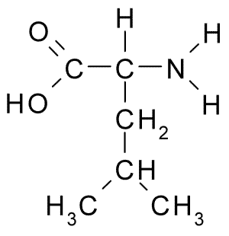
Proteins
Amino Acid building blocks
amine (-NH2)
carboxylic acid (-COOH)
Functions
Structure (tissues, organs)
Movement
Cellular communication
Storage
Transport
Metabolic reactions (enzymes)
Protection (antibodies)
Tryptophan
Leucine

Slide 41
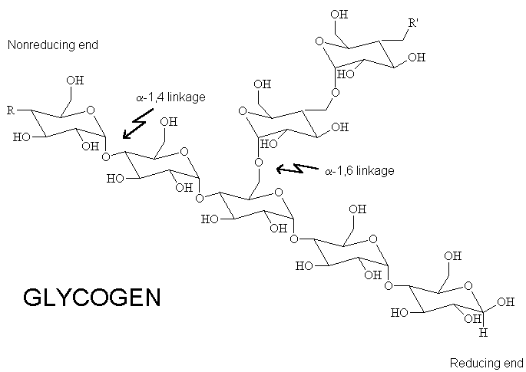
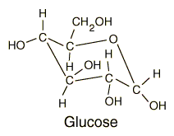
Carbohydrates (sugars/starches)
Building Blocks
Monosaccharides
One sugar
Glucose, Fructose
Large carbohydrates
Polysaccharides
Many sugars
Starch, Glycogen
Functions
Energy source
Structure
Store energy for later use
Cell communication

Slide 42
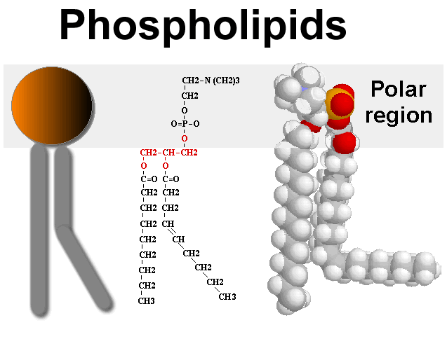
Lipids (fats/oils)
No single building block
Made of C, H and O
Fats (triglycerides)
Steroids
Oils and waxes
Phospholipids
Fat soluble vitamins
Functions:
Energy storage (triglycerides)
Cell communication
Structural
Insulation
Protection (wax)

Slide 43
2.2 Essential Questions & Key Terms
What are the main nutrients found in food?
How can carbohydrates, lipids, and proteins be detected in foods?
What types of foods supply sugar, starch, proteins and lipids?
How can food labels be used to evaluate dietary choices?
What role do basic nutrients play in the function of the human body?
What are basic recommendations for a diabetic diet?
What are the main structural components of carbohydrates, proteins and lipids?
What is dehydration synthesis and hydrolysis?
How do dehydration synthesis and hydrolysis relate to harnessing energy from food?
How is the amount of energy in a food determined?
Adenosine tri-phosphate (ATP)
Amino Acid
Calorie
Carbohydrate
Chemical Bond
Chemical Indicator
Chemical Reaction
Compound
Covalent bond
Dehydration Synthesis
Disaccharide
Element
Glucose
Homeostasis
Hydrolysis
Ionic bond
Lipid
Macromolecule
Molecule
Monomer
Monosaccharide
Nutrient
Polymer
Polysaccharide
Protein

Slide 44
Unit 2.2 Preview: We Will…
Define various terms commonly used on food labels
Analyze food labels to determine the nutritional content of the respective food items
Analyze Anna’s diet and assess how well she was meeting (or exceeding) her nutritional requirements
Complete a series of molecular puzzles to build macromolecules and explore the biochemistry of food
Explore the energy content of various foods by completing calorimetry experiments
See how the body works to harness the power of what we eat

Slide 45
2.2.1 Food Testing
Toxicology report
Anna had high amounts of glucose in her blood
Suggests that Anna ate a large meal near the time of her death
Anna was a diabetic
She had to watch her diet carefully
Analysis of her stomach contents may reveal information about Anna’s last meal
Provide additional evidence
You will perform chemical tests to determine what foods contain carbohydrates, lipids, and proteins

Slide 46
2.2.1 Food Testing
Each student bring one food in:
Ritz crackers
Some brand of low fat crackers
Whole Milk
Skim milk
Potato chips
Apple juice
Yogurt
Gelatin
Cereal
Peanuts (ground) – NOTE: Pay attention to allergies
Lemon Lime soda (7UP)
The Food Testing Virtual Lab available at http://faculty.kirkwood.edu/apeterk/learningobjects/biologylabs.htm

Slide 47
2.2.1
You will explore the basic content of food and begin to investigate how food choices play a role in diabetes management.
Activity Packet
Anna’s Food Diary
Additional Autopsy Results
You will test foods that Anna consumed in the days before her death for the presence of carbohydrates, fats, and proteins.
Part 1: Positive (AND NEGATIVE) Controls
Part II: Test 3 items + Anna’s stomach contents

Slide 48
2.2.1: Part 1
Standard Test | Control Results
 | (-) | (+)
#1: Glucose
#2: Starch
#3: Protein
#4: Lipids

Slide 49
2.2.1 Part II
You are tasked to test Anna’s stomach contents to determine the makeup of her last meal. You will design a procedure for testing this mixture as well as determining the chemical makeup of three standard food items.
Test | Response to Indicator |  |  |  | Make-Up
 | Glucose | Starch | Protein | Lipid
Item 1 __________
Item 2 __________
Item 3 ___________
Stomach Contents

Slide 50
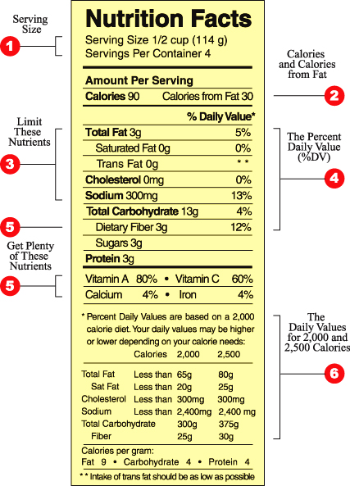
HW: Bring In Food Labels
Breads
Crackers
Peanuts
Marshmallows
Doritos, Fritos, or Cheetos
Low fat crackers
Milk
Apple juice
Yogurt
Gelatin
Cereal
Soda

Slide 51
What have we learned?
About the chemical make-up of food?
About Anna?

Slide 52
2.2.2 Nutritional Labels
You have probably looked at the nutritional label before
Information about the composition of food Overall nutritional value. This information
Helps people, especially diabetics, make smart choices
In Activity 2.2.1 you identified four basic components of common food items.
In this activity you will define various terms commonly used on food labels and then analyze food labels to determine the nutritional content of the respective food items.
Later in the unit, you will test each food item to determine how much energy the item can provide.

Slide 53
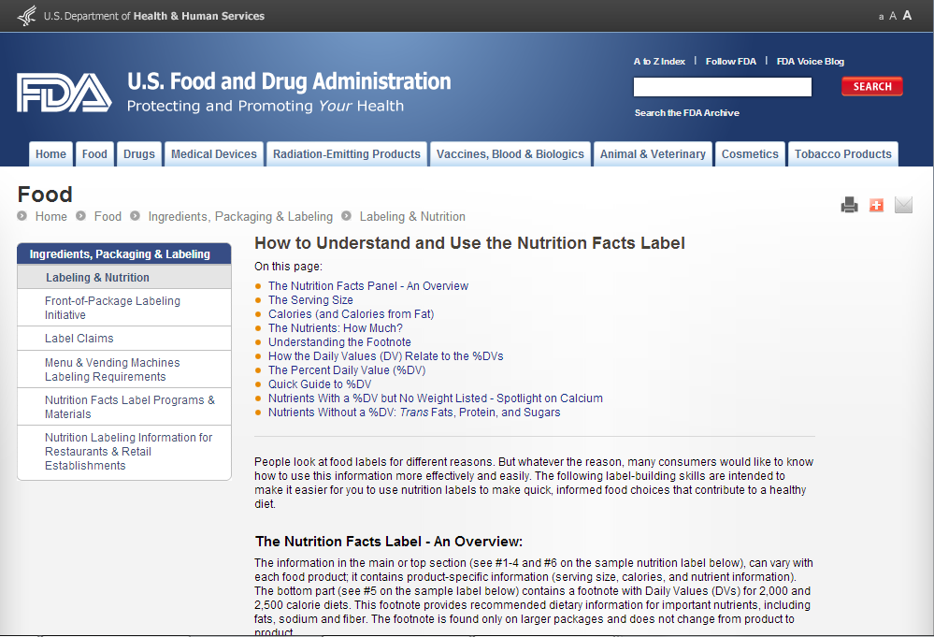
FDA How to Understand and Use The Nutrition Facts Label
http://www.fda.gov/food/ingredientspackaginglabeling/labelingnutrition/ucm274593.htm

Slide 54
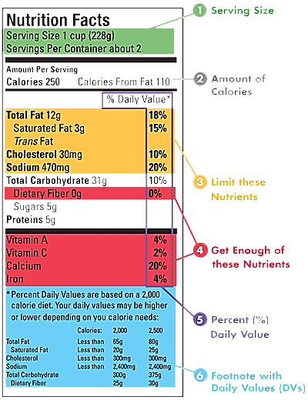
Read the label…
Serving Size
This section is the basis for determining number of calories, amount of each nutrient, and %DVs of a food.
Use it to compare a serving size to how much you actually eat.
Serving sizes are given in familiar units, such as cups or pieces, followed by the metric amount, e.g., number of grams.

Slide 55
Amount of Calories
If you want to manage your weight (lose, gain, or maintain)
The amount of calories is listed on the left side.
The right side shows how many calories in one serving come from fat.
The key is to balance how many calories you eat with how many calories your body uses.
Tip: Remember that a product that's fat-free isn't necessarily calorie-free

Slide 56
Limit these Nutrients
Eating too much total fat (including saturated fat and trans fat), cholesterol, or sodium may increase your risk of certain chronic diseases, such as heart disease, some cancers, or high blood pressure.
The goal is to stay below 100%DV for each of these nutrients per day.

Slide 57
Get Enough of these Nutrients
Americans often don't get enough dietary fiber, vitamin A, vitamin C, calcium, and iron in their diets. Eating enough of these nutrients may improve your health and help reduce the risk of some diseases and conditions.

Slide 58
Percent (%) Daily Value
Tells you whether the nutrients (total fat, sodium, dietary fiber, etc.) in one serving of food contribute a little or a lot to your total daily diet.
The %DVs are based on a 2,000-calorie diet.
Each listed nutrient is based on 100% of the recommended amounts for that nutrient.

Slide 59
18% for total fat
One serving furnishes =18% of the total amount of fat that you could eat in a day and stay within public health recommendations
5%DV or less is low
20%DV or more is high
Footnote with Daily Values
%DVs
The footnote provides information about the DVs for important nutrients, including fats, sodium and fiber. The DVs are listed for people who eat 2,000 or 2,500 calories each day.
The amounts for total fat, saturated fat, cholesterol, and sodium are maximum amounts. That means you should try to stay below the amounts listed.

Slide 60
DVs vs. Dietary Reference Intakes
Recommendations for determining daily nutritional requirements focus on Dietary Reference Intakes (DRIs)
Nutritional needs taking other factors into account
Age, size, and activity
They are not used on food labels
Information on food labels remains general.

Slide 61
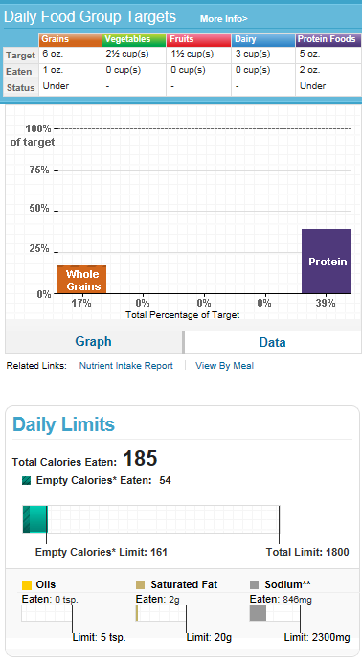
Anna Garcia Nutrient Analysis
United States Department of Agriculture SuperTracker - Food Tracker available at https://www.choosemyplate.gov/SuperTracker/foodtracker.aspx
All food items that Anna consumed on August 12th have been entered into an online food tracker by a nutritionist or dietician.
This tracker compiles nutritional information and compares what is consumed to daily recommendations.

Slide 62
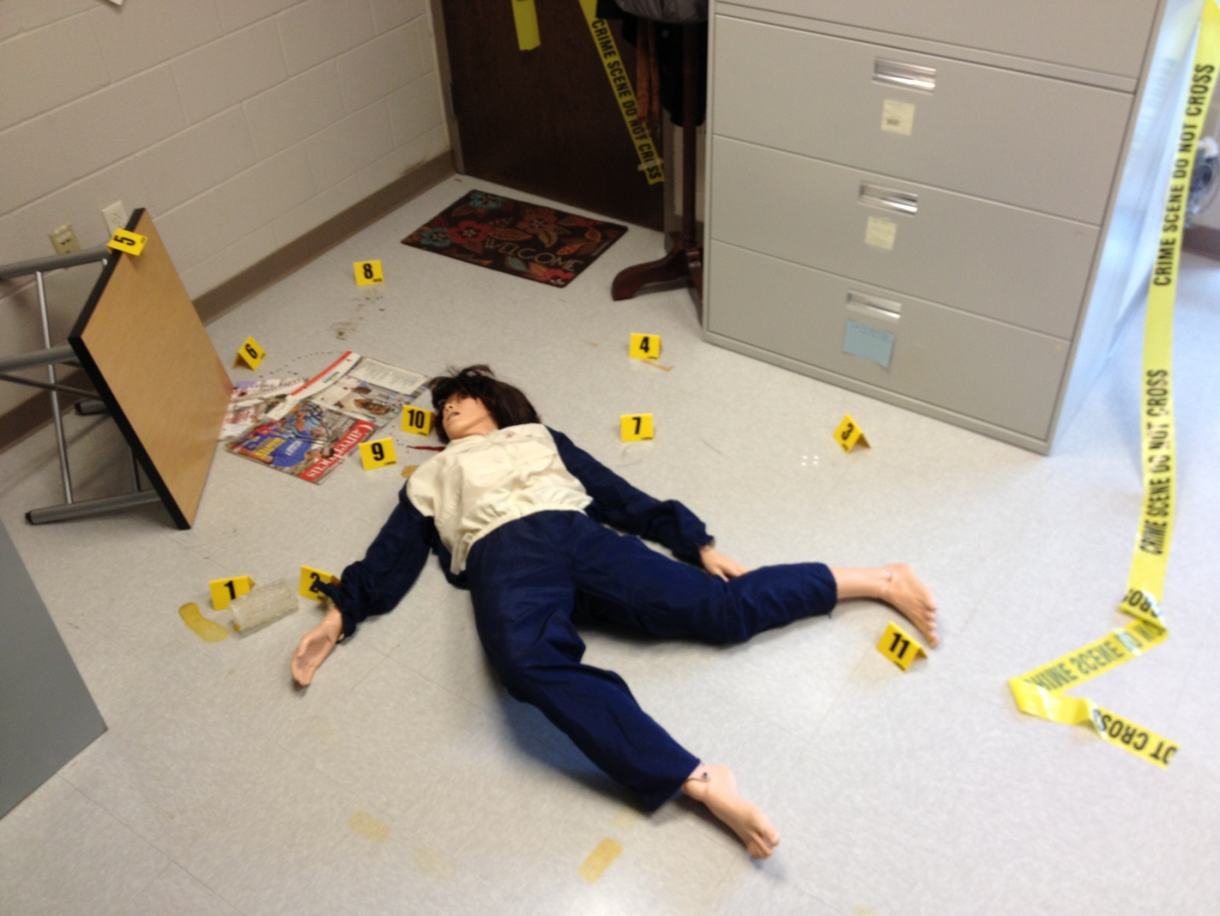
Back to Anna…
Were Anna’s food choices meeting her basic nutritional needs as well as her needs and limitations as a diabetic?
Lets’ discuss!

Slide 63
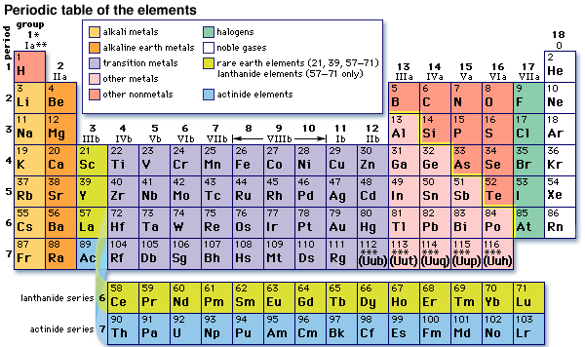
Activity 2.2.3 The Biochemistry of Food

Slide 64
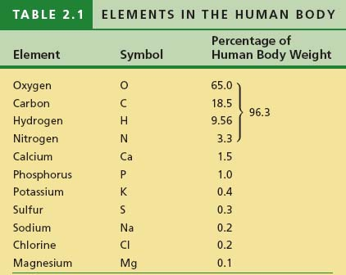
The Bulk of Living Matter:
Carbon, hydrogen, oxygen, and nitrogen
0

Slide 65
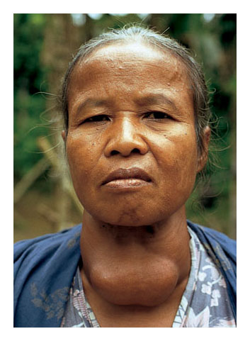
Trace Elements
0
Essential to life
Occur in minute amounts
Common additives to food and water
Dietary deficiencies
Physiological conditions
Ex) iodized salt

Slide 66
Elements Combine to Form Compounds
Compounds-
Chemical elements combined in fixed ratios
0
Sodium
Chlorine
Sodium Chloride
Figure 2.3

Slide 67
Atoms
0
The smallest particle of matter that still retains the properties of an element
Composed of 3 Subatomic Particles
Protons: positive charge
Neutrons: Neutral Charge
Electrons: Negative Charge

Slide 68
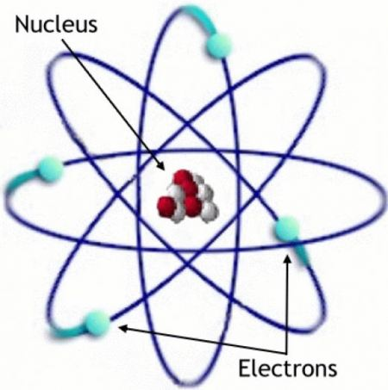
Subatomic Particles
Protons
Positive charge
In a central nucleus
Determine Atomic Number
= to electrons when neutral
neutrons
Neutral charge
In a central nucleus
Electrons
Negative charge
Arranged in electron shells
Surrounding nucleus
Determine ability to bond
= to protons when neutral

Slide 69
Atomic Structure
Outermost electron shell (can hold 8 electrons)
First electron shell (can hold 2 electrons)
Electron
Hydrogen (H)
Atomic number = 1
Carbon (C)
Atomic number = 6
Nitrogen (N)
Atomic number = 7
Oxygen (O)
Atomic number = 8
Periodic Table

Slide 70
0
Atoms whose shells are not full
Tend to interact with other atoms and
Electrons are Transferred (Gain or Lose)
Electrons are Shared
These interactions form chemical bonds
Ionic bonds- e transfer or shift between molecules, results is an ion and attractions (bonds) between ions of opposite charge
Covalent bonds- e sharing, join atoms into molecules (unequally shared= polarity)
Hydrogen bonds- are weak bonds important in the chemistry of life
Form chemical bonds in an attempt to fill their outer shells
With a full outer shell, it has no reason to react with another atom

Slide 71
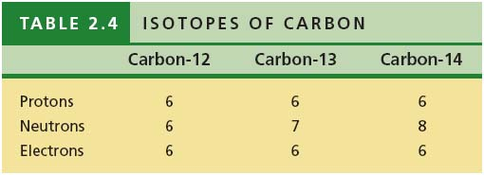
Isotopes
The number of neutrons in an atom may vary
Variant forms of an element are called isotopes
Some isotopes are radioactive
0

Slide 72
Chemical Equations
Chemical equations are “chemical sentences” showing what is happening in a reaction.
Example:
X + Y XY
(reactants) (reacts to form) (product)
What does the equation below mean?
2H₂ + O₂ 2H₂O

Slide 73
Macromolecules
Macromolecules
Nutrients we need
The main nutrients in our food
Large organic molecules that contain carbon
Necessary for life
We will take a much closer look at the structure of the main macromolecules in food

Slide 74
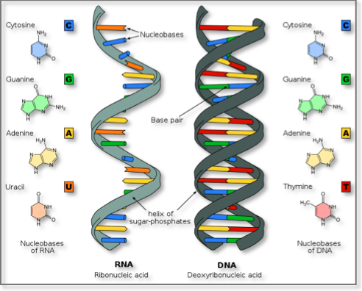
Nucleic Acids
Building Blocks
Nucleotide
Two types of nucleic acids
Deoxyribonucleic Acid (DNA)
Ribonucleic Acid (RNA)
Function
Passing traits from generation to generation
Protein production

Slide 75
Puzzle Rules
Oxygen and hydrogen atoms can bond with anything they fit with. Remember that each snap represents a covalent bond.
A molecule is stable (complete) only if it has no available pegs or slots (Note: proteins are an exception).
Macromolecules are assembled by connecting puzzle pieces of the SAME color and oxygen and hydrogen atoms.
The lettering on the puzzle pieces must be visible and all in the same general direction when assembling the puzzle pieces.

Slide 76
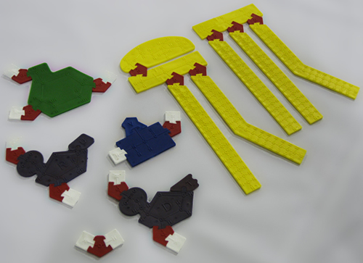
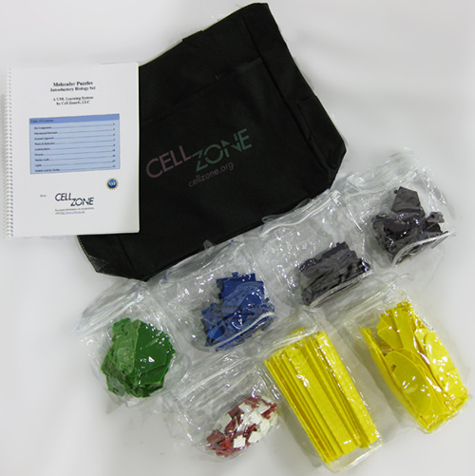
Activity 2.2.3
Complete the Molecular Puzzles
Conclusion Questions
Response Sheet

Slide 77
Name of Macromolecule | Composed of: | Building Block(s): | Function: | Examples:
Carbohydrates | 1 carbon: 2 hydrogen: 1 oxygen | Simple sugars (called monosaccharides – glucose, fructose, galactose, deoxyribose, and ribose) | Provide the body with energy and are easily broken down by the body. | Disaccharides – maltose, sucrose, and lactose. Polysaccharides, also called complex carbohydrates – starch, glycogen.
Proteins | Each amino acid is composed of an amine group (NH₂), carboxyl group (COOH), and a variable group (referred to as a R group) | Amino acids | Build, maintain, and repair the tissues in the body. The proteins you eat are broken down by the digestive system into their component parts and these components are re-assembled into new protein molecules that the body can use. | Enzymes – such as lactase Hormones – such as insulin
Lipids | Hydrogen, carbon, and oxygen | Fatty acids, Glycerol | Make up the cell membrane, provide cell structure, provide insulation, and store energy for the body. | Triglycerides, phospholipids, steroids, and fat-soluble vitamins such as A, E, D and K
Nucleic Acids | Carbon, oxygen, hydrogen, nitrogen, phosphorus | Nucleotides | Stores and carries genetic information. | DNA and RNA

Slide 78
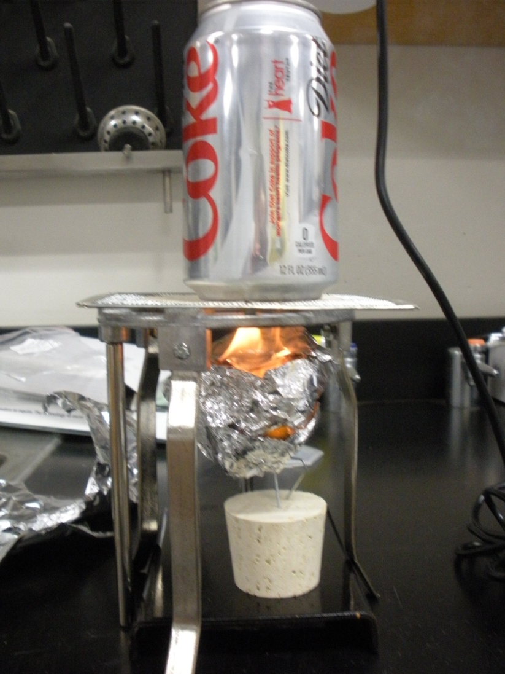
Activity 2.2.4 How much energy is in food?
What is a calorie, and how is it related to food?
Heat= energy
As the food burns…energy is being released
First Law of Thermodynamics Energy can be changed from one form to another, but it cannot be created or destroyed.
Essential Question 2- How is the amount of energy in a food determined?
Key Terms
Chemical Bond
Chemical Reaction
Compound

Slide 79
Using Energy from Food
Everyday actions are powered by the energy obtained from food
Your body disassembles what you eat, bit-by-bit, and captures the energy stored in the molecules that make up the food
Requires multiple body systems working together.
The digestive system
Mechanically
Chemically
Absorbed through the small intestine
Travel via the circulatory system to all the regions of the body
Cells in the tissues of the body capture the energy as the food molecules
Broken into ever smaller molecules with the help of oxygen
Obtained from the respiratory system.

Slide 80
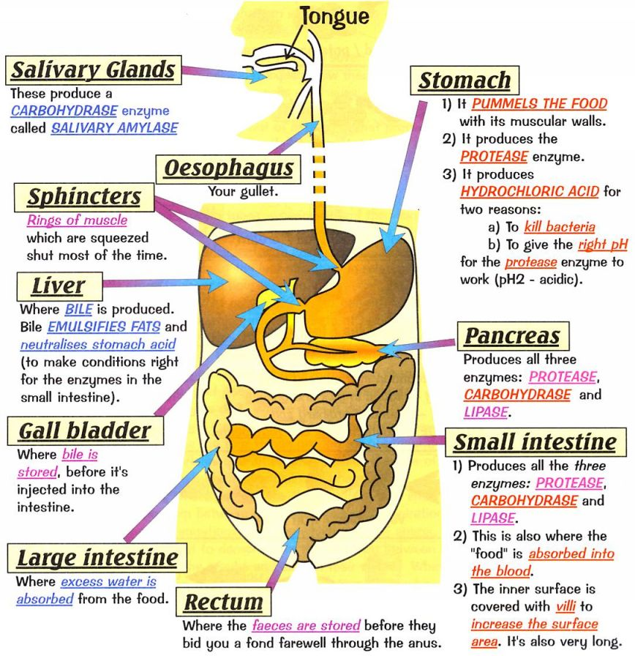

Slide 81
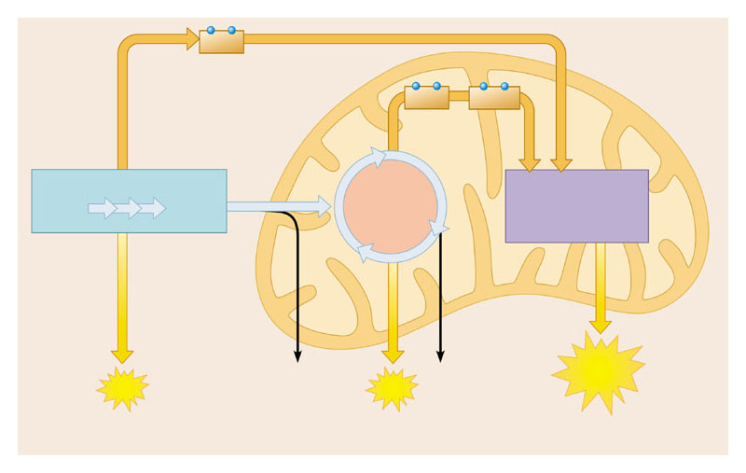
NADH
High-energy electrons carried by NADH
NADH
FADH₂
and
GLYCOLYSIS
CITRIC ACID CYCLE
OXIDATIVE PHOSPHORYLATION (Electron Transport and Chemiosmosis)
Glucose
Pyruvate
Cytoplasm
Mitochondrion
CO₂
CO₂
ATP
ATP
ATP
Substrate-level phosphorylation
Substrate-level phosphorylation
Oxidative phosphorylation

Slide 82
Activity 2.2.4 How much energy is in food?
Labels list the number of calories in a serving of a food
The number of calories is an indication of the amount of energy that a serving of food provides to the body
When referring to food, a calorie is the amount of energy needed to raise the temperature of 1 kg of water 1° C
The number of calories in a piece of food is determined by measuring the increase in temperature of a known volume of water when a portion of the food is burned
This process for measuring the amount of energy in food is called calorimetry

Slide 83
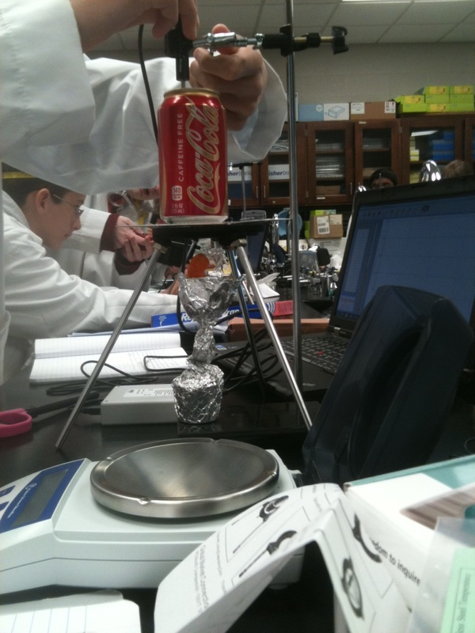
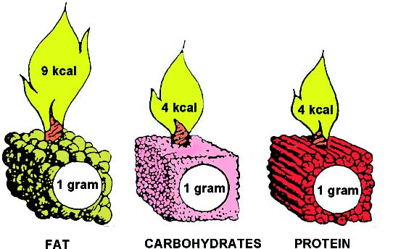
Activity 2.2.4 How much energy is in food?

Slide 84
Activity 2.2.4 How much energy is in food?
Measurements | Sample 1 | Sample 2
Food used
Mass of empty can (g)
Mass of can plus water (g)
Minimum temperature of water (°C)
Maximum temperature of water (°C)
Initial mass of food (g)
Final mass of food (g)

Slide 85
Activity 2.2.4 Math Review
 | Sample 1 | Sample 2
Mass of H2O | 82.30 | 91.90
Change in H2O Temp | 0.08 | 2.30
Change in Food Mass | 0.10 | 1.30
E Gained by water (calories) | 6.58 | 211.37
E food (chem cal/g) | 65.84 | 162.59
E food (food cal/g) | 0.07 | 0.16
Food Energy (joules/g) | 275.61 | 680.61
Food Energy (kilojoules/g) | 0.28 | 0.68
Energy gained by water (chemistry calories) = (mass of water) x (change in temperature) x (specific heat of water)
The specific heat of water is 1 calorie ÷ (1 g x 1°C)= 1.

Slide 86
Activity 2.2.4 Math Review
 | Sample 1 | Sample 2
Mass of H2O | 82.30 | 91.90
Change in H2O Temp | 0.08 | 2.30
Change in Food Mass | 0.10 | 1.30
E Gained by water (calories) | 6.58 | 211.37
E food (chem cal/g) | 65.84 | 162.59
E food (food cal/g) | 0.07 | 0.16
Food Energy (joules/g) | 275.61 | 680.61
Food Energy (kilojoules/g) | 0.28 | 0.68
Energy content of the food sample (chemistry calories) = Energy gained by water ÷ change in mass of food

Slide 87
Activity 2.2.4 Math Review
 | Sample 1 | Sample 2
Mass of H2O | 82.30 | 91.90
Change in H2O Temp | 0.08 | 2.30
Change in Food Mass | 0.10 | 1.30
E Gained by water (calories) | 6.58 | 211.37
E food (chem cal/g) | 65.84 | 162.59
E food (food cal/g) | 0.07 | 0.16
Food Energy (joules/g) | 275.61 | 680.61
Food Energy (kilojoules/g) | 0.28 | 0.68
Calculate the energy content of the food sample in food calories.
1 food calorie= 1000 chem calories (1 km= 1000m)
Chem calorie/1000= food calorie (m/1000=km

Slide 88
Activity 2.2.4 Math Review
 | Sample 1 | Sample 2
Mass of H2O | 82.30 | 91.90
Change in H2O Temp | 0.08 | 2.30
Change in Food Mass | 0.10 | 1.30
E Gained by water (calories) | 6.58 | 211.37
E food (chem cal/g) | 65.84 | 162.59
E food (food cal/g) | 0.07 | 0.16
Food Energy (joules/g) | 275.61 | 680.61
Food Energy (kilojoules/g) | 0.28 | 0.68
Calculate the food energy (joules/g).
One chemistry calorie is equal to 4.186 joules.
E food (chem cal/g) * 4.186= joules/g
Divide by 1000 to get kJ/g

Slide 89
Activity 2.2.4 Math Review
 | Sample 1 | Sample 2
Mass of H2O | 82.30 | 91.90
Change in H2O Temp | 0.08 | 2.30
Change in Food Mass | 0.10 | 1.30
E Gained by water (calories) | 6.58 | 211.37
E food (chem cal/g) | 65.84 | 162.59
E food (food cal/g) | 0.07 | 0.16
Food Energy (joules/g) | 275.61 | 680.61
Food Energy (kilojoules/g) | 0.28 | 0.68
Energy gained by water (chemistry calories) = (mass of water) x (change in temperature) x (specific heat of water)
The specific heat of water is 1 calorie ÷ (1 g x 1°C)= 1.

Slide 90
Review 2.2 Essential Questions & Key Terms
What are the main nutrients found in food?
How can carbohydrates, lipids, and proteins be detected in foods?
What types of foods supply sugar, starch, proteins and lipids?
How can food labels be used to evaluate dietary choices?
What role do basic nutrients play in the function of the human body?
What are basic recommendations for a diabetic diet?
What are the main structural components of carbohydrates, proteins and lipids?
What is dehydration synthesis and hydrolysis?
How do dehydration synthesis and hydrolysis relate to harnessing energy from food?
How is the amount of energy in a food determined?
Adenosine tri-phosphate (ATP)
Amino Acid
Calorie
Carbohydrate
Chemical Bond
Chemical Indicator
Chemical Reaction
Compound
Covalent bond
Dehydration Synthesis
Disaccharide
Element
Glucose
Homeostasis
Hydrolysis
Ionic bond
Lipid
Macromolecule
Molecule
Monomer
Monosaccharide
Nutrient
Polymer
Polysaccharide
Protein

Slide 91
2.3 Essential Questions & Key Terms
What are several ways the life of someone with diabetes is impacted by the disorder?
How do the terms hyperglycemia and hypoglycemia relate to diabetes?
What might happen to cells that are exposed to high concentrations of sugar?
How do Type I and Type II diabetes differ?
What are the current treatments for Type I and Type II diabetes?
What is the importance of checking blood sugar levels for a diabetic?
How can an insulin pump help a diabetic?
What are potential short and long term complications of diabetes?
What innovations are available to help diabetics manage and treat their disease?
Hemoglobin A1c
Hyperglycemia
Hypertonic
Hypoglycemia
Hypotonic
Isotonic
Osmosis
Solute
Solution
Solvent

Slide 92
2.3.1 A Day in the Life of a Diabetic
You will help patients like Anna, confronted with a new diagnosis of diabetes, by designing a “What to Expect” guide
Basic biology of the disease
Insight into a Typical Day
Daily routines
Restrictions
Lifestyle choices and modifications
Coping and Acceptance

Slide 93
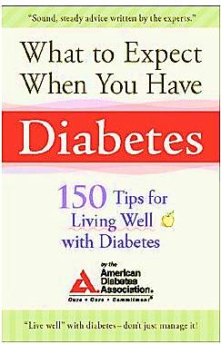
2.3.1 A Day in the Life of a Diabetic
Brainstorm Formats
Read For Inspiration,
Marco’s Story (Type 1)
DJ’s Story (Type 2)
Erica’s Story (Type 1)
Complete & Switch
Update/Complete Venn Diagrams

Slide 94
Diabetic Emergency
You may have touched on these in your guide
What causes a diabetic emergency?
Since her diagnosis, Anna adjusted to checking and regulating her blood sugar with insulin
But on more than one occasion, she lost control of this balance Her body experienced a diabetic emergency.
Read about each of these incidents and connect her symptoms to what was happening with her blood sugar, and consequently, her cells

Slide 95
2.3.2 Diabetic Emergencies
Scenario #1 (Anna, age 16)
On a hot day in August, Anna pushed herself too hard in a soccer game that went into overtime. She felt dizzy, but she wanted to press on for her team. She ate a good meal before the game and took what she felt was the appropriate amount of insulin, but by the end of the game, she was trembling and clammy. Even though she felt weak and her vision was blurry, she stayed on the field with her teammates to celebrate the win. Before she made it back to the bench, she passed out in the arms of a teammate. An ambulance was called and Anna was rushed to the ER. She had a brief seizure in the ambulance.
Scenario #2 (Anna, age 25)
Anna went on vacation with her friends to an all-inclusive resort. Even though she checked her blood sugar frequently, there were times she forgot to bring her supplies with her down to the beach. She allowed herself to splurge on desserts that were not sugar-free. She even had a few glasses of wine. She noticed that she had to go to the bathroom quite often, but she just assumed that was due to the alcohol. She also drank tons of water throughout the day, but attributed her thirst to the heat and humidity. On the 3rd day of the trip Anna felt like she was getting the flu. By the evening, she was confused and disoriented and was beginning to speak incoherently. Anna took more insulin, but her friends took her to the doctor just to be sure she was OK. Luckily, Anna was given IV fluids and sent home after a few hours.
Scenario #3 (Anna, age 29)
At a wedding, Anna knew she would be consuming more food than she normally ate. She took extra insulin before she got there so she did not have to worry about injections during the reception. She figured the ceremony would be short and she could enjoy snacks at the cocktail hour that followed. Unfortunately, the ceremony went longer than expected and she began to feel a bit dizzy. She immediately drank a juice box that was in her purse and she soon felt back to normal. She stopped to check her blood sugar before the reception just to be sure.

Slide 96
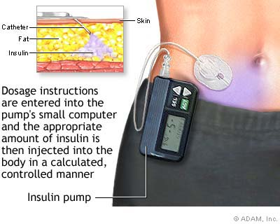
The Good News
Good News
Better treatments
Earlier diagnosis
Proactive early intervention techniques
New Research
But: There is no cure. Yet!
Look at role of:
Food
Macromolecules
Metabolism
Feedback loops
Blood sugar concentration
Insulin

Slide 97
2.3.2 Diabetic Emergencies
In this activity you will use a model of a cell to simulate how the body reacts to varying blood glucose concentrations
First we need some background on cellular regulation: diffusion, active transport and osmosis
Remember:
Plasma membrane is selectively permeable
Phospholipid bilayer
Phospholipids
1 phosphate group and 2 fatty acids
hydrophilic head
hydrophobic tails

Slide 98
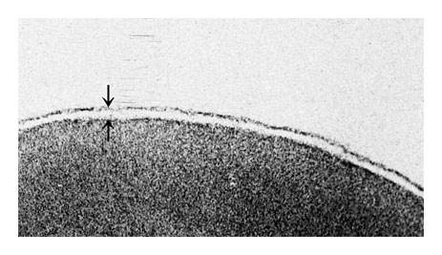
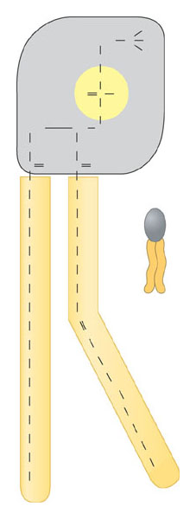
Outside of cell
TEM 200,000 ×
Cytoplasm
Figure 5.10

Slide 99
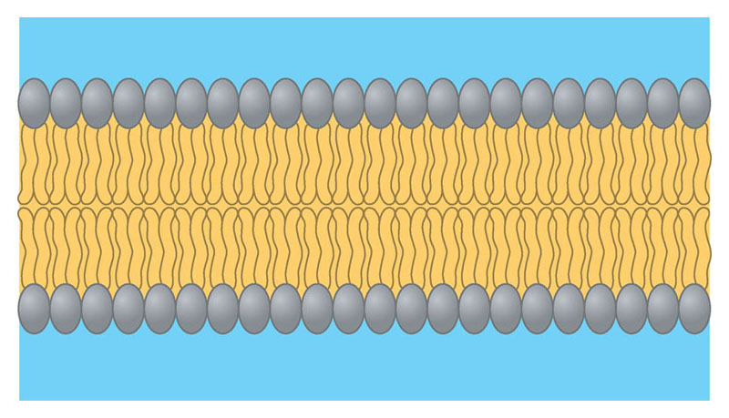
Hydrophilic heads
Water
Hydrophobic tails
Hydrophilic heads
Water
Figure 5.11B

Slide 100
Transport Across Membrane
Diffusion- Passive Transport
Particles spread out evenly in an available space, moving from high concentrated to regions where they are less concentrated
Facilitated Diffusion
Still passive (no energy required) move solutes against a concentration gradient
Requires the help of transport proteins
Osmosis
Diffusion of water from a solution of lower solute concentration to one of higher solute concentration
Active Transport
Transport proteins move solutes against a concentration gradient, requires energy
Exocytosis and Endocytosis
Move large molecules across the membrane

Slide 101
Diffusion
Particles spread out evenly in an available space
Moving from high concentration to low concentration
Concentration Gradient
Travel down concentration gradient until equilibrium is obtained
Multiple substances diffuse independently
Passive transport- substances diffuse through membranes without work by the cell
O₂ and CO₂ move in and out of our red blood cells in our lung
Small, nonpolar molecules diffuse easily
What about large molecules, ions or polar molecules?

Slide 102
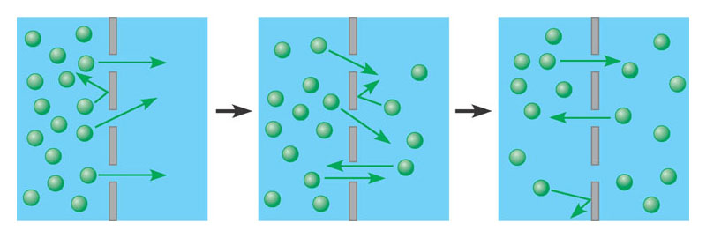
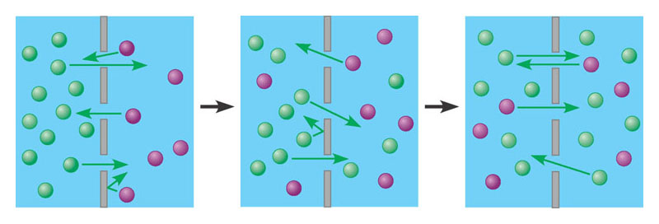
Molecules of dye
Membrane
Equilibrium
Equilibrium

Slide 103
Facilitated Diffusion
Many kinds of molecules do not diffuse freely across membranes
Charge, size, polarity
Require facilitation
Still passive transport- no energy required
Facilitated by transport proteins in 2 ways
Transport protein provides a pore for solute to pass
Transport protein binds to solute, changes shape and releases it on the other side
Solute examples
Sugars, amino acids, ions and water

Slide 104
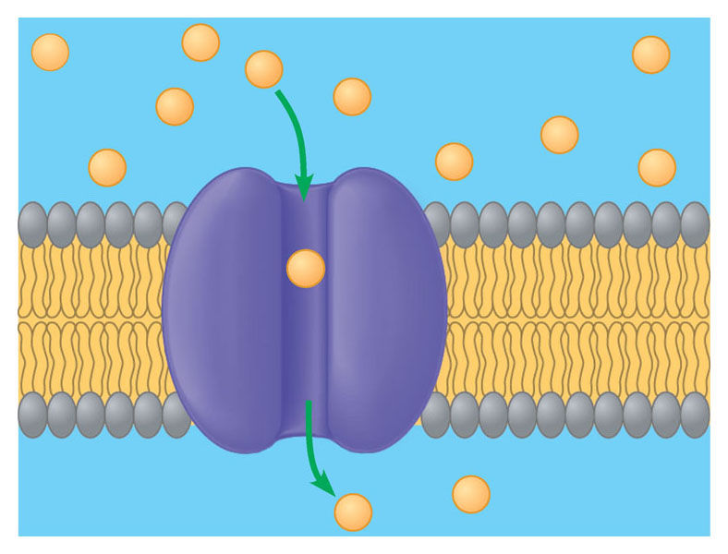
Solute Molecule
Look Familiar?
Transport Protein

Slide 105
Osmosis
DIFFERENT!
NOT about the movement of solute!!!
The diffusion of water across a membrane
Water travels from a solution of lower solute concentration to one of higher solute concentration
Water is used to “balance out” different solute concentrations to equilibrium
“waters down” the side with “too much” solute

Slide 106
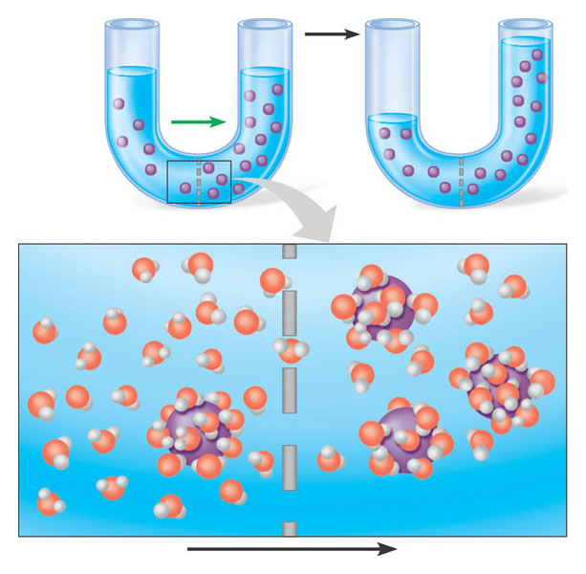
Lower concentration of solute
Higher concentration of solute
Equal concentration of solute
Solute molecule
H₂O
Selectively permeable membrane
Water molecule
Solute molecule with
cluster of water molecules
Net flow of water

Slide 107
Osmosis and Water Balance
Osmoregulation- the control of water balance
Isotonic- solution = in solute concentration to the cell
Hypotonic - solution with solute concentration lower than the cell
Hypertonic- solution with solute concentration greater than the cell
Osmosis causes cells to:
shrink in hypertonic solutions
swell in hypotonic solutions

Slide 108
Isotonic solution
Hypotonic solution
Hypertonic solution
H₂O
H₂O
H₂O
H₂O
Animal cell
(1) Normal
(2) Lysed
(3) Shriveled
H₂O
H₂O
H₂O
Plasma membrane
H₂O
Plant cell
(4) Flaccid
(5) Turgid
(6) Shriveled (plasmolyzed)

Slide 109
Active Transport
Cell work is not ALWAYS about balance
Ex) The cell needs more K+ and less Na+ than its’ external environment (Na+/K+ PUMP) to generate nerve signals
Cells expend energy for active transport
Transport proteins can move solutes against a concentration gradient
To the side with the most solute
requires ATP
Ex) The cell needs more K+ and less Na+ than its’ external environment (Na+/K+ PUMP) to generate nerve signals

Slide 110
Transport protein
P
P
ATP
P
Protein changes shape
Phosphate detaches
Solute
ADP
1
Solute binding
2
Phosphorylation
3
Transport
4
Protein reversion

Slide 111
Exocytosis and endocytosis
Transport large molecules particles through a membrane
Exocytosis- A vesicle may fuse with the membrane and expel its contents
Endocytosis- Membranes may fold inward enclosing material from the outside

Slide 112
Vesicle
Protein

Slide 113
Vesicle forming
Figure 5.19B

Slide 115
2.3.2 Diabetic Emergencies

Slide 116
Activity 2.3.3 Complications of Diabetes
We know rapid shifts in blood sugar can have severe consequences
Many long term consequences of diabetes, especially if the disease is not well-controlled
Effects of Type 1 and Type 2 on various human body systems
You will visualize this impact on a graphic organizer and use information about complications to further analyze details of Anna’s autopsy report

Slide 117
Problem 2.3.4 The Future of Diabetes Management and Treatment
What are the biggest concerns facing diabetics?
Come up with innovation to help diabetics!
You will pitch/present your idea and design to a panel of experts (the members of your class).
You will only have 5 minutes to explain your idea.
Medicines That Backfire presentation on website
Make sure to defend how this innovation would improve the life of a diabetic.

Slide 118
Review 2.3 Essential Questions & Key Terms
What are several ways the life of someone with diabetes is impacted by the disorder?
How do the terms hyperglycemia and hypoglycemia relate to diabetes?
What might happen to cells that are exposed to high concentrations of sugar?
How do Type I and Type II diabetes differ?
What are the current treatments for Type I and Type II diabetes?
What is the importance of checking blood sugar levels for a diabetic?
How can an insulin pump help a diabetic?
What are potential short and long term complications of diabetes?
What innovations are available to help diabetics manage and treat their disease?
Hemoglobin A1c
Hyperglycemia
Hypertonic
Hypoglycemia
Hypotonic
Isotonic
Osmosis
Solute
Solution
Solvent

Slide 119
End of Unit 2
Test Prep and Portfolio Development

