Slide 1
Unit 1.1 Review

Slide 2
What can be done at a scene of a mysterious death to help reconstruct what happened?

Slide 3
Interview witnesses, possible suspects, and known associates
Examine the crime scene for all evidence in an orderly fashion
Sketch the crime scene using a key and scale
Photograph the scene with rulers for size estimation
Collect all evidence

Slide 4
How do the clues found at a scene of a mysterious death help investigators determine what might have occurred and help identify or exonerate potential suspects?

Slide 5
Blood Type
There are four basic blood types
Type A – has A antigens
Type B – has B antigens
Type AB – has A and B antigens
Type O – has no antigens
Blood types can be found by adding antibodies to the blood and seeing if the blood clumps.
Blood will clumps due to the antibody binding to the antigen. Antibodies are specific to each antigen so only B antibodies will bind with B antigens.
Lets look at this animation http://waynesword.palomar.edu/aniblood.htm

Slide 6
Blood Type
Blood Type | Anti-A Serum | Anti-B Serum
O | - (no clumping) | - (no clumping)
A | + (clumping) | - (no clumping)
B | - (no clumping) | + (clumping)
AB | + (clumping) | + (clumping)
Type O does not clump with either antibody because it contains no antigens
Type A clumps only in the presence of A antibodies because it only has A antigens
Type B clumps only in the presence of B antibodies because it only has B antigens
Type AB clumps in the presence of both antibodies because it has both antigens

Slide 7
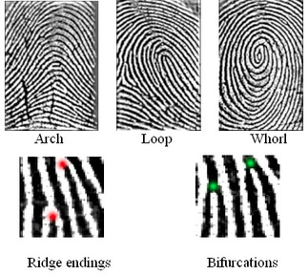
Fingerprints
There are three main patterns you need to understand
Loop
Whorl
Arch

Slide 8
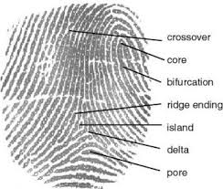
Fingerprints
In order to identify a fingerprint scientists must match minutiae (specific ridge marks) between the crime scene and suspects.

Slide 9
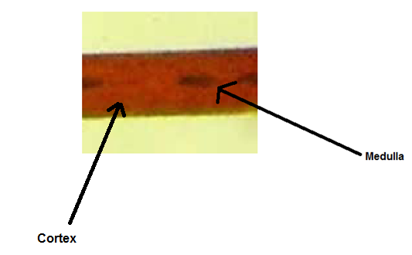
Hair
Hair is made of keratin, a protein found throughout our integumentary system.
It has three layers: Cuticle, Cortex and medulla
Look for distinguishing marks within these three layers.

Slide 10
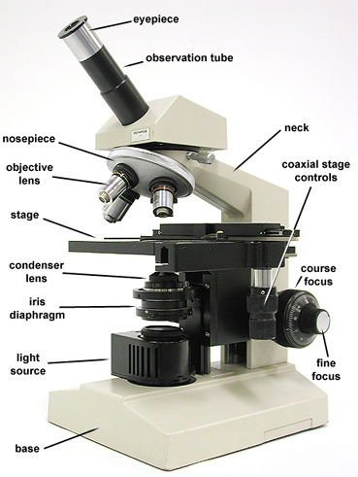
Microscope
Watch the following video to see how to use a microscope correctly

Slide 11
Time of Death
Signs to estimate time of death
Rigor mortis – Tightening of the muscles after death (more on this in HBS)
Algor mortis – Internal temperature cooling
Lividity – Blood pooling
Amount of decomposition
Etomology – study of bugs and when they arrive after death
Factors affecting Algor Mortis
Clothing
Original internal temp
Ambient temperature
Environment
Body size

Slide 12
How do scientists design experiments to find the most accurate answer to the question they are asking?
Example Experiment:
A scientist is studying the affect caffeine on blood sugar in diabetics. The scientist gathers 300 diabetics and half of them drink caffeine every day. The other half do not drink caffeine. They continue this for a month. Blood sugar is measured every day.

Slide 13
Independent variable – What you change or manipulate (Caffeine)
Dependent variable – Outcome or data that is collected (Blood sugar)
Null Hypothesis – A hypothesis that assumes everything will stay the same (Caffeine will have no effect on blood sugar)
Alternative Hypothesis – A hypothesis that describes the outcome that is predicted (Caffeine will affect blood sugar)
Random – Patients should be selected at random (The experimenter chose people with diabetes at random)
Replication – How many times the experiment is repeated (there were 150 participants in each sample)
Standardization – Each group should have the same conditions as each other except for the independent variable. All extraneous variables should be controlled and kept constant between groups. (Each group should have the same type of diabetes, same diet, and same physical activity)
Control – There needs to be control group for the experimental group to be tested against. (The control was people without caffeine.)
Negative control – Nothing should happen to this group (the people without caffeine is a negative control)
Positive control – a group used to show what a positive result looks like

Slide 14
How are bloodstain patterns left at a crime scene used to help investigators establish the events that took place during a crime?

Slide 15
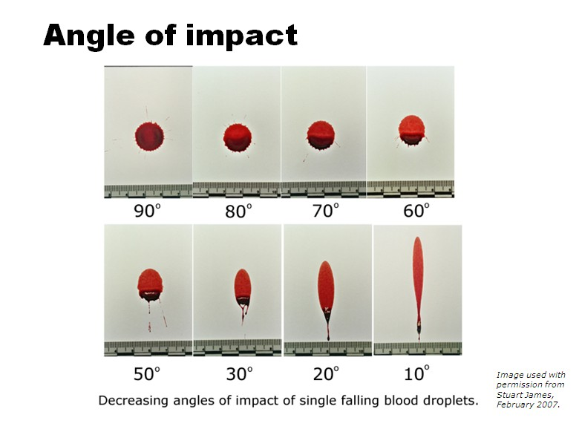
Things that affect blood spatter patterns
Force
Height
Amount of blood
Angle
Objects in the way
How close the victim
is to the perpetrator

