Slide 1
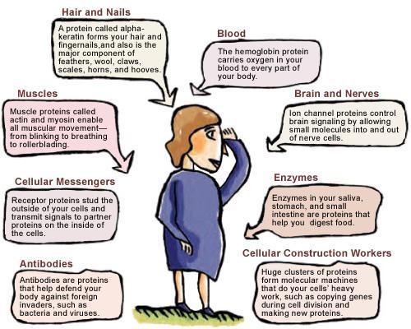
Protein Synthesis (Gene Expression) Notes
Proteins (Review)
Proteins make up all living materials

Slide 2
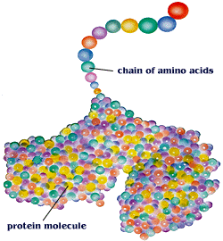
Proteins are composed of amino acids – there are 20 different amino acids
Different proteins are made by combining these 20 amino acids in different combinations

Slide 3
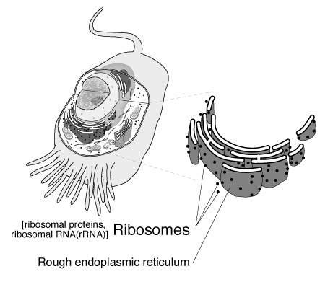
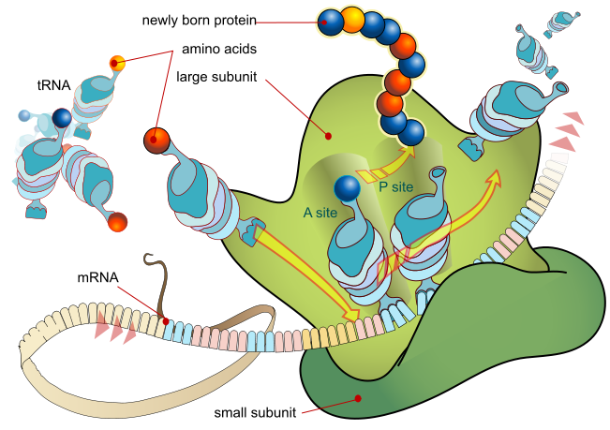
Proteins are manufactured (made) by the ribosomes

Slide 4
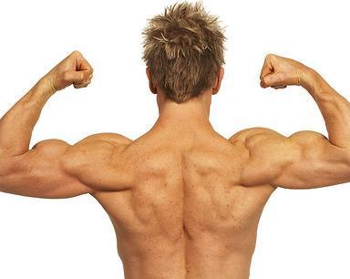
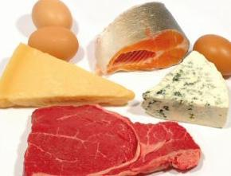
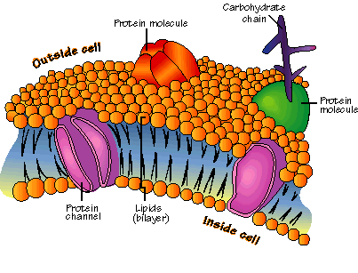
Function of proteins:
Help fight disease
Build new body tissue
Enzymes used for digestion and other chemical reactions are proteins
(Enzymes speed up the rate of a reaction)
4. Component of all cell membranes

Slide 5
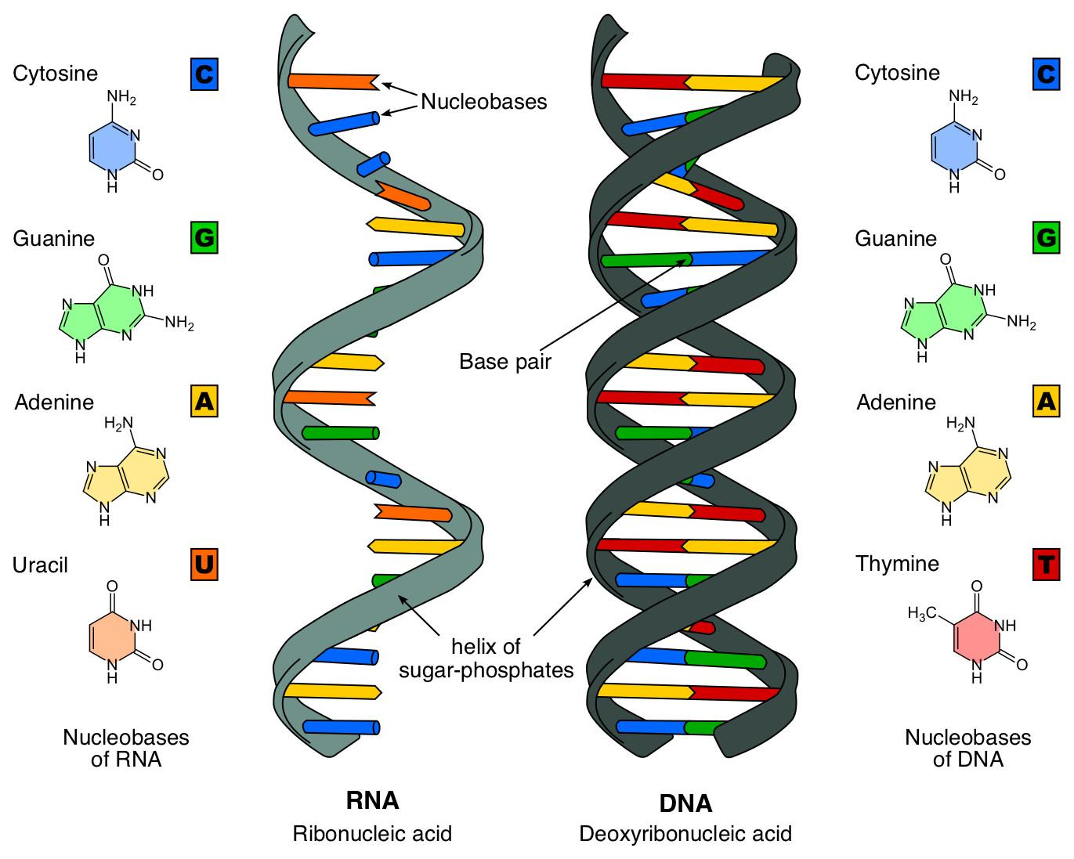
RNA Vs. DNA

Slide 6
Making a Protein—Transcription
First Step: Copying of genetic information from DNA to RNA called Transcription
Why?
DNA has the genetic code for the protein that needs to be made.
proteins are made by the ribosomes—ribosomes are outside the nucleus in the cytoplasm.
DNA is too large to leave the nucleus (double stranded), but RNA can leave the nucleus (single stranded).

Slide 7
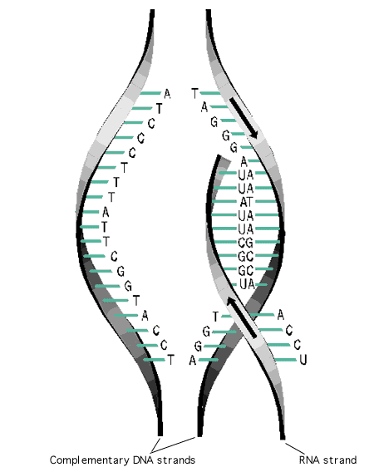
Part of DNA temporarily unzips and is used as a template to assemble complementary nucleotides into messenger RNA (mRNA).

Slide 8
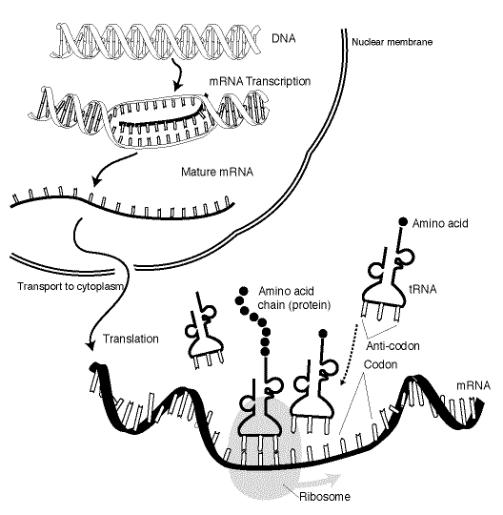
mRNA continues to copy nucleotides until it reaches the Termination sequence of the gene it is copying.
mRNA then goes through the pores of the nucleus with the DNA code and attaches to the ribosome.

Slide 9
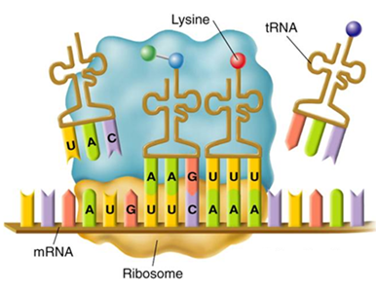
Making a Protein—Translation
Second Step: Decoding of mRNA into a protein is called Translation.
Transfer RNA (tRNA) carries amino acids from the cytoplasm to the ribosome.

Slide 10
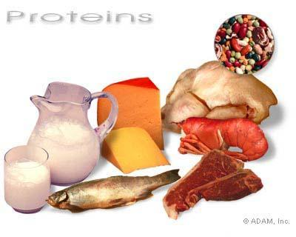
These amino acids come from the food we eat. Proteins we eat are broken down into individual amino acids and then simply rearranged into new proteins according to the needs and directions of our DNA.

Slide 11
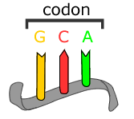
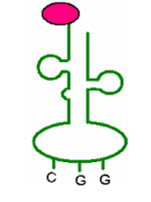
A series of three adjacent bases in an mRNA molecule codes for a specific amino acid—called a codon.
A triplet of nucleotides in tRNA that is complementary to the codon in mRNA—called an anticodon.
Each tRNA codes for a different amino acid.
Amino acid
Anticodon

Slide 12
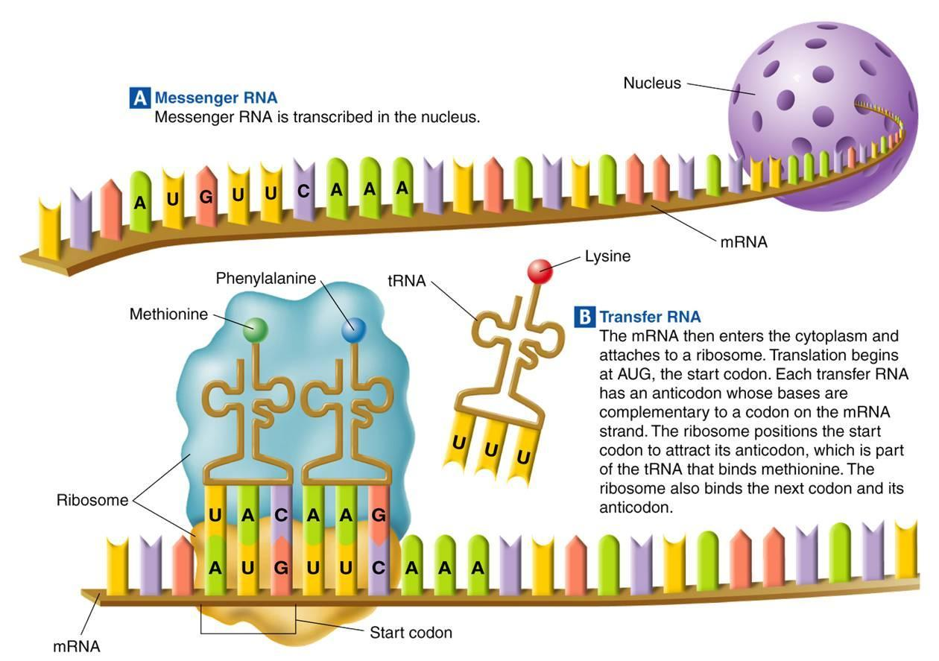
mRNA carrying the DNA instructions and tRNA carrying amino acids meet in the ribosomes.

Slide 13
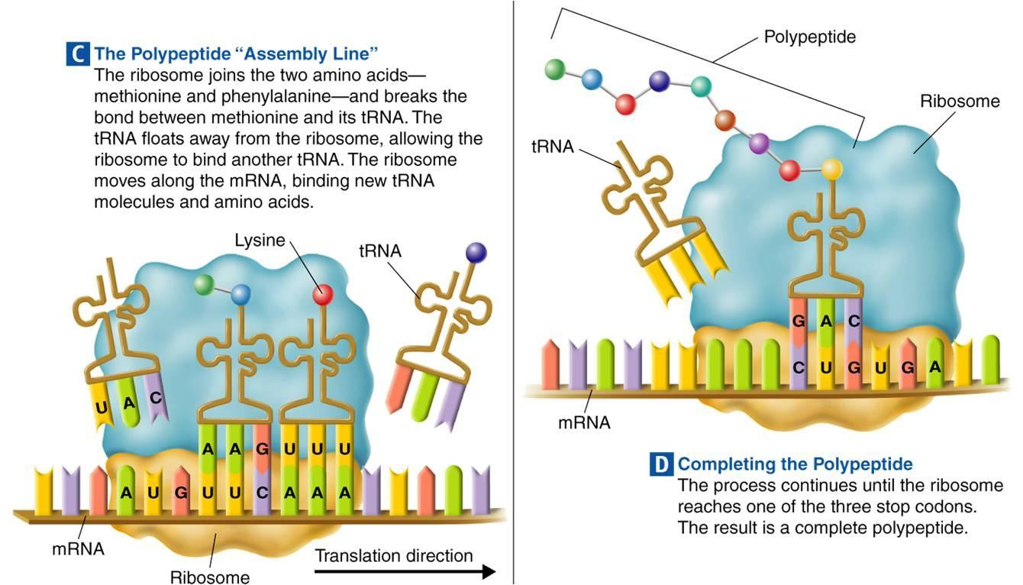
Amino acids are joined together to make a protein.
Polypeptide = Protein

Slide 14
Use one of the codon charts on the next page to find the amino acid sequence coded for by the following mRNA strands.
CAC/CCA/UGG/UGA
___________/___________/___________/____________
AUG/AAC/GAC/UAA
___________/___________/___________/____________

Slide 15
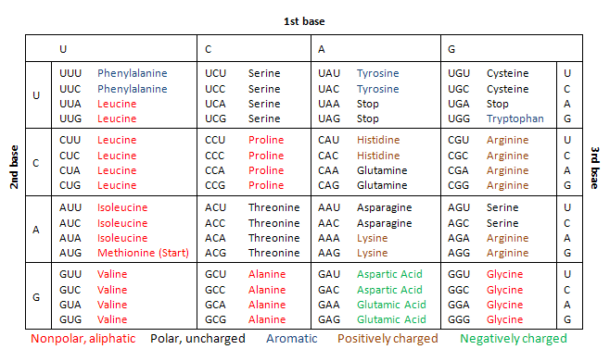
CAC/CCA/UGG/UGA
___________/___________/___________/____________
Histidine
Proline
Tryptophan
Stop
2nd Base
1st Base
3rd Base

Slide 16
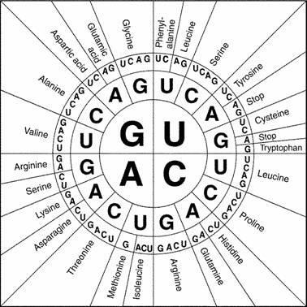
AUG/AAC/GAC/UAA
___________/___________/___________/____________
Methionine
Asparagine
Aspartic Acid
Stop

Slide 17
Protein Synthesis

Slide 18
