Slide 1
Anna Garcia

Slide 2
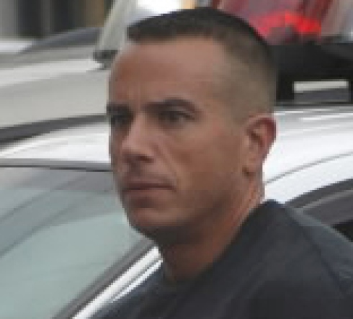
Alex Garcia
Alex is Anna’s former husband.
Alex and Anna went through a nasty divorce last year. As soon as the divorce was finalized, Alex quickly remarried a much younger woman.
Alex and his new wife are currently expecting a baby.
Alex is rumored to be having financial difficulties and is still the beneficiary on Anna’s life insurance plan.
Alex last saw Anna last night when he went to her house to discuss some paperwork.

Slide 3
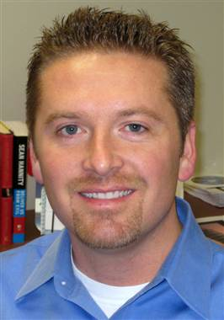
Doug Greene
Doug is Anna’s neighbor and friend who called the police.
Doug last saw Anna when she was walking her dog at 6:30am yesterday morning.
Doug reports that Anna usually walks her dog every morning, but that recently she’s been skipping the morning walk. He stated that Anna lives alone, has no family that lives close by, and her closest companion is her dog.
Doug and Anna recently were involved romantically, but Anna abruptly ended the relationship last week.

Slide 4
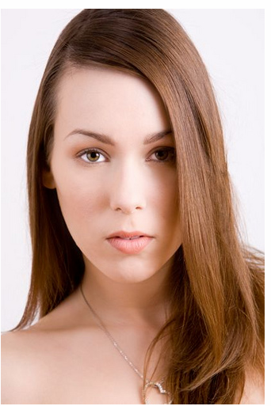
Erica Piedmont
Erica is the new wife of Alex Garcia.
Reported that Erica was seen sitting in a car parked on the street in front of Anna’s house the day before her death.
Erica and Alex were seen at a local diner recently having a heated argument.

Slide 5
Lucy Leffingwell
Anna’s best friend and co-owner of a local bakery.
Business has been doing very well lately, but Anna and Lucy have been arguing over whether or not to expand the business and create a sugar-free line of products. Lucy really wants to expand, but Anna refuses.
Last saw Anna at work yesterday. Anna left work a little early because she said she had something to take care of.
Lucy has been debating whether or not to buy Anna out of her half of the business. The conflict with their business arrangement has caused a lot of strife in their friendship.
Lucy mentioned that Anna had been in the hospital recently, but assumed that she was feeling better as Anna told her that she was no longer taking the antibiotics prescribed to her. Anna did however note that she had been experiencing back pain radiating towards her sides.

Slide 6
Anna’s Dog

