Slide 1
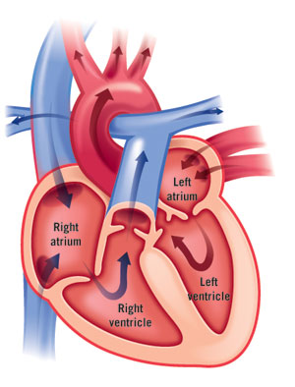
4.2 The Heart at Work
By Hunter Weller

Slide 2
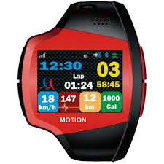
In what ways can technology be used to collect and analyze cardiovascular data?
There are many ways that technology can help to find cardiovascular data.
EKG (Electrocardiogram) it records your heart’s electrical activity
Blood Pressure Cuff : a blood pressure cuff measures the pressure of blood on the arterial walls
Heart rate monitor: The heart rate monitor measurers your heart’s beats per minute

Slide 3
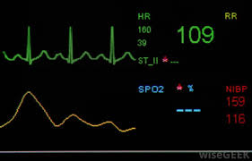
Why is it important to monitor the rate at which the heart beats?
Its is important that way you can tell if you heart is beating correctly.
You want to know if you heart is beating correctly and that you don’t have any abnormalities
By taking you pulse you can tell if your heart rate is normal or not

Slide 4
What factors can influence heart rate?
Your heart rate can tell you many different things.
Exercise is a big thing that can influence your heart rate. The more you exercise the better your heart rate will be.
Caffeine influences your nervous system to make your heart work harder therefore pumping quicker.

Slide 5
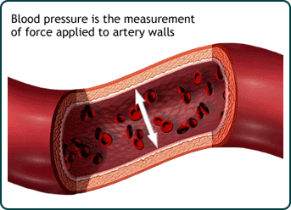
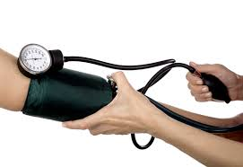
What is blood pressure?
Blood pressure measurement of force
applied to artery walls

Slide 6
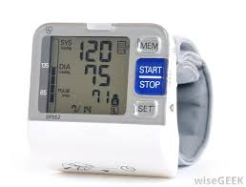
How do systolic and diastolic blood pressure values relate to the movement of blood in arteries?
Diastolic: Pressure that is exerted on the walls of varies arteries throughout the body in between heart beats.
Systolic: The amount of pressure that is exerted on the arteries and vessels while the heart is beating.

Slide 7
What factors can influence blood pressure?
Poor diet
Lack of proactivity
Smoking
Consuming too much alcohol
Weight

Slide 8
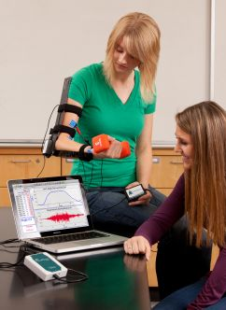
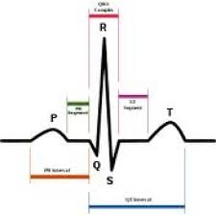
What is an EKG?(ELECTROCARDIOGRAM)
An EKG is a test that is done to see how the electricity of the heart is working. From the firing of the p wave to the ventricles contracting in qrs, to repolarization of the ventricles in t wave.
It can help doctors see how every thing is working like if you have a abnormal heart beat then you might get a EKG

Slide 9
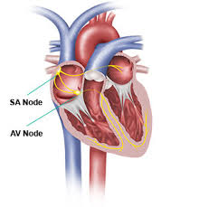
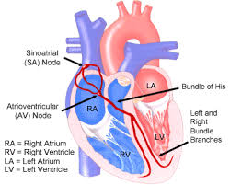
How can an EKG be used in the diagnosis and treatment of heart disease?
It can bee used to make sure that the SA node and everything else is working together. If your sa node does not work you will need a pacemaker

