Slide 1
HBS

Slide 2
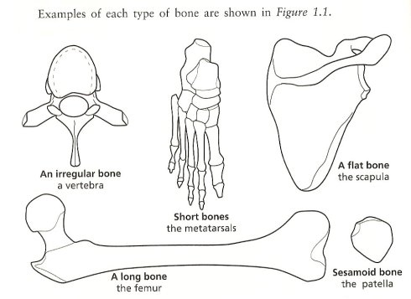
4 Types of Bones
The 206 bones are divided into 4 types based on their form.

Slide 3
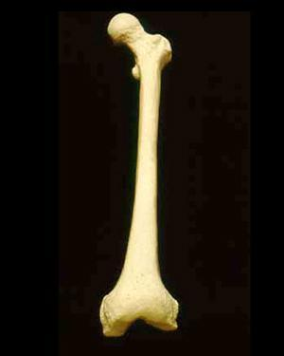
Long Bones
Long Bones - constructed for weight - bearing and movement.
Examples are the femur and the humerus

Slide 4
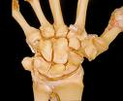
Short Bones
Short Bones - make flexible movement possible
Examples are wrist bones (carpals) and foot bones (tarsals)

Slide 5
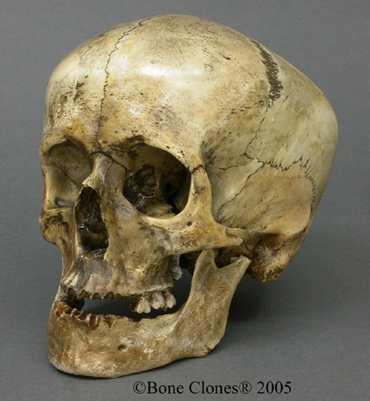
Flat Bones
Flat Bones - these bones help provide organ protection and are important sites for hemopoiesis (blood cell formation.)
Examples are skull bones, sternum, and ribs.

Slide 6
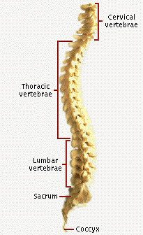
Irregular Bones
Irregular Bones - odd shapes that do not fit into the other three categories
They have unique shapes related to their function
Examples are the vertebrae and the ear bones.

Slide 7
Tissue Structure of Bones
There are two major types of bone based on their
histological (tissue) structure:
. Compact or Cortical Bone - mostly solid bone matrix and cells with few spaces.

Slide 8
Tissue Structure of Bones
Spongy or Cancellous bone - has many
spaces within a lacy network of bone.

Slide 9
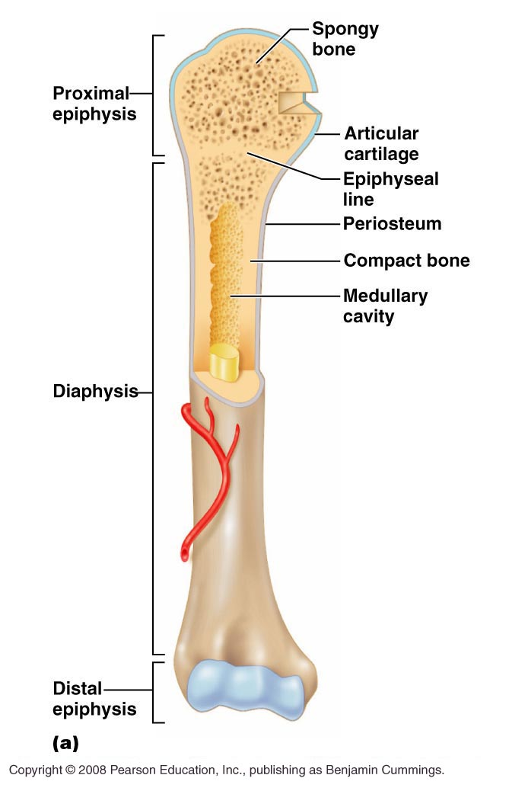
Long Bones
Long bones are hollow and shaped
like rods or shafts with rounded end

Slide 10
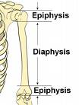
Parts of the Long Bone
Diaphysis
Also called the “shaft”
Mostly compact or cortical bone.
Strong yet light enough in weight to permit easy movement

Slide 11
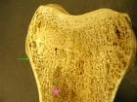
Parts of the Long Bone
Epiphysis
Mostly spongy or cancellous bone
Has many spaces filled with red bone marrow which produces red and white blood cells

Slide 12
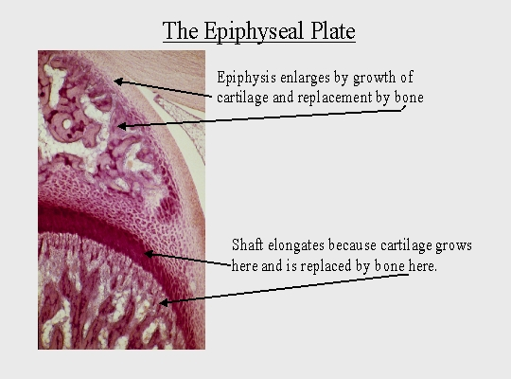
Parts of the Long Bone
Epiphyseal Plate
Cartilage between the epiphyses and the diaphysis
Site of growth in bone length
Growth ceases when all epiphyseal cartilage is transformed into bone.

Slide 13
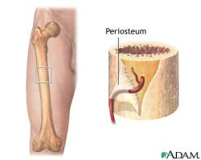
Parts of the Long Bone
Periosteum
“Peri” means around
and “osteum” means bone
Tough, white, vascular,
fibrous membrane on the outside of a bone
Contains blood vessels, lymph vessels, and nerves
Responsible for bone growth, bone repair, and nutrition.
If periosteum is removed
bone will die

Slide 14
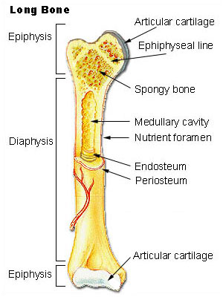
Parts of the Long Bone
Endosteum
“Endo” means within and “osteum” means bones
Membrane within the bone that lines the medullary cavity
Osteoclasts (tear down bones) are located in this cavity. They dissolve bone to keep the cavity

Slide 15
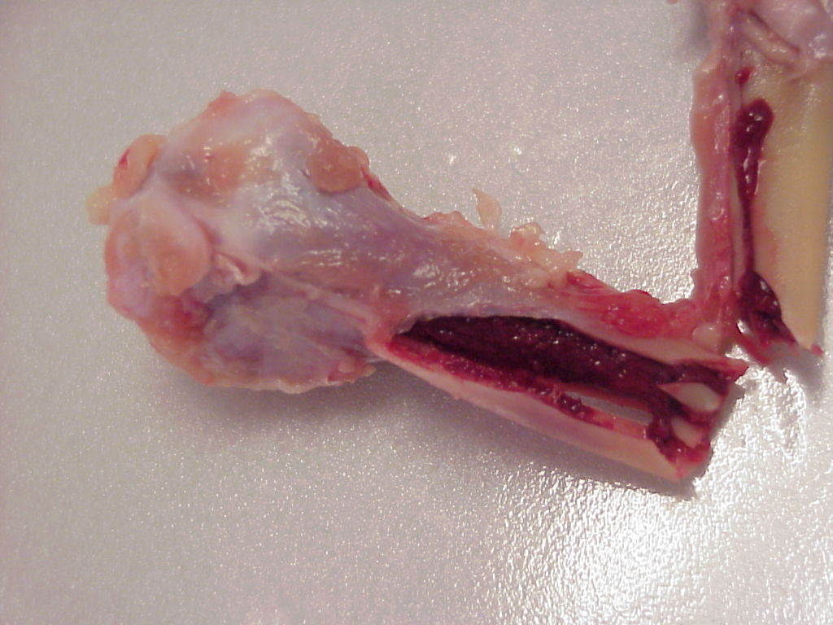
Parts of the Long Bone
. Medullary Cavity
Hollow space or cavity inside the diaphyses of the bone that contains the yellow bone marrow
Yellow marrow started out as red marrow, but gradually turns to fat cells in long bones
These fat cells can be converted to energy when needed
Some WBC’s are made here

Slide 16
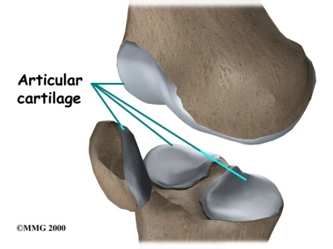
Parts of the Long Bone
Articular Cartilage
Thin layer of cartilage covering each epiphysis
Acts like a shock absorber between bones

Slide 17
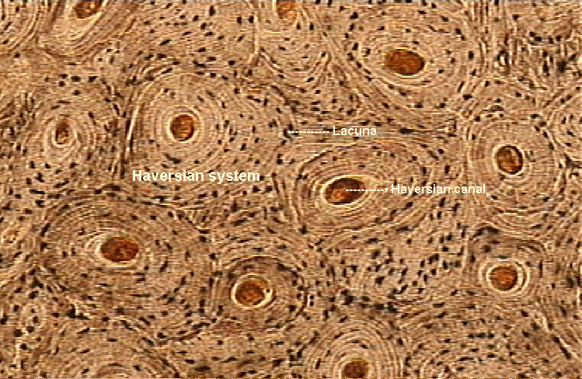
Parts of the Long Bone
Haversian System (HC)
Circulatory system within bone
Contains blood vessels that run parallel to the long axis of the bone
Provides nutrients to the osteocytes (OC) and removes waste.

Slide 18
[Dense bone is called compact bone and porous bone is called:]
[Bone marrow]
[Cartilage]
[Spongy bone]
[Soft bone]

Slide 19
[These bones are oddly shaped (like jigsaw puzzle pieces).]
[Long bones]
[irregular bones]
[flat bones]
[short bones]

Slide 20
[The shaft of the long bone is called?]
[Medulla]
[Periosteum]
[Epiphysis]
[Diaphysis]

Slide 21
[The outer covering of the bones is the]
[Cartilage]
[Diaphysis]
[Epiphysis]
[Periosteum]

Slide 22
[When eating a chicken leg, which part of the bone has most of the meat on it?]
[Epiphysis]
[Diaphysis]
[Bone Marrow]
[Endosteum]

