Slide 1
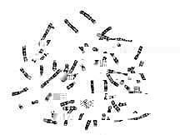
How Do Chromosomes
Carry Information?
Image courtesy of Dr. Sinnamon, Dean College of Arts and Sciences, Southern Wesleyan University
Principles of Biomedical Science

Slide 2
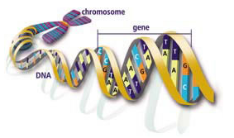
U.S. Department of Energy Human Genome Program http://www.ornl.gov/sci/techresources/Human_Genome/education/images.shtml

Slide 3
Chromosomes – What We Know
Located in the cell’s nucleus
Humans have 23 pairs
Inherit one of each of the 23 types of chromosomes from each parent
Passed to new generation in sperm and egg cells
Inherited diseases are passed to new generation on chromosomes
Composed of DNA

Slide 4
Reproductive Cells and Chromosomes
Chromosomes contain the genetic material
Each reproductive cell (sperm and egg) contains one copy of each of the 23 human chromosomes

Slide 5
Fertilization
Sperm cell (containing 23 chromosomes) fuses with egg cell (containing 23 chromosomes)
The nucleus of the sperm cell is injected into the egg cell
After the sperm fertilizes the egg, a zygote containing 23 pairs of chromosomes (46 total chromosomes) is formed

Slide 6
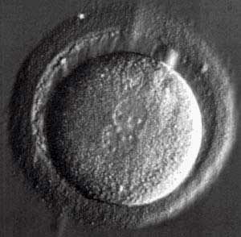
Early Zygote
Nuclei from egg and sperm fusing
Used with the permission of Richard Sherbahn, MD. Advanced Fertility Center of Chicago
http://www.advancedfertility.com/embryos.htm

Slide 7
Chromosome Function
Chromosomes contain the code or instructions for how to make specific proteins which then determine the organism’s traits
The specific instructions for a protein are on sections of the chromosome called genes

Slide 8
What Is a Gene?
A section of DNA that corresponds to a discrete unit of heredity
Generally a gene is the information needed to make a specific polypeptide (chain of amino acids)
Proteins that are a single polypeptide are usually associated with a single gene
Proteins that consist of multiple polypeptides are associated with multiple genes

Slide 9
Chromosomes and Sickle Cell
Chromosome 11 carries the instructions (genes) to make the hemoglobin protein
There are different versions of these genes:
Normal – healthy
Mutated or changed – Sickle cell or other hemoglobin disorder

