Slide 1
Prep for Calorimetry lab

Slide 2
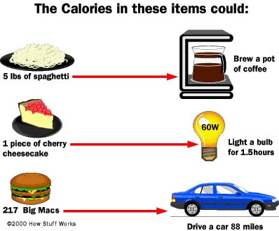
What is a calorie?
Amount of energy needed to raise the temperature of 1 g of water 1 °C (now usually defined as 4.1868 joules)

Slide 3
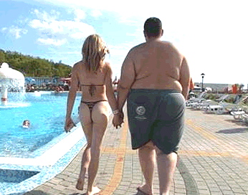
Why do calories matter?
Too few
Too many

Slide 4
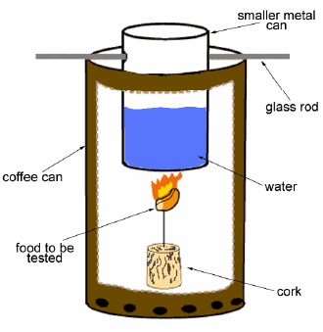
Why is food considered “fuel”?
Food contains ENERGY in the form of CHEMICAL BONDS.

Slide 5
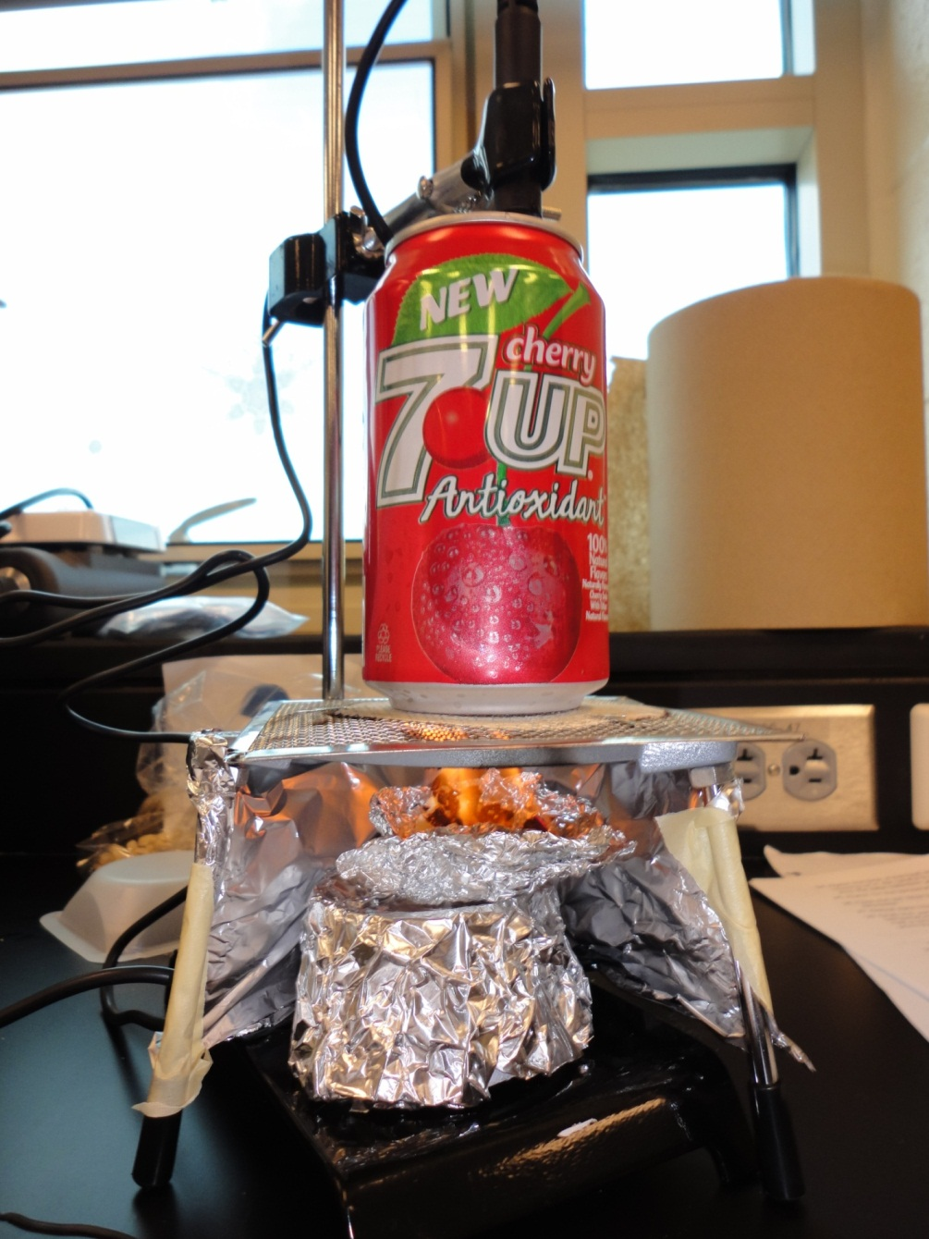
Why does food burn?
When it burns, the bonds are BROKEN, which releases energy in the form of HEAT.

Slide 6
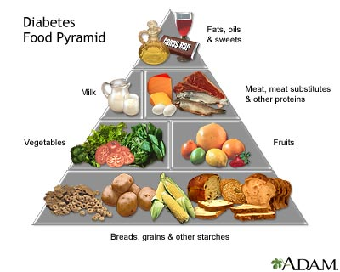
What’s that have to do with diabetes, etc.?

Slide 7
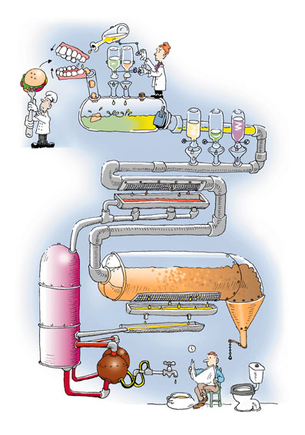
Burning food is just like digesting it, only MUCH quicker!

Slide 8
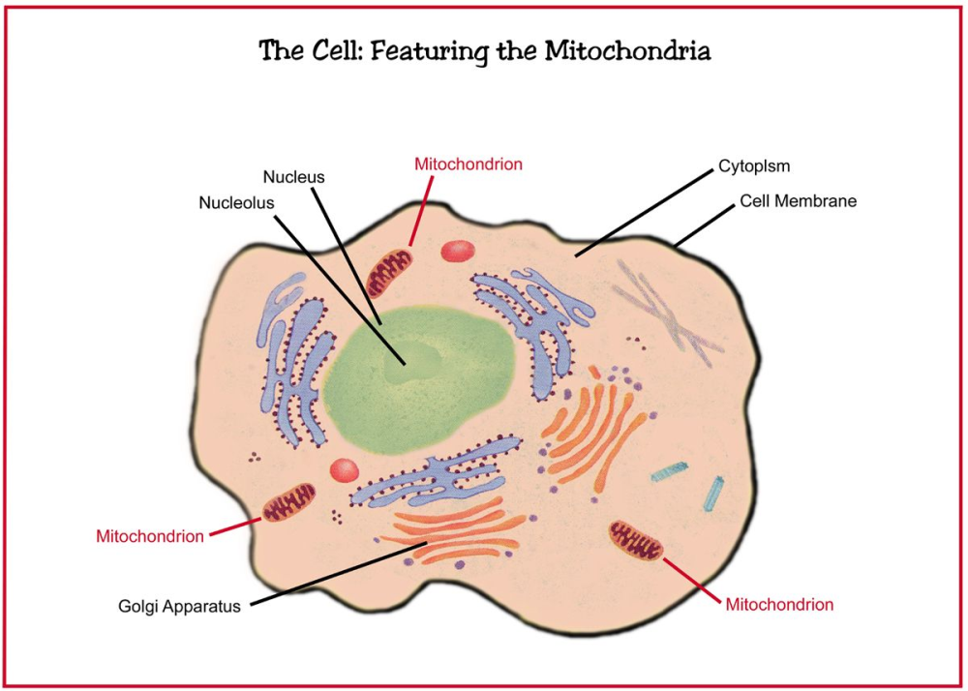
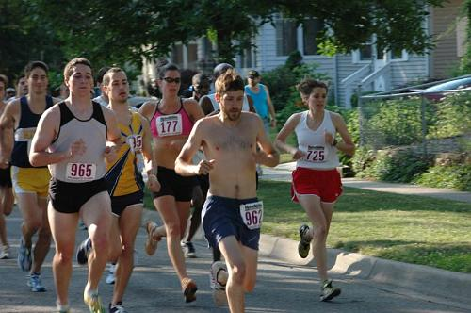
The energy in the food we eat is converted into energy our cells can use, which then allows us to walk, think, see, and talk—just as the energy in gasoline is converted to energy that can run and move the car.

Slide 9
How are calories measured?
…by measuring the increase in temperature of a known volume of water when a portion of the food is burned

Slide 10
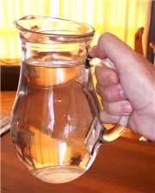
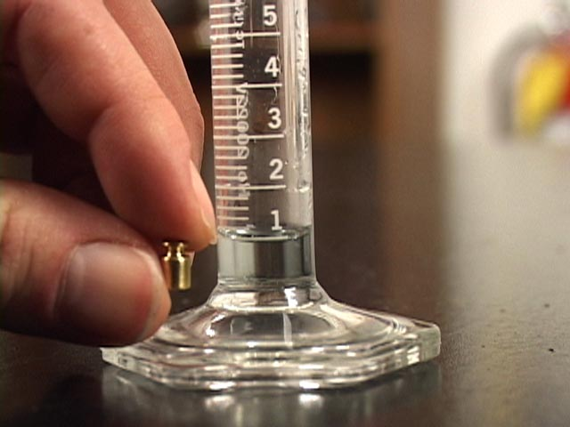
2 kinds of “calories”
A “calorie”
A “Calorie”
the amount of energy needed to raise the temperature of 1 g of water 1° C
Equal to 4.186 joules
the amount of energy needed to raise the temperature of 1 kg of water 1° C
Also called a “food calorie” or “kilocalorie”
1,000 x bigger than a “calorie” (Equal to 4,186 joules)

Slide 11
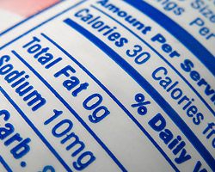
2 kinds of “calories”
A “calorie”
A “Calorie”
What we’ll measure in the lab
The unit used on food labels
What we’ll convert into in the lab

Slide 12
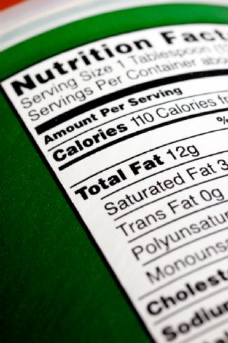
How do we convert from “calories” to “Calories”?!
A “Calorie” is 1,000 x bigger so…
DIVIDE Calories BY 1,000 to get calories

Slide 13
Safety protocols for tomorrow
Safety glasses are REQUIRED when working with fire!

