Slide 1
The Chemistry of Life
Principles of Biomedical Science

Slide 2
Directions
To move forward click the arrow.
Answer questions included in the presentation to help you review key material.
Complete work as indicated in your laboratory journal.

Slide 3
Part I: Chemistry Basics

Slide 4
Why Chemistry?
To understand the chemical reactions that occur in the human body, it is essential to have some knowledge of basic chemistry.
Biochemistry, the study of chemical processes in living organisms, is an important foundation for the biomedical sciences.
So let’s learn a bit of chemistry!

Slide 5
Elements
All matter is made of elements.
There are 117 known elements, of which 92 occur in nature. The other 25 are produced in laboratories and exist for very short periods of time.
You can view the periodic table of elements at http://periodic.lanl.gov/index.shtml

Slide 6
Elements in the Human Body
Four major elements make up 96% of the mass of a human body.
Oxygen
Carbon
Hydrogen
Nitrogen

Slide 7
Elements in the Human Body Copy this chart in your notebook.
Major | Minor | Trace
Oxygen | Calcium | Aluminum
Carbon | Chlorine | Copper
Hydrogen | Iron | Iodine
Nitrogen | Phosphorous | Zinc
 | Potassium
 | Sodium
 | Sulfur

Slide 8
Symbols of Elements
Chemical symbols are often the first letter of the element’s name in upper case form. For example, the symbol for carbon is C.
Because several elements begin with the same first letter, for some elements the first and second letters of the name are used. The second letter is in lower case. For example, the symbol for chlorine is Cl.
Sometimes the Latin version of the element’s name is used. For example, the symbol for iron is Fe from the Latin word Ferrum.

Slide 9
Symbols of Elements
Using the periodic table, write the correct symbol next to the name of each of the elements in the human body you copied into your notebook.
Be careful of upper and lower case letters!
After you have listed the symbols, check your answers with a partner, and go to the next slide.

Slide 10
Atomic Structure
Elements are made of atoms.
An atom is the smallest whole particle of an element.
Atoms have 3 major subatomic particles, and some of these subatomic particles have charges.
Protons - positive charge
Electrons - negative charge
Neutrons - no charge

Slide 11
Atomic Number
The number of protons in an atom determines the atom’s atomic number.
For example, an element with the atomic number 2 has 2 protons, each with a positive charge.
The atomic number determines an element’s placement on the periodic table.

Slide 12
Atomic Charges
The number of protons in an atom is equal to the number of electrons.
Consequently, the number of positive charges equals the number of negative charges, resulting in a net charge of zero.
Therefore, atoms do not have a charge and are considered to be neutral.

Slide 13
Choose One
Let’s practice using atomic numbers to determine atomic structure:
Oxygen has the atomic number 8. Therefore,
Oxygen has 8 protons and 8 electrons.
Oxygen has 16 protons and 8 electrons.
Oxygen has 8 protons and 16 electrons.

Slide 14
Sorry!
Go back and review information about atomic number:

Slide 15
Good Job! Now Let’s Look At Atomic Structure
Protons and neutrons are located in the nucleus, the center portion of the atom.
Electrons are moving in orbits outside the nucleus.
The outermost electrons are called valence electrons.
Oxygen has 6 valence electrons and Carbon has 4 valence electrons.
Valence electrons
Valence electrons
Nucleus with 6 protons and 6 neutrons
Nucleus with 8 protons and 8 neutrons
O
C

Slide 16
Valence Electrons
Valence electrons are very important in chemical reactions.
An atom strives to have a complete outer shell, consisting of eight valence electrons. An atom gains these electrons and completes this octet, or set of eight, by interacting with other atoms.
Note: The exception to this is that hydrogen and helium want 2 electrons in the outer shell.
Atoms form chemical bonds in an attempt to fill their outer shells. If an atom already has a full outer shell, it has no reason to react with another atom.

Slide 17
Valence Electrons
Valence electrons can be transferred from one atom to the valence shell of another atom, or the valence electrons from two atoms can be shared. These interactions form chemical bonds.
When the valence electrons of two atoms are shared, the atoms remain neutral.
An atom can share each of its valence electrons.

Slide 18
Chemical Bonds
Chemical bonds form due to the force of attraction between the atoms.
The stronger the force of attraction, the stronger the bond.
Chemical bonds act like glue.
Bonds vary in strength from very weak to very strong, just as different glues have varying holding strengths – consider a glue stick compared to super glue.

Slide 19
Chemical Bonds
Two or more atoms can join together to form a new unit. The force holding the atoms together is called a chemical bond.
When valence electrons are transferred or shift in location, an ionic bond forms between the atoms. The bond is formed due to the attraction of opposite charges.
When valence electrons are shared between atoms, a covalent bond forms between the atoms. The bond is formed due to the physical sharing of the electrons.

Slide 20
Ionic Bonding
When atoms transfer electrons, they become ions and take on either positive(+) or negative(-) charges.
Example:
Na - 1e⁻ Na+¹ (ion)
( Sodium losing 1 electron) (Sodium ion with +1 charge)
Cl + 1e- Cl⁻¹ (ion)
(Chlorine gaining an electron) (Chlorine ion with -1 charge)

Slide 21
Ionic Bonding
Opposite charges attract and ionic bonds can be formed, creating a compound known as a salt.
Example
The opposite charges on sodium and chlorine attract and complete the octet of each molecule, forming an ionic bond.
Na⁺ + Cl⁻ NaCl (sodium chloride)
Ions Table Salt

Slide 22
Choose One
An atom of potassium (K) may become a potassium ion (K⁺) by:
Losing one electron
Gaining one electron
Losing one proton

Slide 23
Sorry!
Go back and review ions and ionic bonding:

Slide 24
Correct!
Continue on to Covalent Bonding

Slide 25
Covalent Bonds
Electrons are shared between atoms.
Note: Hydrogen, H, only needs 2 electrons in its outer shell.
H
H
Hydrogen Molecule or H₂
H
H

Slide 26
Covalent Bonds
Covalent bonds form between atoms of the same element or between atoms of different elements.
Molecules are formed when two or more atoms are joined together by covalent bonds.
These atoms can come from the same or different elements.
Examples:
O + O O₂
C + H + H + H + H CH₄
atom + atom molecule

Slide 27
Covalent Bonds
If two atoms share a single pair of electrons, a single bond is formed.
If two atoms share two pairs of electrons, a double bond is formed.
Three pairs of electrons can even be shared in a triple bond.

Slide 28
Chemical Reactions
Chemical reactions occur when atoms, molecules, or ions interact. Bonds are either broken or assembled.
Molecules can store energy as potential energy because of the structural arrangement of their atoms.
When molecules consumed in our food, such as carbohydrates, are broken down into smaller molecules, the rearrangement of atoms can cause this energy to be available for cellular work.

Slide 29
Chemical Equations
Chemical equations are “chemical sentences” showing what is happening in a reaction.
Example:
X + Y XY
(reactants) (reacts to form) (product)
What does the equation below mean?
2H₂ + O₂ 2H₂O

Slide 30
Answer
2 H₂ + O₂ 2 H₂O
2 Hydrogen molecules plus 1 Oxygen molecule
react to form 2 molecules of water. The hydrogen and oxygen molecules are the reactants and the water molecules are the products.
Were you correct? If yes, proceed. If not, go back and review or ask for clarification from your teacher.

Slide 31
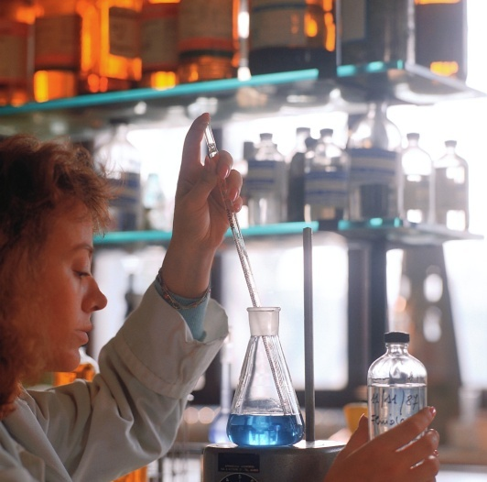
Nice Work!
You now have a basic knowledge of chemistry that you will use in your continued study of the biomedical sciences.
You will now explore the molecules of life in more detail.

Slide 32
Return to Step 3 in Activity
Note: Leave this presentation open as you will return to it shortly

Slide 33
Part II: Macromolecules

Slide 34
The Building Blocks of Life
All life is made up of four main building blocks called macromolecules.
The four types of macromolecules are:
Carbohydrates
Proteins
Lipids
Nucleic Acids

Slide 35
Macromolecules
Macromolecules are large molecules (the word macro means big or large).
With the exception of lipids, macromolecules are also polymers.
A polymer is a large molecule made of many smaller repeating sub-units, called monomers, linked together.
Monomer: A single unit
Polymer: Chain of multiple monomers

Slide 36
Return to Step 10 in Activity
Note: Leave this presentation open as you will return to it shortly

Slide 37
Click on the Puzzle Set that you will be using next:
Puzzle Set #1 – Carbohydrates
Puzzle Set #2 – Proteins
Puzzle Set #3 – Lipids
Nucleic Acids

Slide 38
Puzzle Set #1 – Carbohydrates

Slide 39
Carbohydrates
Carbohydrates are the primary energy source for the human body.
The body can obtain energy from lipids and proteins, but carbs are used first if available
Carbs are easily broken down by the body
The energy stored in carbs is captured and ultimately transferred to another molecule called adenosine triphosphate (ATP)
ATP is the actual energy source for all cell processes including communication, growth, repair, and reproduction

Slide 40
Carbohydrates
All carbohydrates are made up of only three elements: carbon, hydrogen, and oxygen.
All carbs are composed of simple sugars (composed on one monomer) – called monosaccharides.
Examples of monosaccharides:
Glucose – the primary building block of many complex carbohydrates that are essential for our bodies; common sweetener used in foods
Fructose – simple sugar found in many fruits
Deoxyribose – the sugar molecule used to form DNA
Ribose – the sugar molecule used to form RNA

Slide 41
Choose One
. Carbohydrates are mainly used in our bodies for… ?
Structural molecules, such as hair
and fingernails
Building genetic material
Energy storage
Lipid storage

Slide 42
Sorry!
Go back and review Carbohydrates:

Slide 43
Correct!
Continue on to the next slide

Slide 44
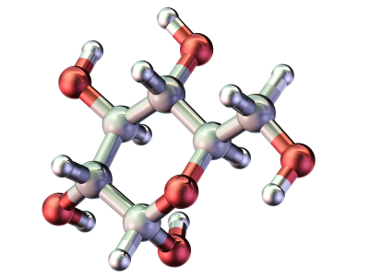
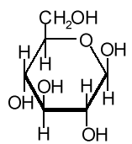
Monosaccharides
Glucose
©iStockphoto.com
Return to Step 15 in Activity
Note: Leave this presentation open as you will return to it shortly

Slide 45
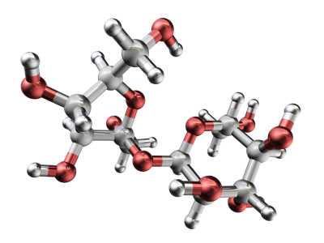
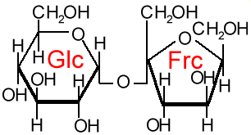
Disaccharides
A disaccharide is a carbohydrate created when two monosaccharides are linked together.
©iStockphoto.com
Examples of disacchardies:
Sucrose – glucose linked to fructose (common table sugar)
Maltose – two linked glucose molecules (sugar used to make malted candy and milkshakes)
Lactose – glucose linked to galactose (sugar found in cow’s milk)
Sucrose
Return to Step 17 in Activity
Note: Leave this presentation open as you will return to it shortly

Slide 46
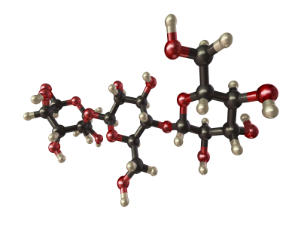
Polysaccharides
A polysaccharide is a carbohydrate created when three or more monosaccharides are linked together (polysaccharides can contains hundreds or even thousands of sugar units bonded together).
Starch
These carbohydrates are referred to as complex carbohydrates.
Complex carbohydrates:
Don’t taste sweet
Are insoluble in water
High energy foods that can be harnessed for energy
©iStockphoto.com

Slide 47
Polysaccharides
Animals, including humans, combine multiple glucose molecules obtained from food to form glycogen.
Glycogen is stored in the liver and muscle tissue to use as an energy source for when the body needs it.

Slide 48
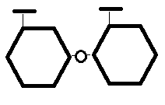
Choose One
. The molecule shown below is a … ?
Disaccharide
Monosaccharide
Complex Carbohydrate

Slide 49
Sorry!
Go back and review Carbohydrates:

Slide 50
Correct!
Continue on and return to Step 25 in Activity
Note: Leave this presentation open as you will return to it shortly

Slide 51
Click on the Puzzle Set that you will be using next:
Puzzle Set #1 – Carbohydrates
Puzzle Set #2 – Proteins
Puzzle Set #3 – Lipids
Nucleic Acids

Slide 52
Puzzle Set #2 – Proteins

Slide 53
Proteins
Are large molecules with many different shapes and structures.
Are the primary structural component of all tissues in humans and all other animals.
Build, maintain, and repair the tissues in the body.
Are highly specialized and have specific purposes in the body.
Structural components
Signal or communication molecules
Enzymes
Transport molecules
Hormones

Slide 54
Proteins
All proteins are composed of amino acids linked together.
All amino acids are composed of:
Amine group (NH2)
Carboxyl group (COOH)
Variable group (referred to as a R group)

Slide 55
Proteins
The bond that holds two amino acids together is called a peptide bond.
Short chains of amino acids, generally containing fewer than 50 amino acids, are referred to as peptides.
Longer chains of amino acids are referred to as polypeptides.
Each protein has its own combination of different amino acids.

Slide 56
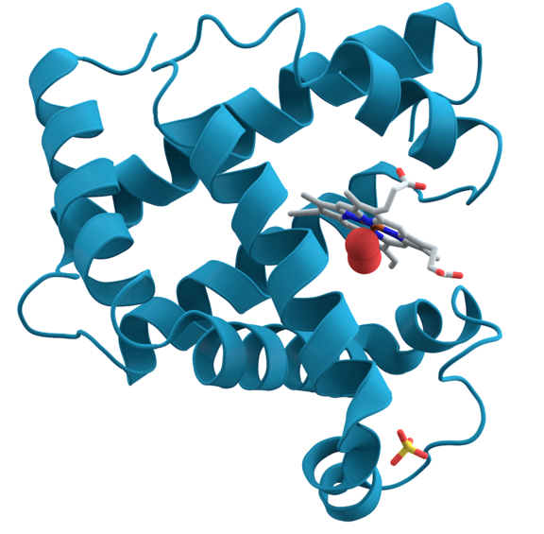
Proteins
http://en.wikipedia.org/wiki/File:Myoglobin.png

Slide 57
Choose One
Proteins are made up of … ?
Fatty acids
Amino acids
Carbohydrates

Slide 58
Sorry!
Go back and review Proteins:

Slide 59
Correct!
Return to Step 31 on the activity document.

Slide 60
Click on the Puzzle Set that you will be using next:
Puzzle Set #1 – Carbohydrates
Puzzle Set #2 – Proteins
Puzzle Set #3 – Lipids
Nucleic Acids

Slide 61
Puzzle Set #3 – Lipids

Slide 62
Lipids
Are made up of fatty acids and glycerol.
Are non-polar (no atomic charges or ions) and hydrophobic (do not dissolve in water).
Are primarily composed of hydrogen and carbon atoms, along with a few oxygen atoms.
Examples:
Triglycerides (commonly referred to as fats and oils)
Phospholipids
Steroids
Fat-soluble vitamins such as A, E, D and K

Slide 63
Lipids
Lipids have many functions in the body.
Triglycerides, fats in the food we eat, store large quantities of energy and can be classified as saturated or unsaturated
Phospholipids are essential for the structure of membranes
Steroid hormones are responsible for cell communication
Vitamin D responsible for bone structure

Slide 64
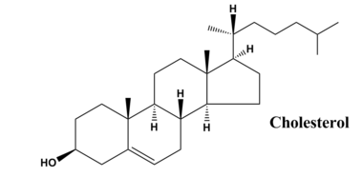
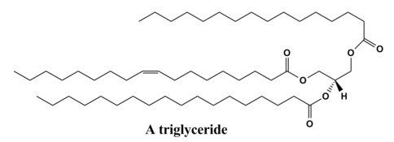
Lipids
All images available from http://en.wikipedia.org/wiki/File:Common_lipids_lmaps.png

Slide 65
Choose One
Which of these is considered to be a lipid?
Fatty acids
Triglycerides
Steroid hormones
All of the above

Slide 66
Sorry!
Go back and review Lipids:

Slide 67
Correct!
Return to Step 45 on the activity document.

Slide 68
Click on the Puzzle Set that you will be using next:
Puzzle Set #1 – Carbohydrates
Puzzle Set #2 – Proteins
Puzzle Set #3 – Lipids
Nucleic Acids

Slide 69
Nucleic Acids

Slide 70
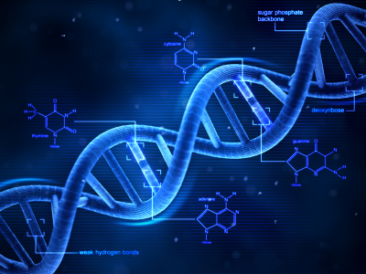
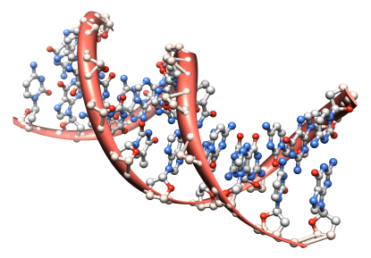
Nucleic Acids
Nucleic acids are composed of carbon, oxygen, hydrogen, nitrogen, and phosphorus atoms
Nucleic acids are made up of nucleotides.
Stores and carries genetic information in the form of DNA and RNA.
©iStockphoto.com

Slide 71
Choose One
DNA is a polymer made of … ?
Fatty acids
Nucleotides
Ribose sugars
All of the above

Slide 72
Sorry!
Go back and review Nucleic Acids:

Slide 73
Correct!
Continue on to the next slide

Slide 74
Nice Work!
You’re done!! Return to Step 61 in Activity

