Slide 1
ACTION POTENTIALS
By: Heidi Hisrich

Slide 2
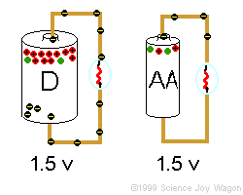
What is electrical potential?
Difference in concentration of charges from one point to another (i.e. flashlight battery has potential of 1.5 V)

Slide 3
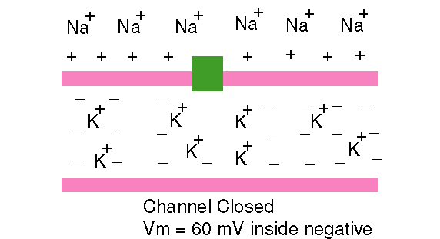
Also called “POLARIZED”
Inside of membrane is more NEGATIVE and outside is more POSITIVE

Slide 4
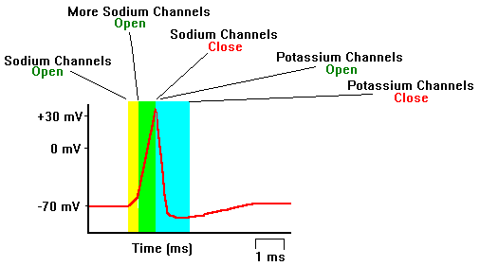
RMP (Resting Membrane Potential) comes from this polarity
RMP of the membrane of an axon is -70mV

Slide 5
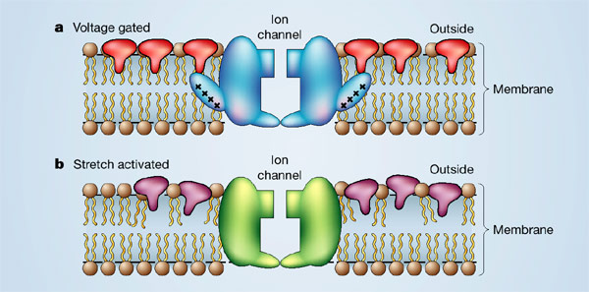
Why it is negative
Potassium has greatest effect on RMP because membrane is most permeable to potassium

Slide 6
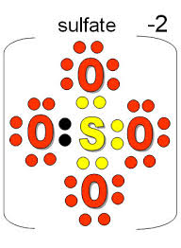
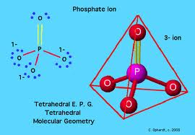
Why it is negative (continued)
Inside the cell are many anions (negative ions) that cannot leave
Phosphates
Sulfates
Organic acids
Proteins
ATP
RNA

Slide 7
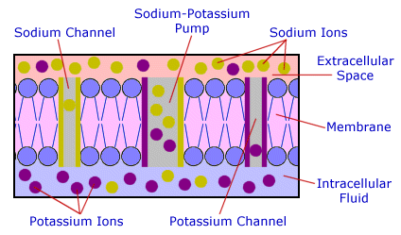
Resting Potential
Sodium is leaking in VERY slowly and potassium out LESS slowly (both try to reach equilibrium of concentration inside and outside the membrane)
BUT… Sodium-Potassium pump works MUCH FASTER, compensating

Slide 8
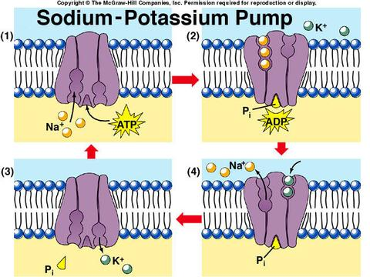
Resting Potential (continued)
Na/K pump pumps OUT
3 Na+ ions
And pumps IN
2 K+ ions

Slide 9
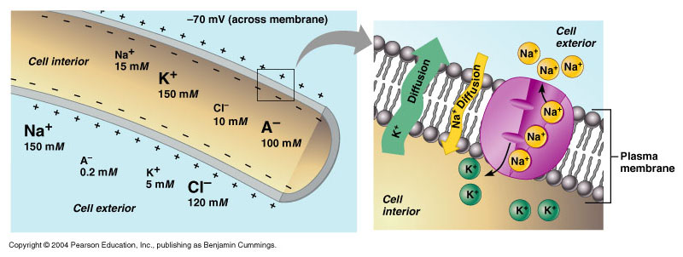
Resting Potential (continued)
The Na/K pump maintains the cell’s POLARITY or RMP at -70 mV by keeping the:
OUTSIDE positive
INSIDE negative

Slide 10
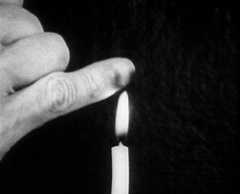
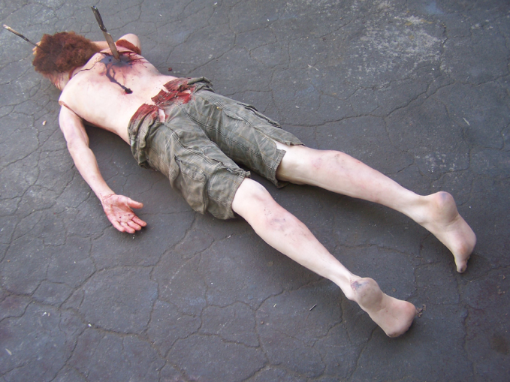
Then what? Neural stimulation!
Neurons can be stimulated by:
Chemicals
Light
Heat
Mechanical distortion of the membrane

Slide 11
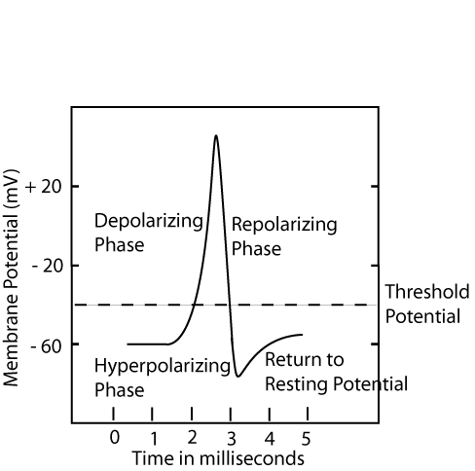
Triggers Depolarization
It’s depolarization ANYTIME the membrane potential moves toward zero

Slide 12
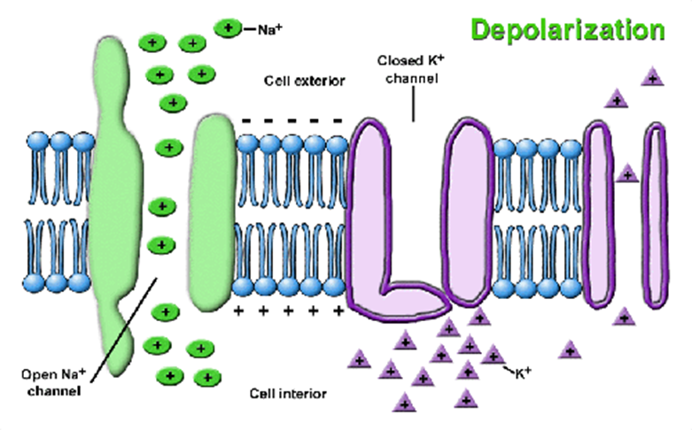
Depolarization
Na+ channels open
Na+ rushes INTO cell
Outside of cell becomes NEGATIVE and inside becomes POSITIVE

Slide 13
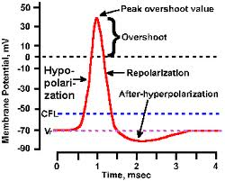
CAN LEAD to an Action Potential
Only an action potential if it gets above zero

Slide 14
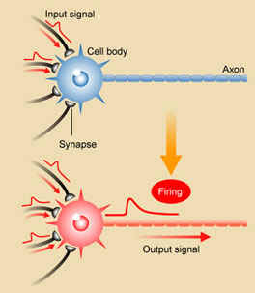
Action Potentials
All or nothing—the nerve fires or it doesn’t

Slide 15
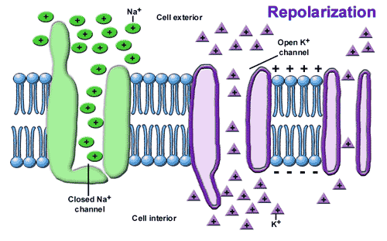
Right after nerve fires--repolarization
Membrane becomes polarized again (RE-polarized)
K+ channels open
K+ rushes OUT OF the cell (to restore concentration equilibrium)
Outside becomes NEGATIVE & inside POSITIVE

Slide 16
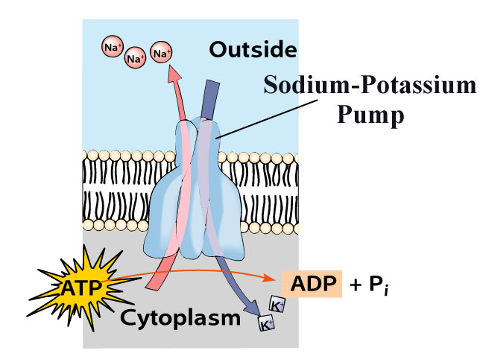
Return to resting potential
To MAINTAIN polarization, the sodium-potassium pump must work CONSTANTLY!!!!

Slide 17
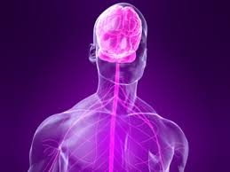
Maintaining resting potential takes WORK!
It takes 70% of the energy requirements of the nervous system

Slide 18
Maintaining resting potential takes WORK!
It takes 1/3 of the body’s total energy!

Slide 19
Learn more here!
Crash Course in the Nervous System

Slide 20
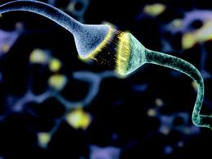
So after a neuron FIRES, what happens?
They have to send the message to the NEXT neuron! So now we’ll learn how that’s done… (continue with 2.2.2.)

