Slide 1
2.1 Diagnosing Diabetes
Quiz Review

Slide 2
Key terms
Glucagon | A protein hormone secreted by pancreatic endocrine cells that raises blood glucose levels; an antagonistic hormone to insulin.
Glucose Tolerance Test | A test of the body’s ability to metabolize glucose that involves the administration of a measured dose of glucose to the fasting stomach and the determination of blood glucose levels in the blood or urine at intervals thereafter and that is used especially to detect diabetes.
Homeostasis | The maintenance of relatively stable internal physiological conditions (as body temperature or the pH of blood) in higher animals under fluctuating environmental conditions.
Hormone | A product of living cells that circulates in blood and produces a specific, often stimulatory, effect on the activity of cells that are often far from the source of the hormone.
Insulin | A protein hormone secreted by the pancreas that is essential for the metabolism of carbohydrates and the regulation of glucose levels in the blood.
Negative Feedback | A primary mechanism of homeostasis, whereby a change in a physiological variable that is being monitored triggers a response that counteracts the initial fluctuation.
Positive Feedback | Feedback that tends to magnify a process or increase its output.
Type 1 Diabetes | Diabetes of a form that usually develops during childhood or adolescence and is characterized by a severe deficiency of insulin, leading to high blood glucose levels.
Type 2 Diabetes | Diabetes of a form that develops especially in adults and most often obese individuals and that is characterized by high blood glucose resulting from impaired insulin utilization coupled with the body’s inability to compensate with increased insulin production.

Slide 3
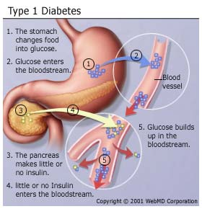
Pancreas is unable to make insulin. Therefore, glucose cannot get into the cells for energy.

Slide 4
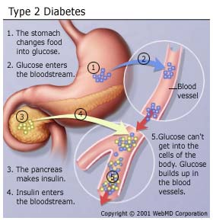
Insulin is made, but cell receptors do not work at getting recognizing that insulin. Therefore, glucose cannot get into the cells for energy.

Slide 5
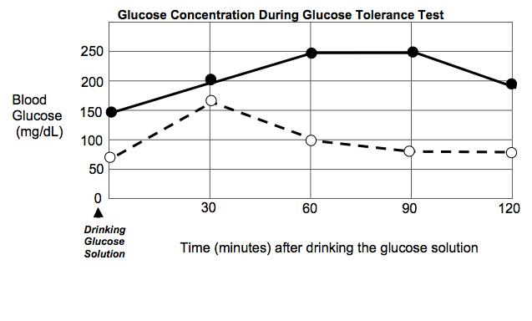
Glucose tolerance testing
Examples:
Solid line: glucose is high and remains high for several minutes after drinking the glucose solution. This patient has diabetes. We cannot tell what type yet, we would have to do insulin testing to determine this.
Dotted line: glucose goes up immediately after drinking the glucose solution and then goes down shortly afterward. This patient does not have diabetes because insulin is bringing their blood glucose levels down, like it should.

Slide 6
Insulin Testing: No Diabetes
Glucose levels remain low while insulin levels are high . After drinking the glucose solution, insulin increases to keep the glucose levels low in the bloodstream.

Slide 7
Insulin Testing: Type 1 Diabetes
High Glucose, very low and no increase to insulin levels. Insulin is not being made in type 1 diabetes.

Slide 8
Insulin Testing: Type 2 Diabetes
Glucose and insulin are both high. The insulin is being made, but the cells do not know how to use it. Therefore, the insulin is not helping lower the blood sugar because it is not allowing the cells to take in the excess glucose.

Slide 9
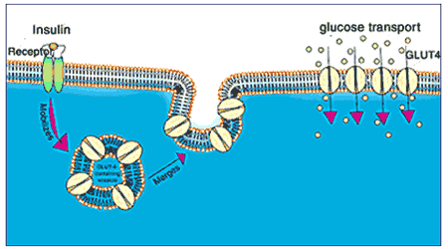
How Does Insulin Help Glucose Enter the Cells?
After eating, the glucose levels increase in the bloodstream.
Insulin is released from the pancreas.
Insulin attaches to insulin receptors on the cell membrane.
This sends a message to the glucose transporters inside the cell to attach its channel proteins into the cell membrane.
Glucose then enters the cell through these transport proteins.

Slide 10
Negative vs. Positive Feedback
The human body maintains homeostasis, a steady state, by monitoring changes in the internal and external environment and feeding this information back to the body so that it can make necessary change. The control of body temperature, heart rate, and the concentration of sugar in the blood are all regulated by these feedback mechanisms or feedback loops. There are actually two types of feedback mechanisms: negative feedback and positive feedback. In this instance, the terms positive and negative do not infer good or bad. Instead, the terms refer to the effect the input of information (feedback) has on the output (action) of the system. Positive feedback causes a reinforcement of the original action, so the input causes the reaction to increase. Negative feedback causes the system to stop doing the original action and to either take no action or to perform an opposite action.

Slide 11
Glucose Feedback Loop

