Slide 1
Brain organization
By Heidi Hisrich

Slide 2
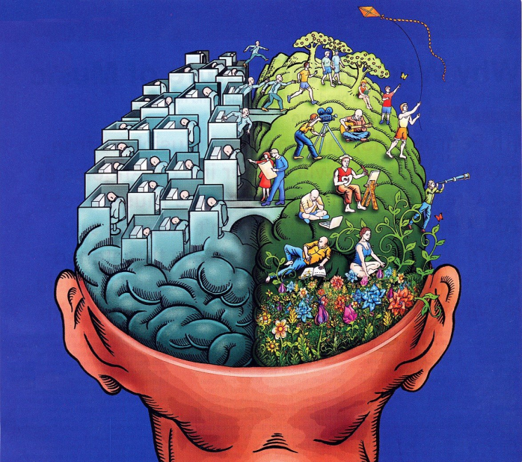
Our Amazing Brain
3 parts
Old/Reptilian
Inner/Mammalian
Newest/Primate

Slide 3
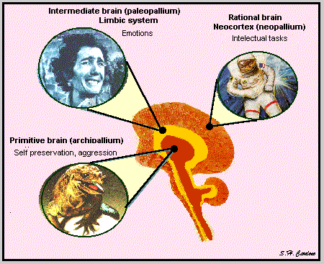
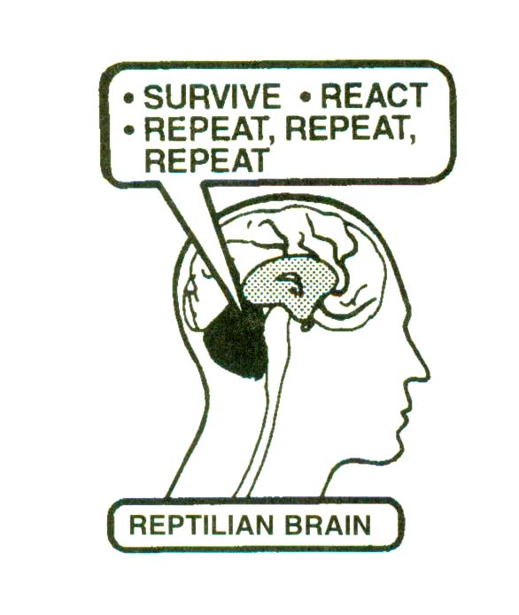
The Old Brain (Reptilian)
Evolved 1st
2 parts
Cerebellum
Brain Stem

Slide 4
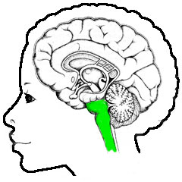
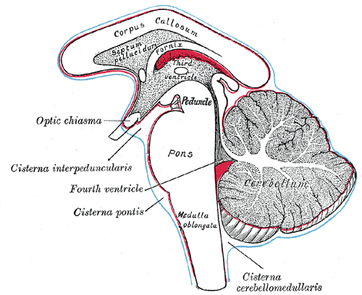
The Brain Stem
Part of Reptilian Brain that includes the
Midbrain (most superior)
Hindbrain, which includes:
Pons
Medulla Oblongata (most inferior)—connects to spinal cord

Slide 5
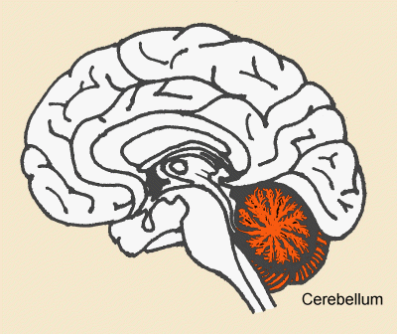
The Cerebellum (“little brain”)
The other part of the Reptilian Brain

Slide 6
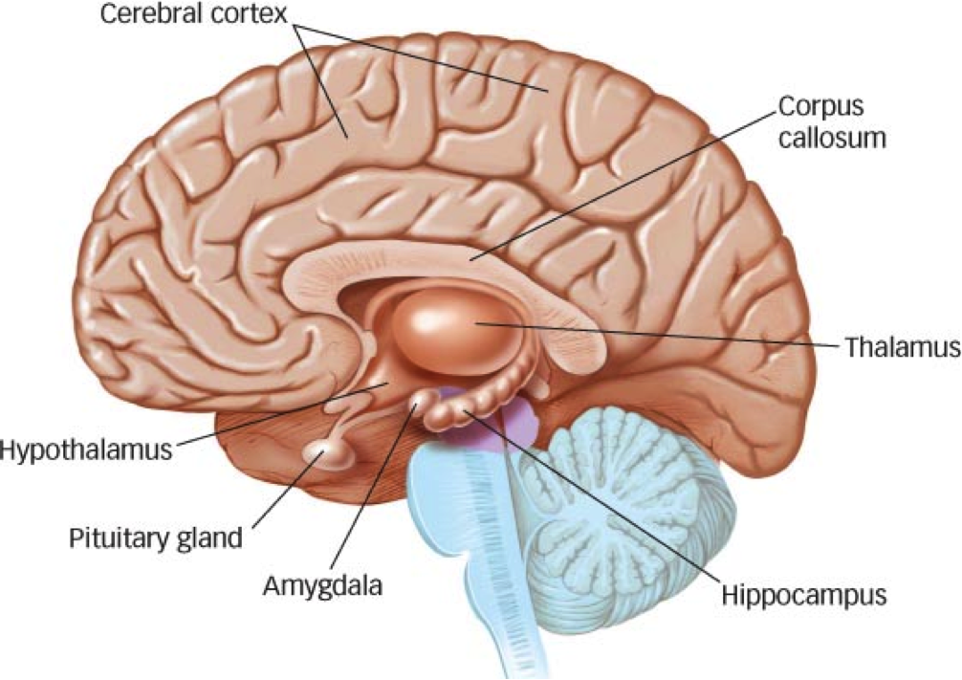
The Forebrain (newer brain)
The stuff that’s newer
Brown in pic
2 parts
Limbic System
Neocortex

Slide 7
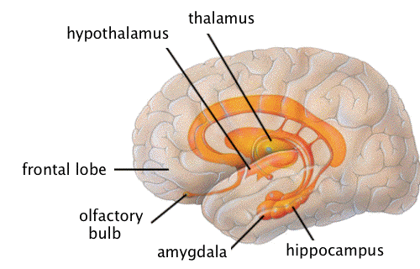
The Limbic System (Mammalian Brain)
Part of forebrain
Evolved 2nd (after reptilian and before Neocortex)
Deepest portion—Many parts, including:
Hippocampus
Hypothalamus
Amygdala
Olfactory bulbs
Pineal gland

Slide 8
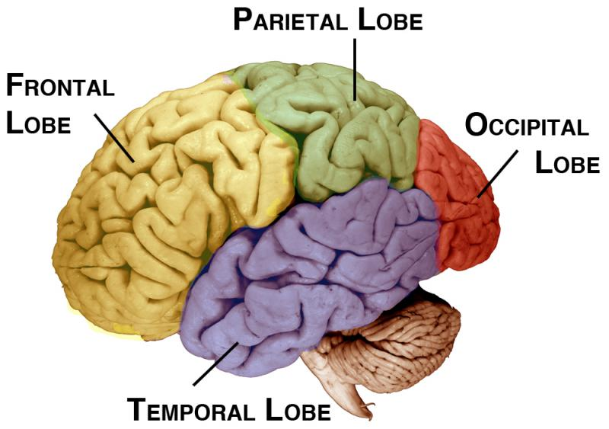
The Neocortex (Primate)
Part of forebrain
Evolved most recently
Meaning is “new covering”
4 lobes
Frontal
Temporal
Parietal
Occipital

Slide 9
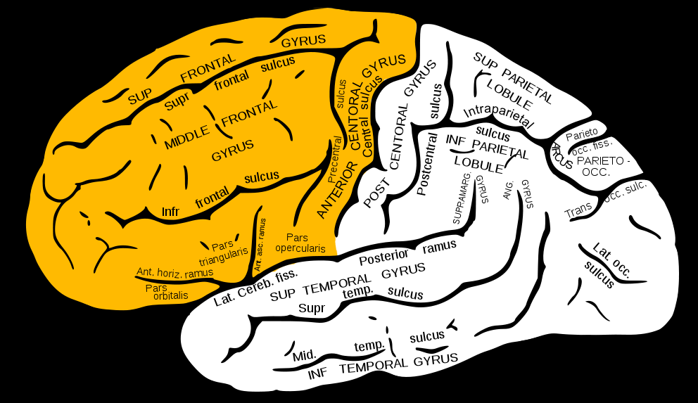
Frontal Lobe
Part of Neocortex
Last part of brain to develop as we grow
2 important regions
Motor Cortex
Broca’s Area

Slide 10
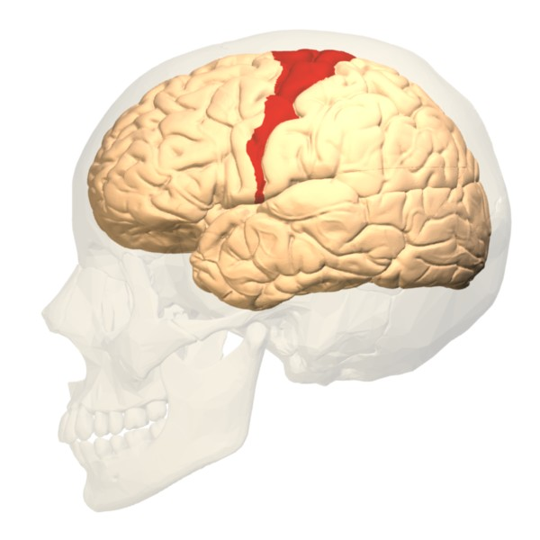
Motor Cortex
Posterior portion of frontal lobe

Slide 11
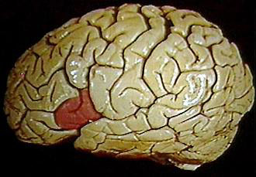
Broca’s Area
Small, lateral region of frontal lobe

Slide 12
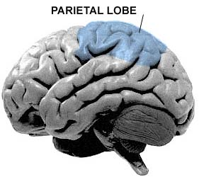
Parietal Lobe
Part of Neocortex
An important region is the sensory cortex

Slide 13
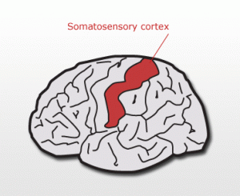
Sensory Cortex
Anterior portion of parietal lobe

Slide 14
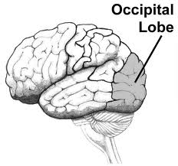
Occipital Lobe
Most posterior part of Neocortex

Slide 15
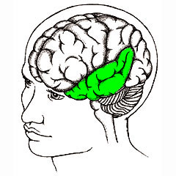
Temporal Lobe
Part of Neocortex
2 important regions
Auditory cortex
Wernicke’s area

Slide 16
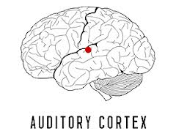
Auditory Cortex
A small region of the temporal lobe

Slide 17
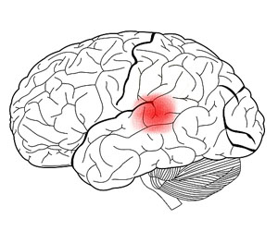
Wernicke’s Area
A superior and posterior portion of the temporal lobe

Slide 18
Now you get to find out what each part does!
Time to get to researching… ☺

